Slide 1
محاضرة بمادة التقنيات الرقمية
م.د حسين فالح مهدي
جامعة ديالى
كلية الهندسة –قسم هندسة الحاسبات
2021-2022
Combinational Logic Circuits -5

Slide 2
Multiplexer (Data Selector)
Multiplexing means transmitting a large number of information units over a smaller number of channels or lines. A digital multiplexer selects binary information from one of many input lines and directs it to a single output line.
Multiplexer
Combinational Logic Circuit
2^{n} Inputs
1 Output
n Selection Lines

Slide 3
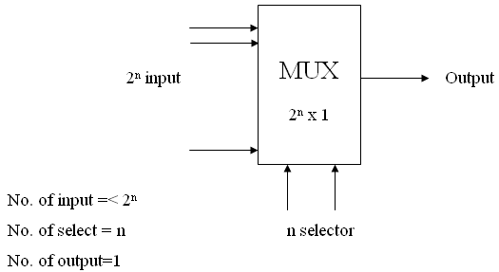
Multiplexer (Data Selector)
The selection of a particular input line is controlled by of a selection lines.
Normally, $2^{n}$input lines and $n$ selection variables.
A multiplexer is also called a data selector.
Multiplexers may be 2x1,4x1,8x1,16x1,32x1

Slide 4
Internal structure of a 2-to-1 multiplexer.
The design of a 2-to-1 multiplexer is shown below.
If S=0 then the output “Y” has the same value as the input “I0”
If S=1 then the output “Y” has the same value as the input “I1”

Slide 5
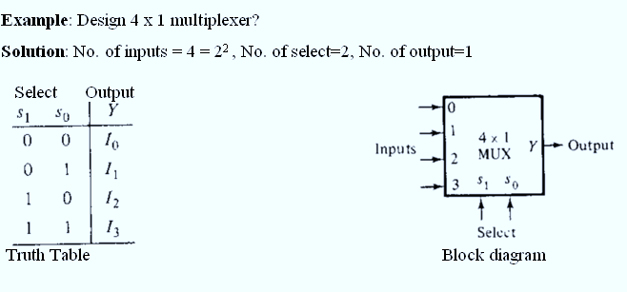

Slide 6
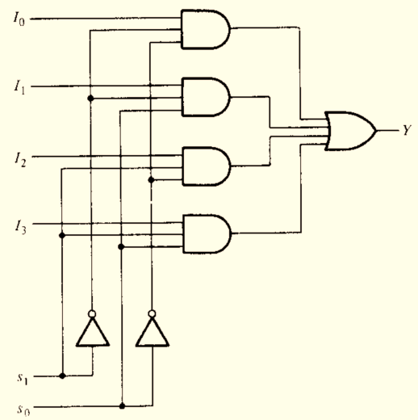

Slide 7
Design 4-to-1 (MUX) using 2-to-1 (MUX)

Slide 8
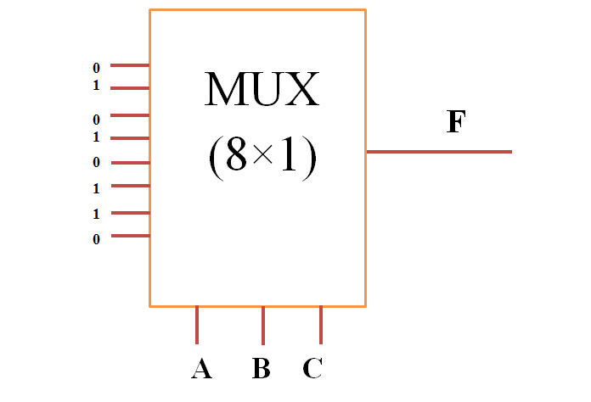
Circuit implementation using Multipliexer
Example / Implement the following function using
1) 8×1 MUX 2) 4×1 MUX 3) 2×1 MUX
F (A,B,C)= $\sum{(1,3,5,6)}$
Solution/ 1) 8×1 MUX
F | C | B | A
0 | 0 | 0 | 0 | 0
1 | 1 | 0 | 0 | 1
0 | 0 | 1 | 0 | 2
1 | 1 | 1 | 0 | 3
0 | 0 | 0 | 1 | 4
1 | 1 | 0 | 1 | 5
1 | 0 | 1 | 1 | 6
0 | 1 | 1 | 1 | 7

Slide 9
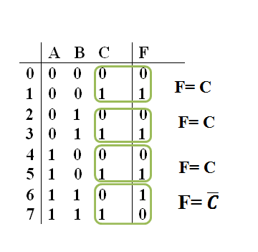
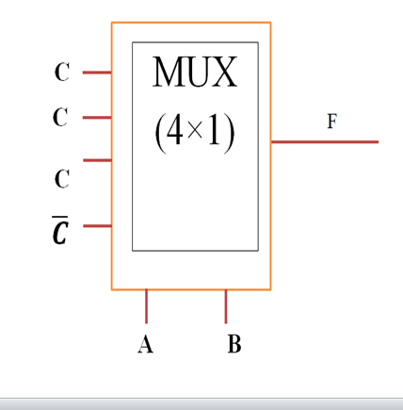
Circuit implementation using Multipliexer
2)(4×1) MUX

Slide 10
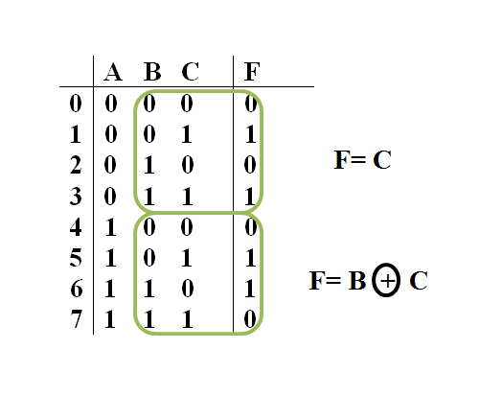
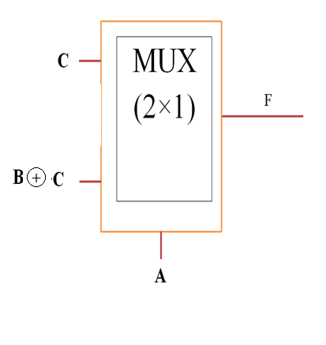
Circuit implementation using Multipliexer
3) (2×1) MUX

Slide 11
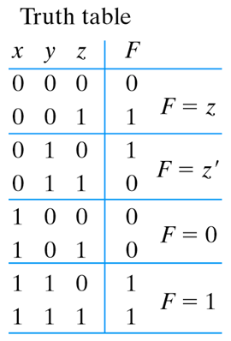
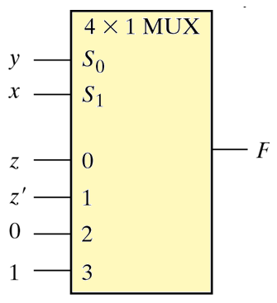
Circuit implementation using Multipliexer
EX/ design the following function using (4*1) mux F(x,y,z)=∑(1,2,6,7)

Slide 12
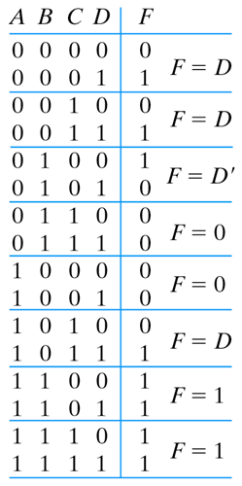
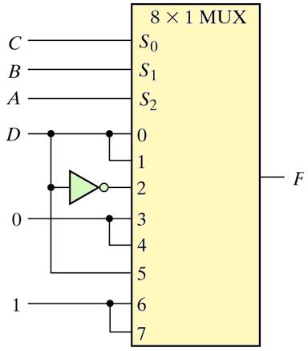
Circuit implementation using Multipliexer
EX/ design the following function using (8*1) mux F(A,B,C,D)=∑(1,3,4,11,12,13,14,15)

Slide 13
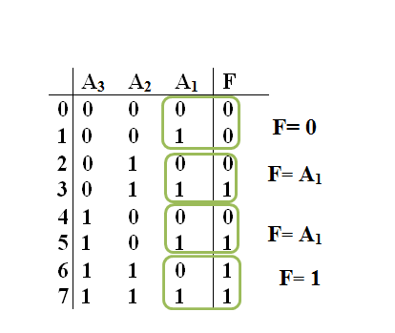
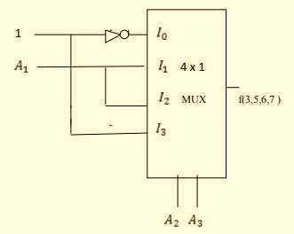
Example
Implement the following Boolean function using 4x1mux.
f(A3 , A2 , A1 ) =Σ(3,5,6,7)
Solution

Slide 14
Example
Implement the Boolean function using 8: 1 multiplexer F (A, B, C, D) = Σ m (0, 2, 3, 4, 8, 9, 12, 13)
Solution
Variables, n= 4 (A, B, C, D) Select lines= n-1 = 3 (S2, S1, S0)
$2^{n−1}$to MUX $2^{3}$to 1 = 8 to 1 MUX
Input lines= $2^{n−1}$ = $2^{3}$= 8 (D0, D1, D2, D3, D4, D5, D6, D7)

Slide 15
F | D | C | B | A
1 | 0 | 0 | 0 | 0 | 0
0 | 1 | 0 | 0 | 0 | 1
1 | 0 | 1 | 0 | 0 | 2
1 | 1 | 1 | 0 | 0 | 3
1 | 0 | 0 | 1 | 0 | 4
0 | 1 | 0 | 1 | 0 | 5
0 | 0 | 1 | 1 | 0 | 6
0 | 1 | 1 | 1 | 0 | 7
1 | 0 | 0 | 0 | 1 | 8
1 | 1 | 0 | 0 | 1 | 9
0 | 0 | 1 | 0 | 1 | 10
0 | 1 | 1 | 0 | 1 | 11
1 | 0 | 0 | 1 | 1 | 12
1 | 1 | 0 | 1 | 1 | 13
0 | 0 | 1 | 1 | 1 | 14
0 | 1 | 1 | 1 | 1 | 15

Slide 16
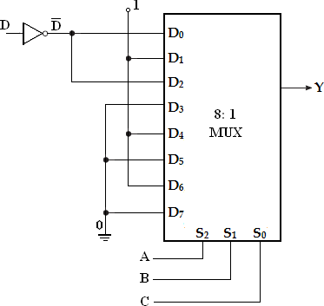
Multiplexer Implementation (Using 8: 1 MUX):

Slide 17
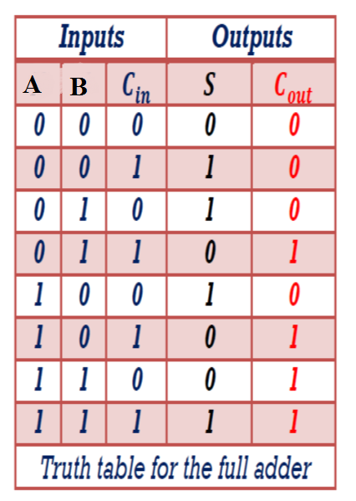
Design Full Adder circuit using multipliexer (8×1)

Slide 18
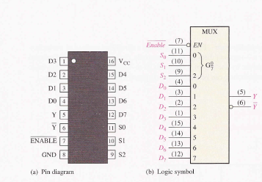
E is called the strobe or enable input which is useful for the cascading. It is generally an active low terminal, that means it will perform the required operation when it is low.. Such the IC 74LS151 8-INPUT Data selector\Multiplexer shown in figure.

Slide 19
Demultiplexer
A demultiplexer (or demux) is a device that takes a single input line and routes it to one of several digital output lines. A demultiplexer of 2^{n} outputs has n select lines, which are used to select which output line to send the input. A demultiplexer is also called a data distributor.Demultiplexers can be used to implement general purpose logic. By setting the input to true, the demux behaves as a decoder.
The reverse of the digital demultiplexer is the digital multiplexer
De-Multiplexer
Combinational Logic Circuit
1 Input
2^{n} Outputs
n Selection Lines

Slide 20
Communication system with MUX and DMUX
Source
Destination
Communication Channel
MUX
DEMUX
Select Source
Select Destination

Slide 21
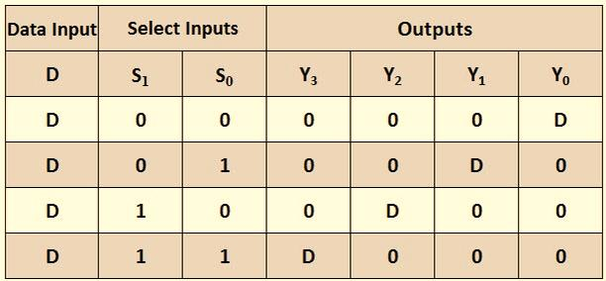
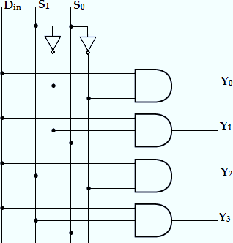
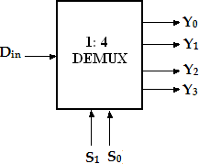
1-to-4 Demultiplexer:
A 1-to-4 demultiplexer has a single input, Din, four outputs (Y0 to Y3) and two select inputs (S1 and S0).

Slide 22
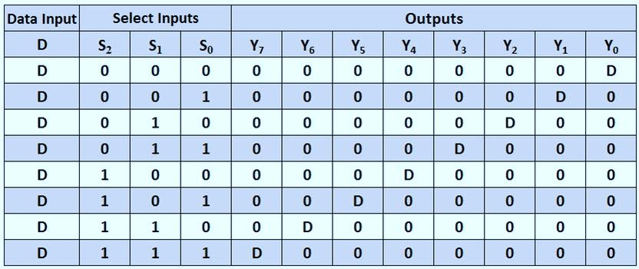
1-to-8 Demultiplexer:
A 1-to-8 demultiplexer has a single input, Din, eight outputs (Y0 to Y7) and three select inputs (S2, S1 and S0). It distributes one input line to eight output lines based on the select inputs. The truth table of 1-to-8 demultiplexer is shown below.

Slide 23
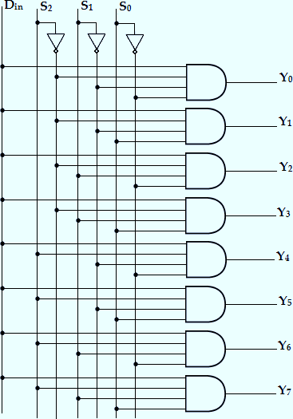

Slide 24
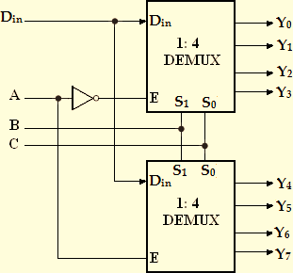
Implement 1:8 demultiplexer using two 1:4 DEMUX.

Slide 25
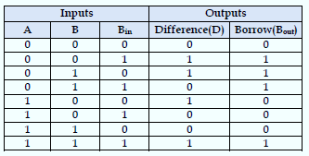
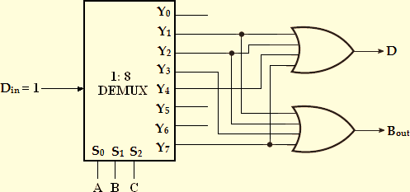
Example
Implement full subtractor using demultiplexer.
solution

Slide 26
Tri-state gate(Buffer)

Slide 27
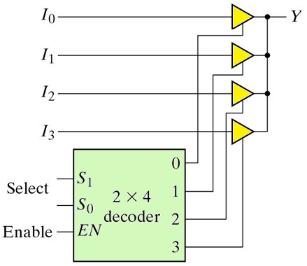
Example/Design (4-1) MUX using Tri state buffer and 2×4 decoder?

