Slide 1


محاضرة بمادة التقنيات الرقمية
م. د حسين فالح مهدي
جامعة ديالى
كلية الهندسة –قسم هندسة الحاسوب
2019-2020
Combinational Logic Circuits -1

Slide 2
Digital system main types
Digital system may be combinational (H.A, F.A , H.S, F.S, Encoder , decoder, Multipliexer , Demultipliexer, Comparator.......etc) or sequential( Flip- Flops, registers,counters....etc).
A combinational circuit is a circuit that the output at any time is depended only on the present inputs where sequential circuit is dependet on past and present inputs .
The logical function performed by a combinational circuit is fully defined by a set of Boolean expressions.

Slide 3
Combinational v.s Sequential Circuits
! Combinational circuits:
1) Consist of logic gates only
2) Outputs are determined from the present values of inputs
3)Operations can be specified by a set of Boolean functions
! Sequential circuits:
1) Consist of logic gates and storage elements
2)Outputs are a function of the inputs and the state of the storage elementsDepend not only on present inputs, but also on past values
3)Circuit behavior must be specified by a time sequence of
inputs and internal states

Slide 4
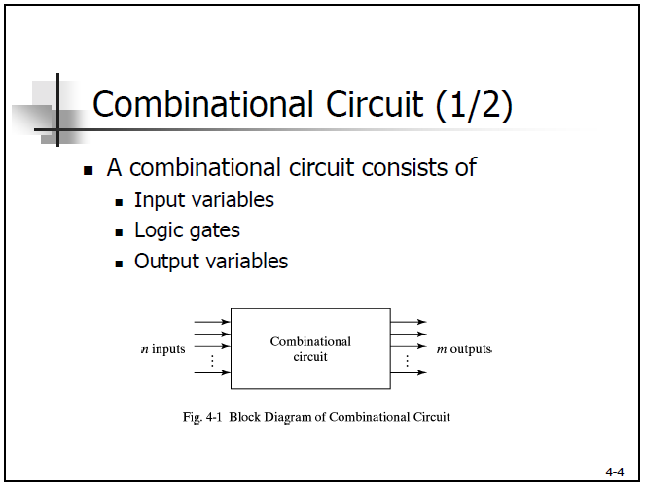

Slide 5
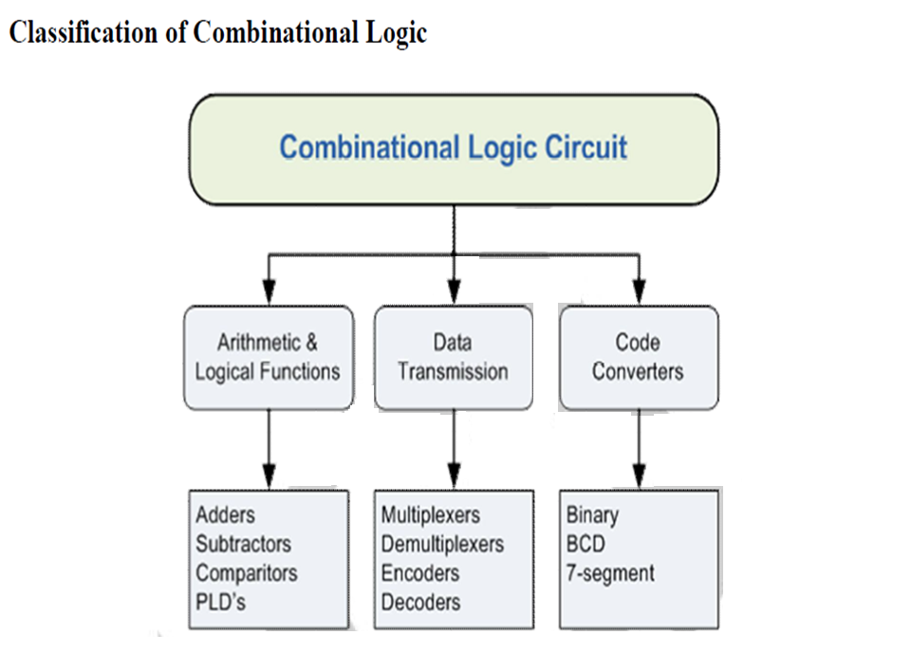

Slide 6
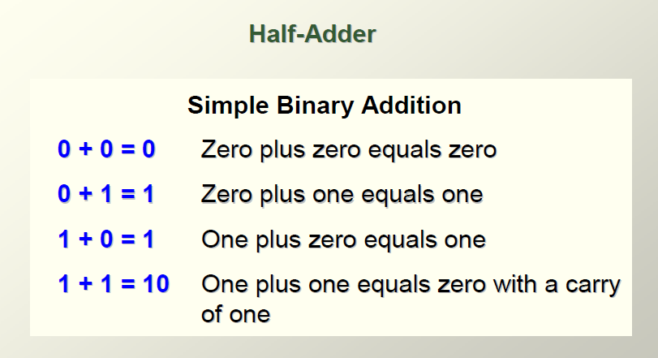
Binary Adder Subtractor

Slide 7
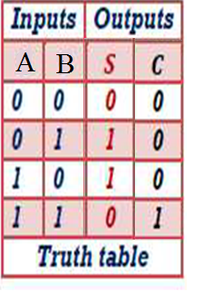

Half-Adder(H.A)
Basic rules of binary addition are performed by a half adder, which has two binary inputs (A and B) and two binary outputs (Carry out and Sum).
The inputs and outputs can be summarized on a truth table.
The logic symbol and equivalent circuit are:
Σ
Sum
Sum = $\overline{A}$B+A$\overline{B}$= A⊕B
A
Σ
H.A
A
Carry
B
C_{out}
B
Carry =AB

Slide 8
Full-Adder(F.A)
By contrast, a full adder has three binary inputs (A, B, and Carry in) and two binary outputs (Carry out and Sum). the A full-adder can be constructed from two half adders as shown.
Σ
Σ
Σ
Σ
A
A
A
Sum
H.A
H.A
Sum
B
B
C_{out}
B
C_{out}
A
B
F.A
C_{in}
C_{in}
C_{arry}
C_{out}
Symbol

Slide 9
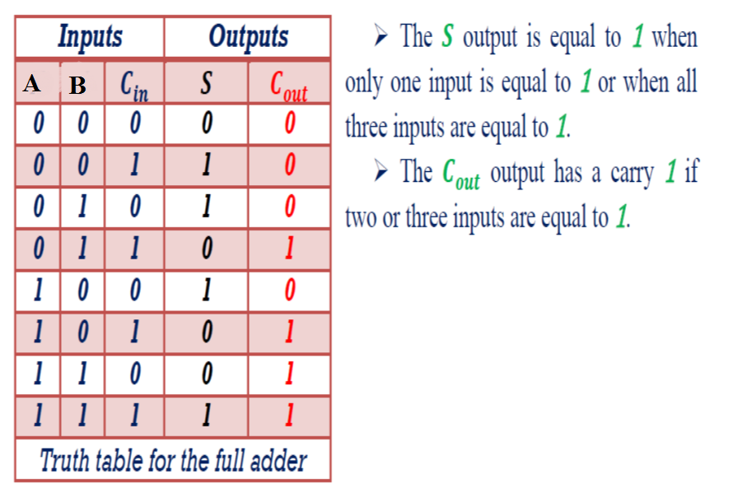

Slide 10
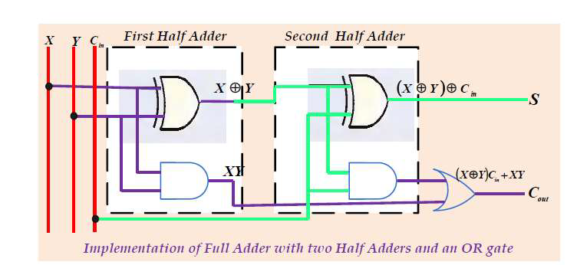
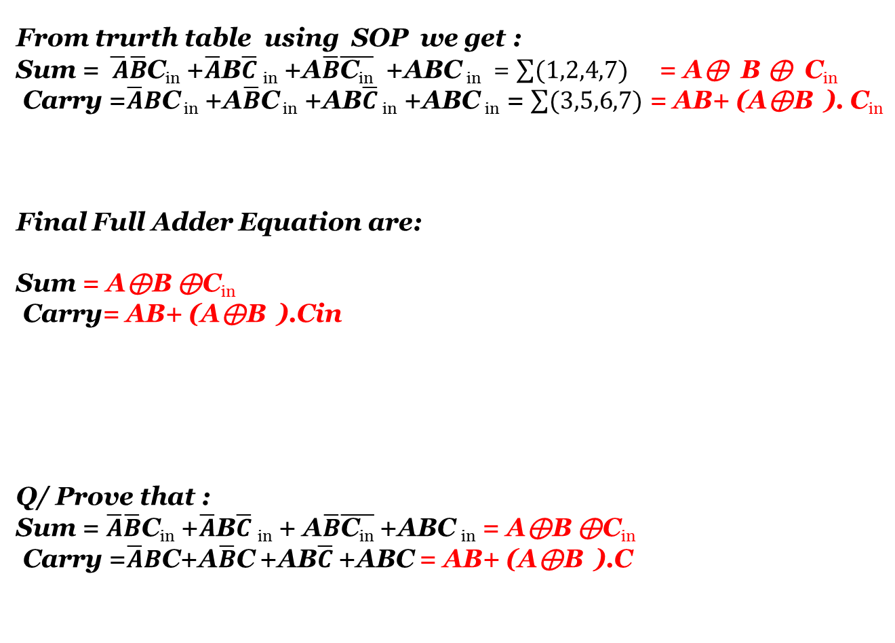
From trurth table using SOP we get :
Sum = $\overline{ A}\overline{B}$C_{in} +$\overline{A}$B$\overline{C}$ _{in} +A$\overline{B}\overline{\text{C}\text{in}}$ +ABC _{in} = $\sum{(1,2,4,7)}$ = A⊕ B ⊕ C_{in}
Carry =$\overline{A}B$C _{in} +A$\overline{B}$C _{in} +AB$\overline{C}$ _{in} +ABC _{in} = $\sum{(3,5,6,7)}$ = AB+ (A⊕B ). C_{in}
Final Full Adder Equation are:
Sum = A⊕B ⊕C_{in}
Carry= AB+ (A⊕B ).Cin
Q/ Prove that :
Sum = $\overline{A}\overline{B}$C_{in} +$\overline{A}$B$\overline{C}$ _{in} + A$\overline{B}\overline{\text{C}\text{in}}$ +ABC _{in} = A⊕B ⊕C_{in}
Carry =$\overline{A}B$C+A$\overline{B}$C +AB$\overline{C}$ +ABC = AB+ (A⊕B ).C

Slide 11
Full-Adder
Σ
Σ
1
Σ
Σ
0
Sum
1
A
A
Example
B
0
1
0
C_{out}
B
C_{out}
For the given inputs, determine the intermediate and final outputs of the full adder.
1
C_{out}
1
Solution
The first half-adder has inputs of 1 and 0; therefore the Sum =1 and the Carry out = 0.
The second half-adder has inputs of 1 and 1; therefore the Sum = 0 and the Carry out = 1.
The OR gate has inputs of 1 and 0, therefore the final carry out = 1.

Slide 12
Full-Adder
Notice that the result from the previous example can be read directly on the truth table for a full adder.
Σ
Σ
1
Σ
Σ
0
Sum
1
A
A
B
0
1
0
C_{out}
B
C_{out}
1
C_{out}
1

Slide 13
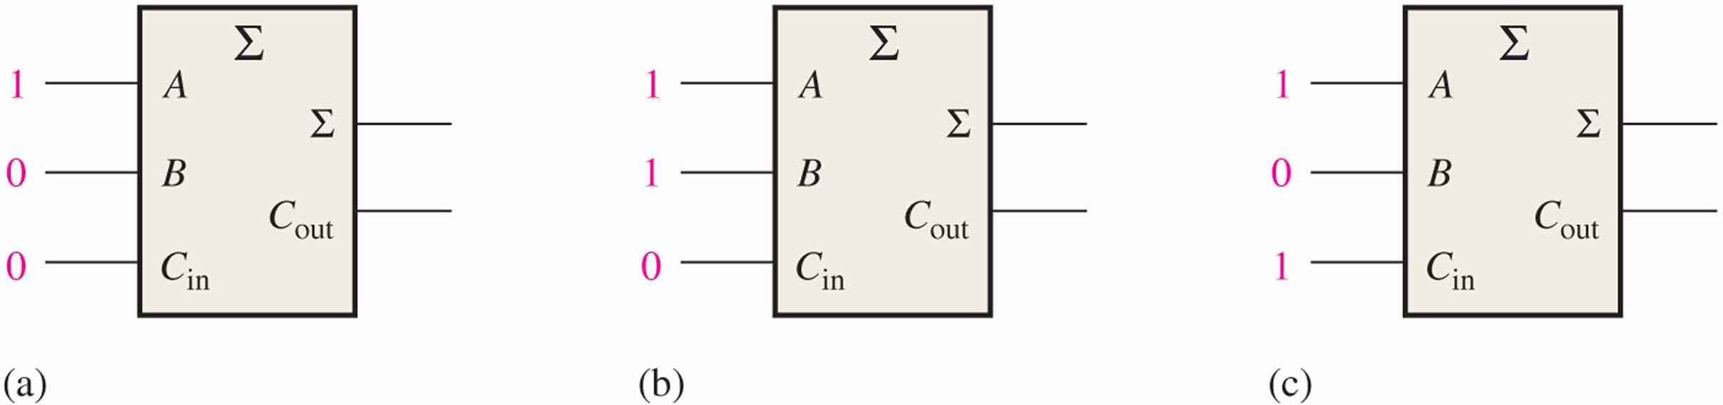
0
0
1
1
0
1

Slide 14
Parallel Adders
Full adders are combined into parallel adders that can add binary numbers with multiple bits. A 4-bit adder is shown.
A₄ B₄
A₃ B₃
A₂ B₂
A₁ B₁
C₀
A
B
C_{in}
A
B
C_{in}
A
B
C_{in}
A
B
C_{in}
C_{out}
Σ
C_{out}
Σ
C_{out}
Σ
C_{out}
Σ
C₄
C₃
C₂
C₁
Σ₄
Σ₃
Σ₂
Σ₁
The output carry (C₄) is not ready until it propagates through all of the full adders. This is called ripple carry, delaying the addition process.

Slide 15
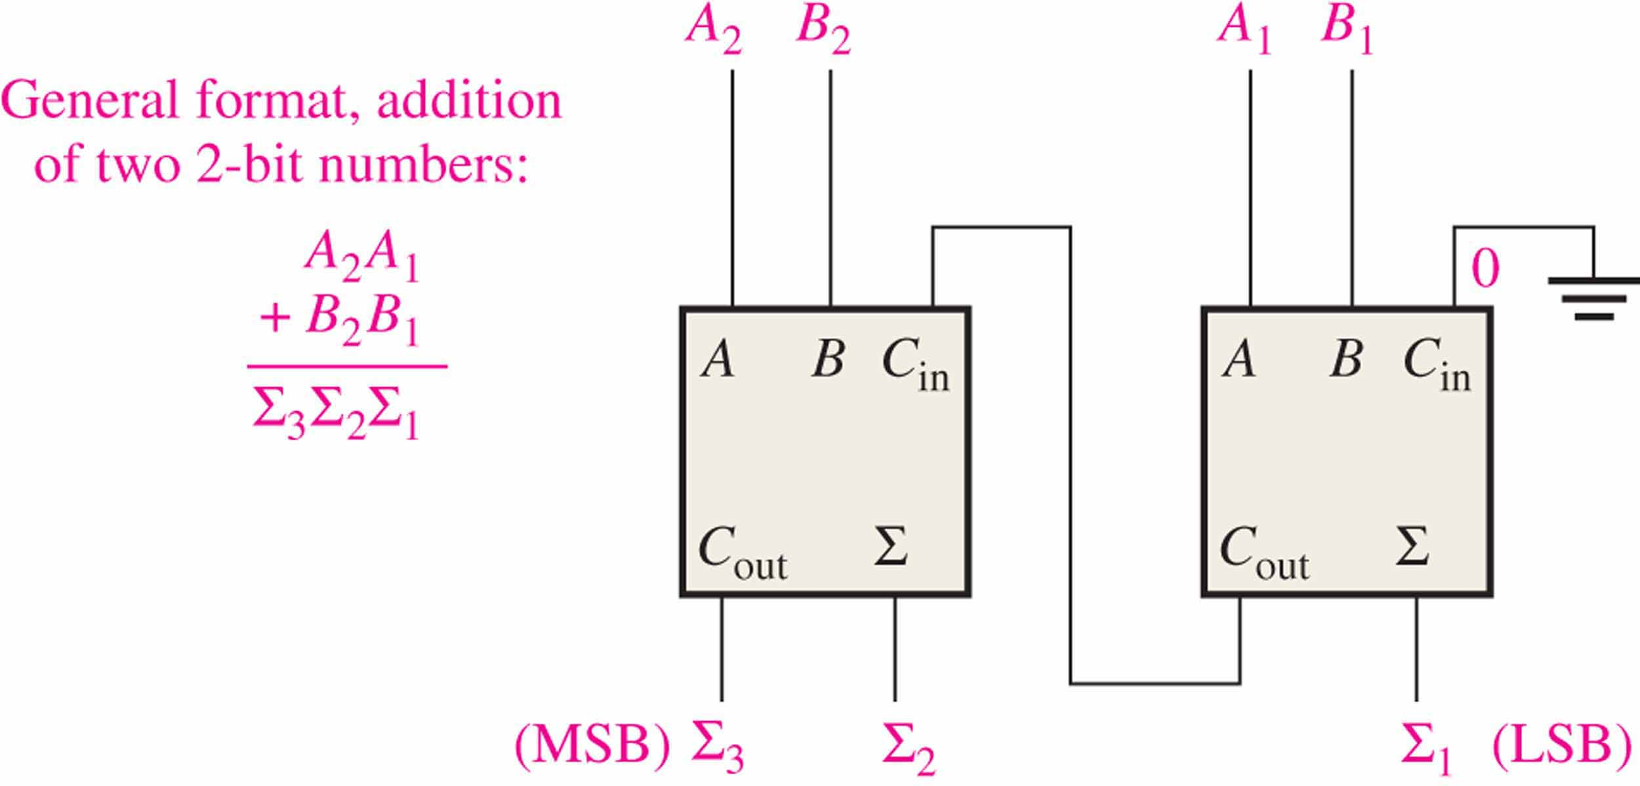

Slide 16
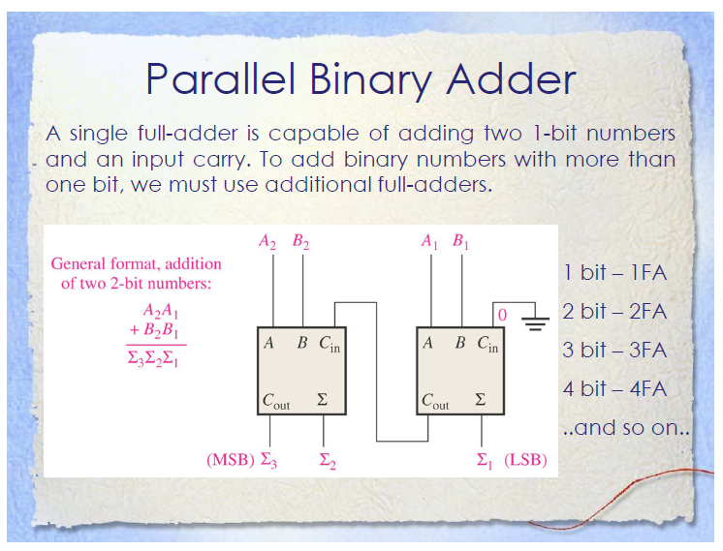

Slide 17
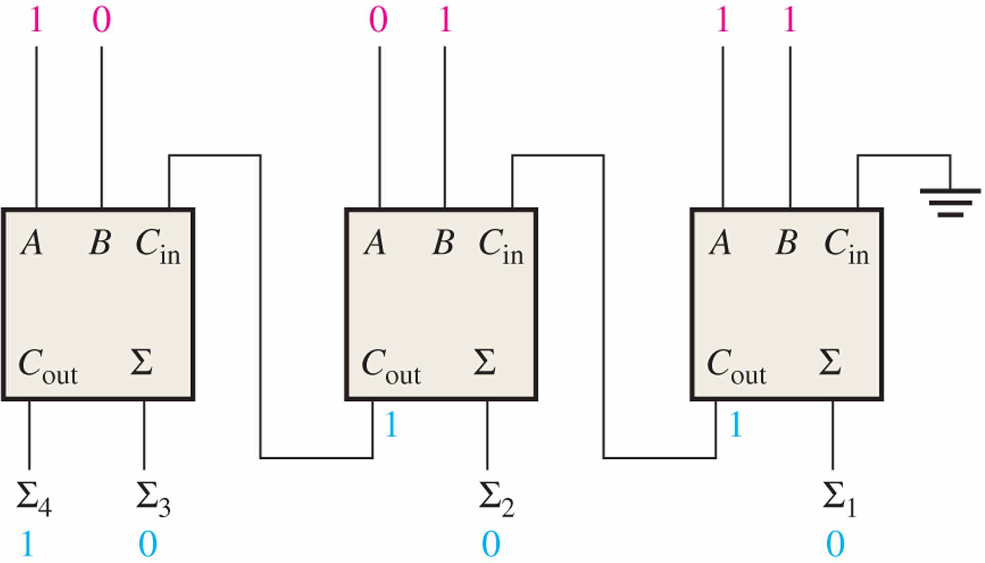

Slide 18
Parallel Adders
The logic symbol for a 4-bit parallel adder is shown. This 4-bit adder includes a carry in (labeled (C₀) and a Carry out (labeled C₄).
Σ
1
2
3
4
1
2
3
4
Binary number A
4-bit sum
1
2
3
4
Binary number B
Input carry
C₀
C₄
Output carry
The 74LS283 is an example. It features look-ahead carry, which adds logic to minimize the output carry delay. For the 74LS283, the maximum delay to the output carry is 17 ns.

Slide 19
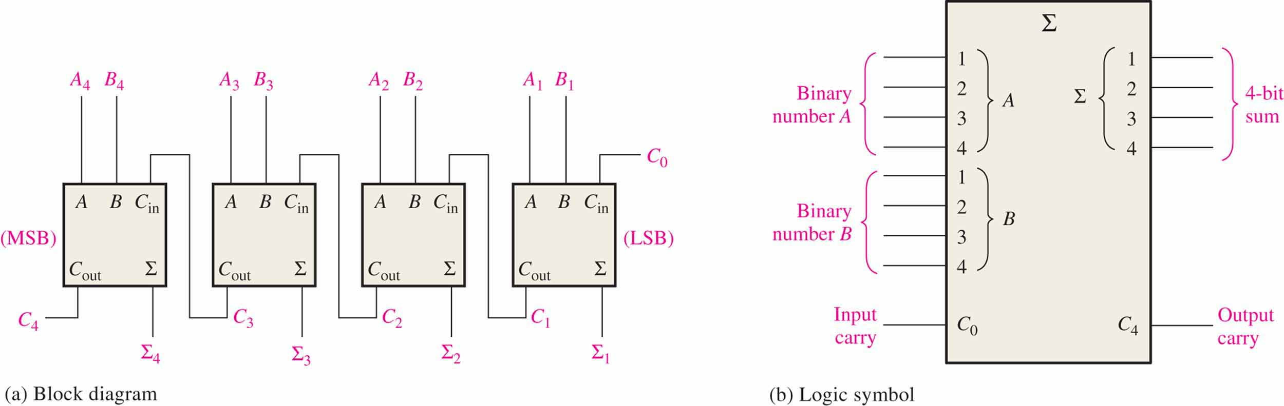

Slide 20
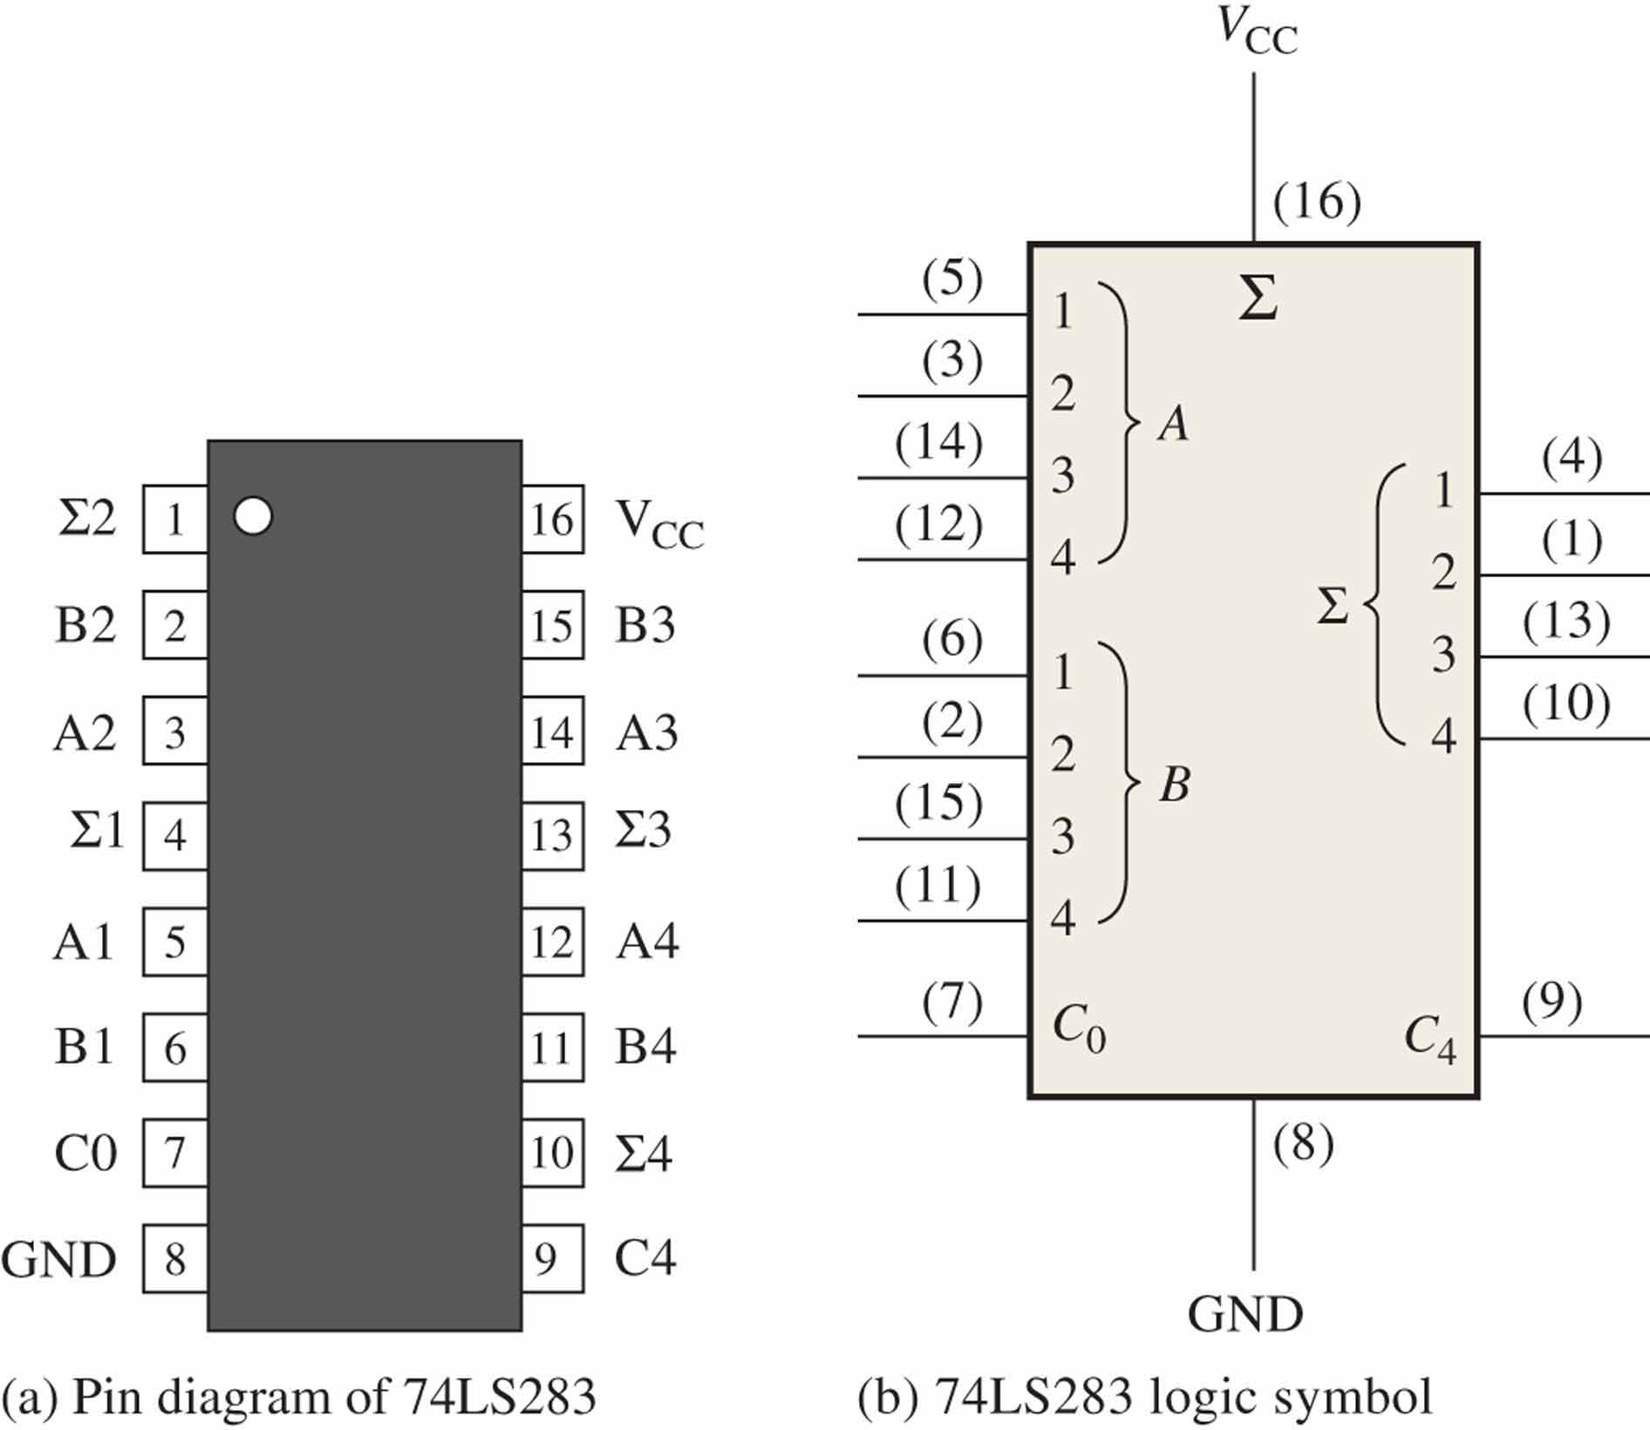

Slide 21
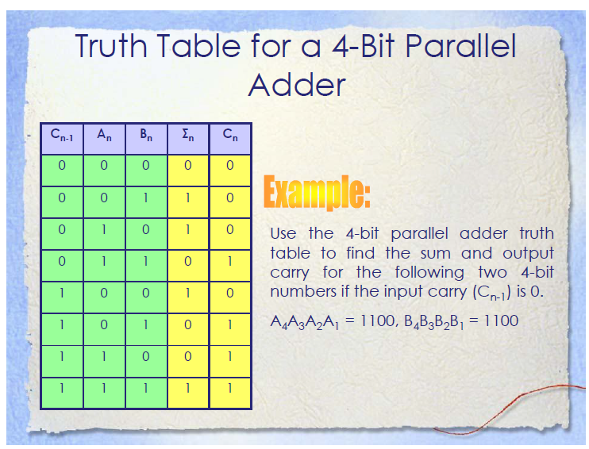

Slide 22
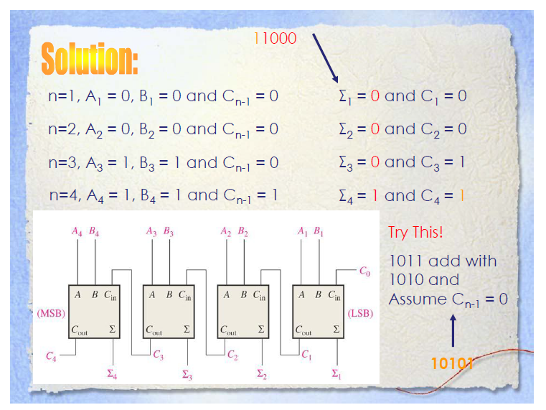

Slide 23
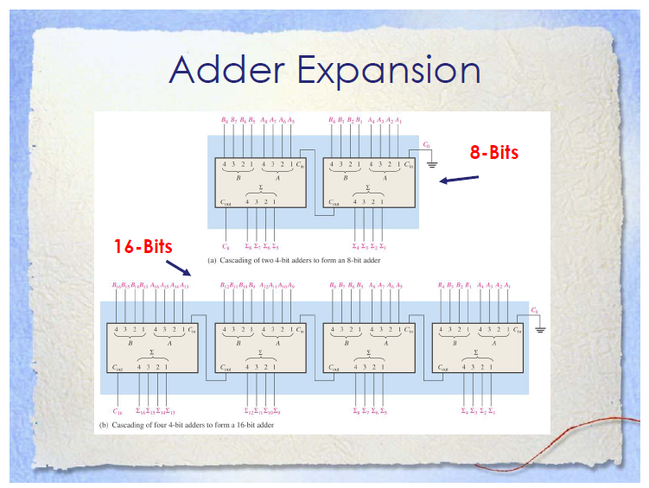

Slide 24
