Slide 1
محاضرة بمادة التقنيات الرقمية
م.د حسين فالح مهدي
جامعة ديالى
كلية الهندسة –قسم هندسة الحاسبات
2021-2022
Combinational Logic Circuits -2

Slide 2
4 –Bits Parallel Adder
Floyd, Digital Fundamentals, 10
th
© 2009 Pearson Education, Upper Saddle River, NJ 07458. All Rights
ed
Reserved

Slide 5
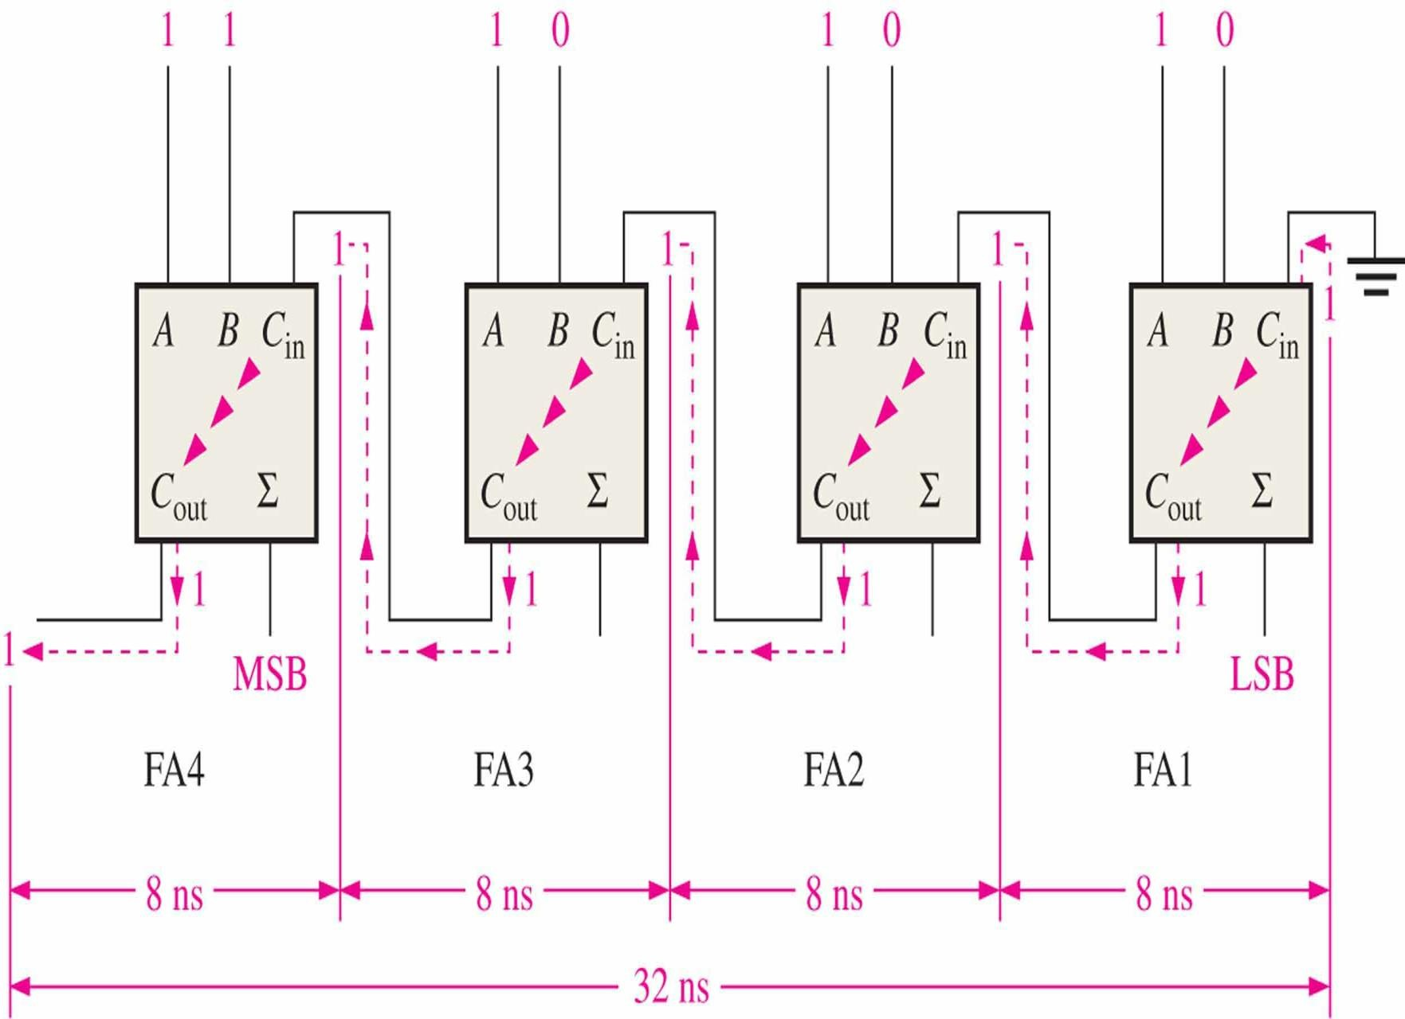

Slide 8
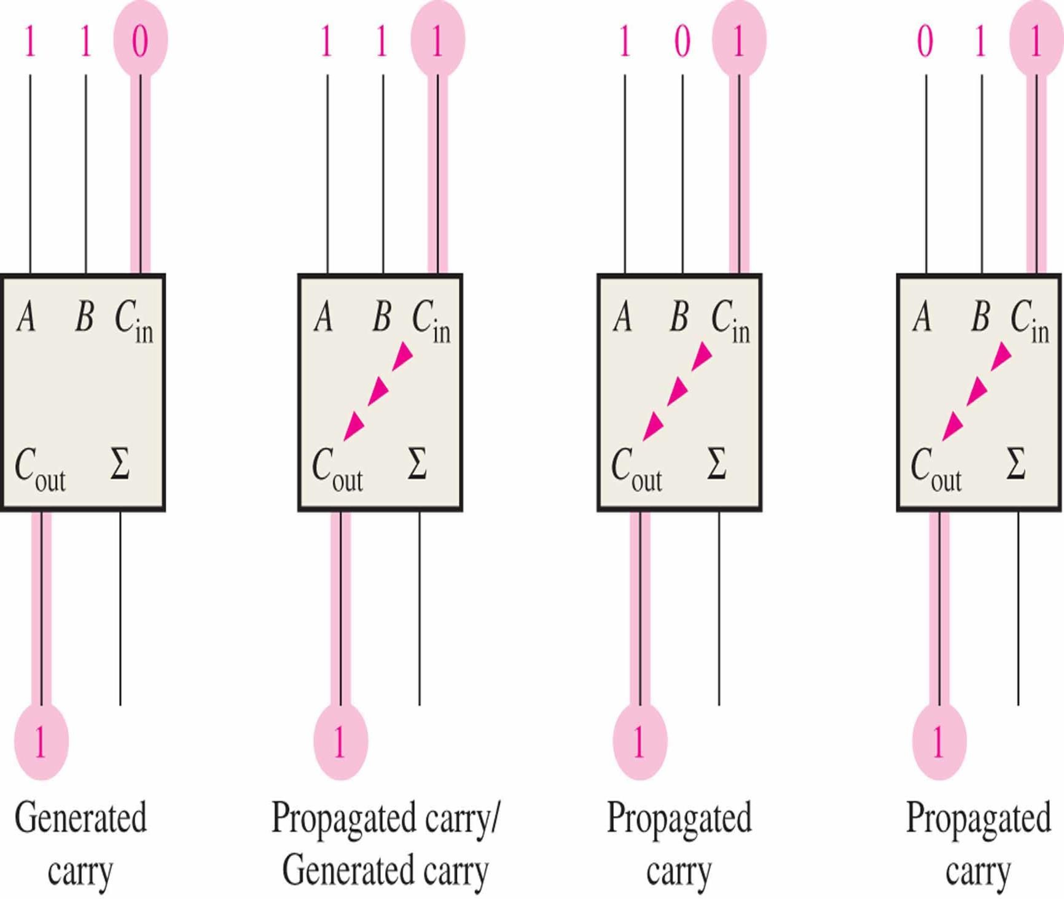

Slide 11
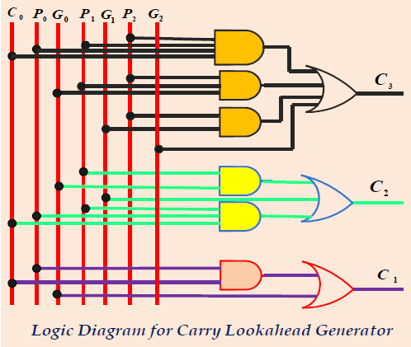
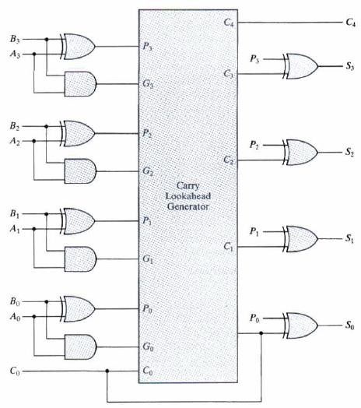
UOD-Electronic Engineering Dep.

Slide 12
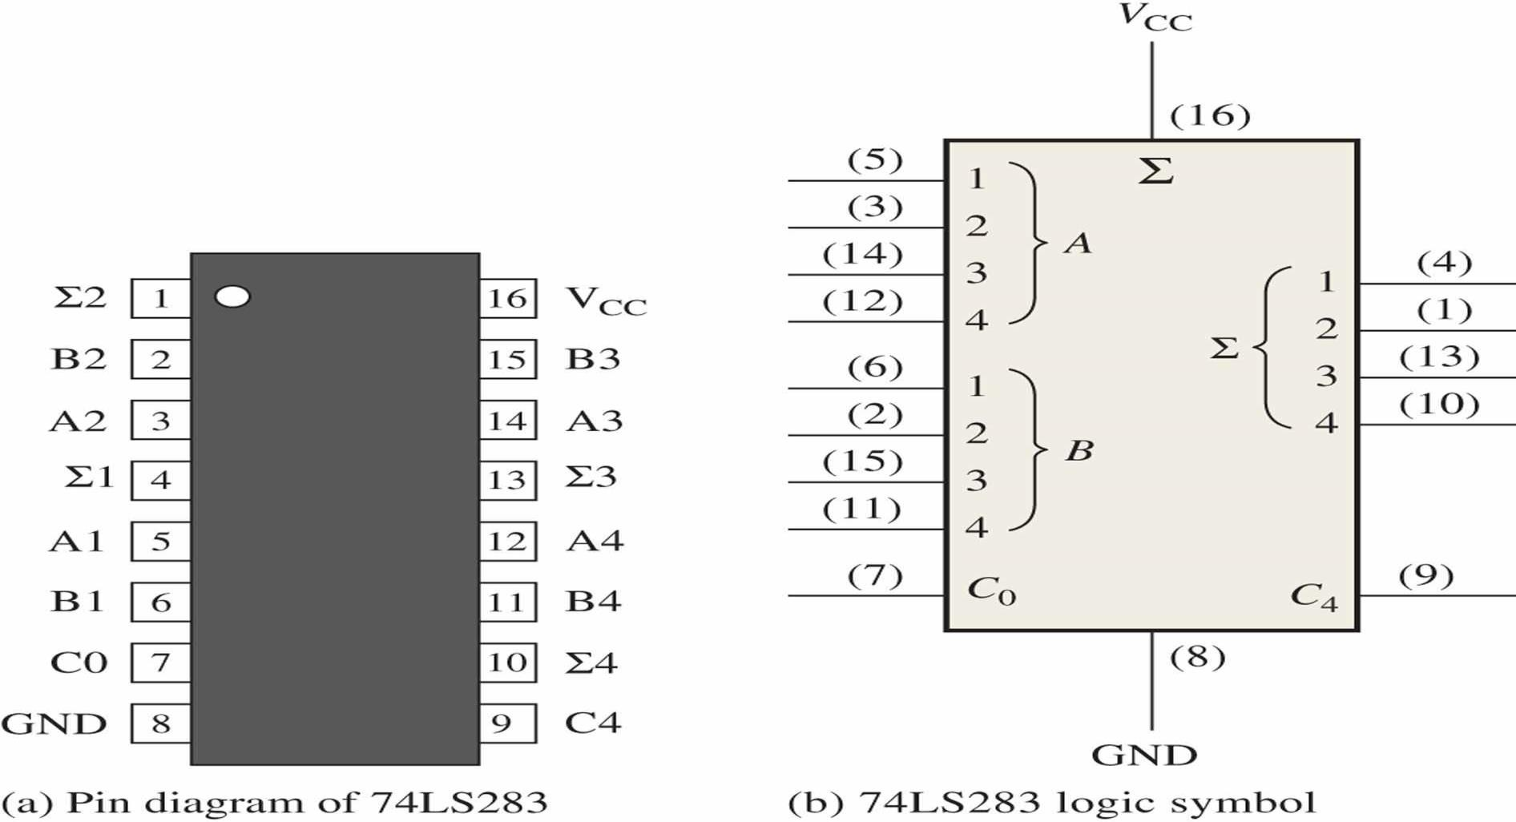
The 74LS283 is an example. It features look-ahead carry, which adds logic to minimize the output carry delay. For the 74LS283, the maximum delay to the output carry is 17 ns.
UOD-Electronic Engineering Dep.

Slide 13
A | 1 | Y=A + 1 | Y=𝑨
0 | 1 | 1 | 1
1 | 1 | 0 | 0
 | A | 0 | Y=A + 0 | Y=A
 | 0 | 0 | 0 | 0
 | 1 | 0 | 1 | 1
1
A
0
A
𝑨
A

Slide 14
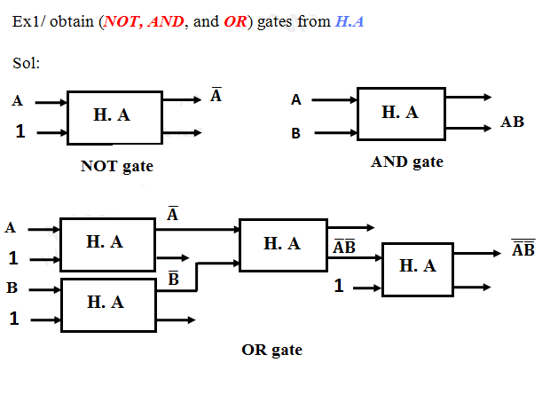
𝑨 .𝑩 =𝑨 + 𝑩 = A+B

Slide 15
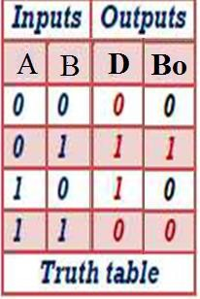
0-0=0
Half-Subtractor(H.S)
0-1=1 with borrow 1
1-0=1
1-1=0
The logic symbol and equivalent circuit are:
A
D
Difference= 𝐀B+A𝐁= A⊕B
H.S
^{B}out
B
Borrow =𝑨B

Slide 16
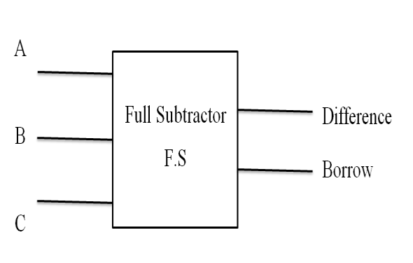
Full-Subtractor(F.s)
A full Subtractor has three binary inputs (A, B, and C) and two binary outputs (Difference and Borrow). the A Full-Subtractor can be constructed from two half adders as shown.
D
H.S
Bo
Difference
A
A D
H.S
Bo
A
_{B} F.S
^{C}in
Difference
B
B
C
Borrow
Borrow
Symbol

Slide 17
Full Subtractor
D
H.S
Bo
Difference
A
A D
H.S
Bo
B
B
C
Borrow
A
D
B
B
17

Slide 18
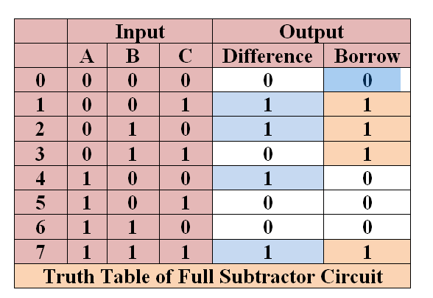
Q/ Prove that : Difference = 𝑨𝑩C +𝑨B𝑪
+A𝑩C+ABC
= ∑(𝟏, 𝟐, 𝟒, 𝟕)
= A⊕ B ⊕ C_{in}
Borrow= 𝑨𝑩C +𝑨B𝑪
+𝑨BC +ABC
= ∑(, 𝟏, 𝟐, 𝟑, 𝟕)
= 𝑨B+ (A⊕B ).C_{in}
From trurth table using SOP we get :
Difference = 𝑨𝑩C +𝑨B𝑪 +A𝑩C+ABC = ∑(𝟏, 𝟐, 𝟒, 𝟕)= A⊕ B ⊕ C_{in} Borrow= 𝑨𝑩C +𝑨B𝑪 +𝑨BC +ABC= ∑(𝟏, 𝟐, 𝟑, 𝟕) = 𝑨B+ (A⊕B ).C_{in}

Slide 19
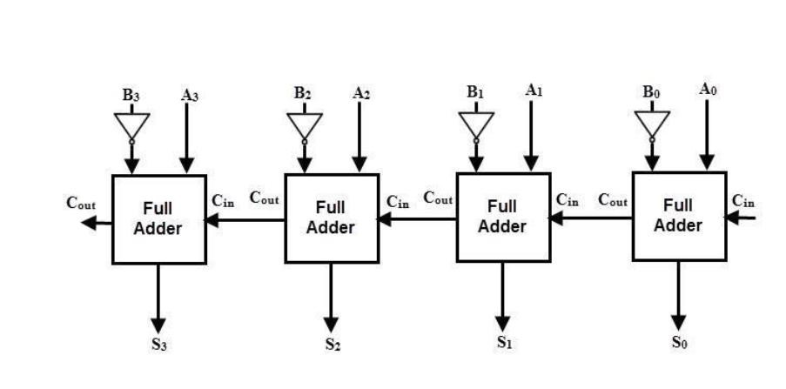
4 Bit Parallel Subtractor
The number to be subtracted B is first passed through inverters to obtain its 1's complement.

Slide 20
A | 1 | Y=A + 1 | Y=𝑨
0 | 1 | 1 | 1
1 | 1 | 0 | 0
 | A | 0 | Y=A + 0 | Y=A
 | 0 | 0 | 0 | 0
 | 1 | 0 | 1 | 1
1
A
0
A
𝑨
A
2’s Complement = 1’s complement+1
To design Adder subtractor circuit we need a control unit that convert circuit between addition and subtraction and convert subtracted number to 2’s Complement by using NOT gate and adding logic 1

Slide 21
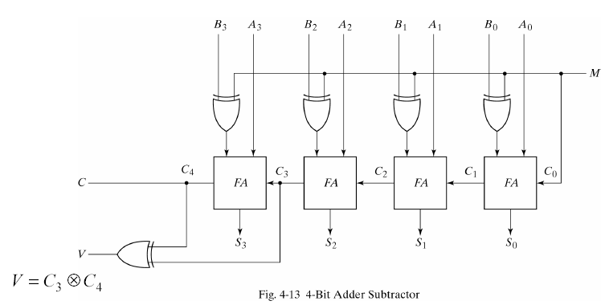
M= 1 Subtraction
M= 0 Addition

Slide 31
Excess-3 Adder Circuit
To perform Excess-3 addition, add two XS-3 code groups
:
If carry=1, add 0011 (3) to the sum of those two code groups
If carry=0, subtract 0011 (3), i.e, add 1101 (13 in decimal) to the sum of those two code groups.
-Implementation of XS-3 adder by using 4-bit binary adders is shown in the figure.
The Augend and Addend in XS-3 are added using the 4- bit parallel adder. If the carry is a 1, then 0011 (3) is added to the sum bits of the upper adder in the lower 4 bit parallel adder. If the carry is a 0, then 1101 (13) is added to the sum bits (this is equivalent to subtracting 0011 (3) from the sum bits.)

Slide 32
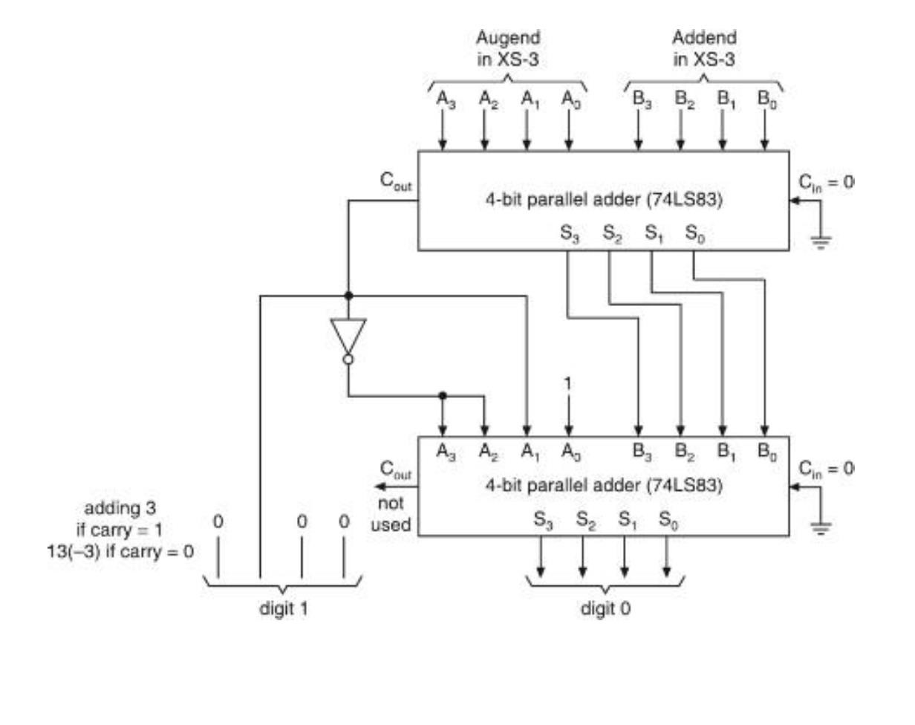
With no carry (0)adding (13) = 1101
with carry (1) adding (3) = 0011

