Slide 1


محاضرة بمادة التقنيات الرقمية
م.د حسين فالح مهدي
جامعة ديالى
كلية الهندسة –قسم هندسة الحاسبات
2021-2022
Combinational Logic Circuits -3

Slide 2
Binary Multiplier
Multiplication of binary numbers is performed in the same way as in decimal numbers. The multiplicand is multiplied by each bit of the multiplier starting from the least significant bit. Each such multiplication forms a partial product.
products are shifted one position to the left. The final product is obtained from the sum of partial products.

Slide 3
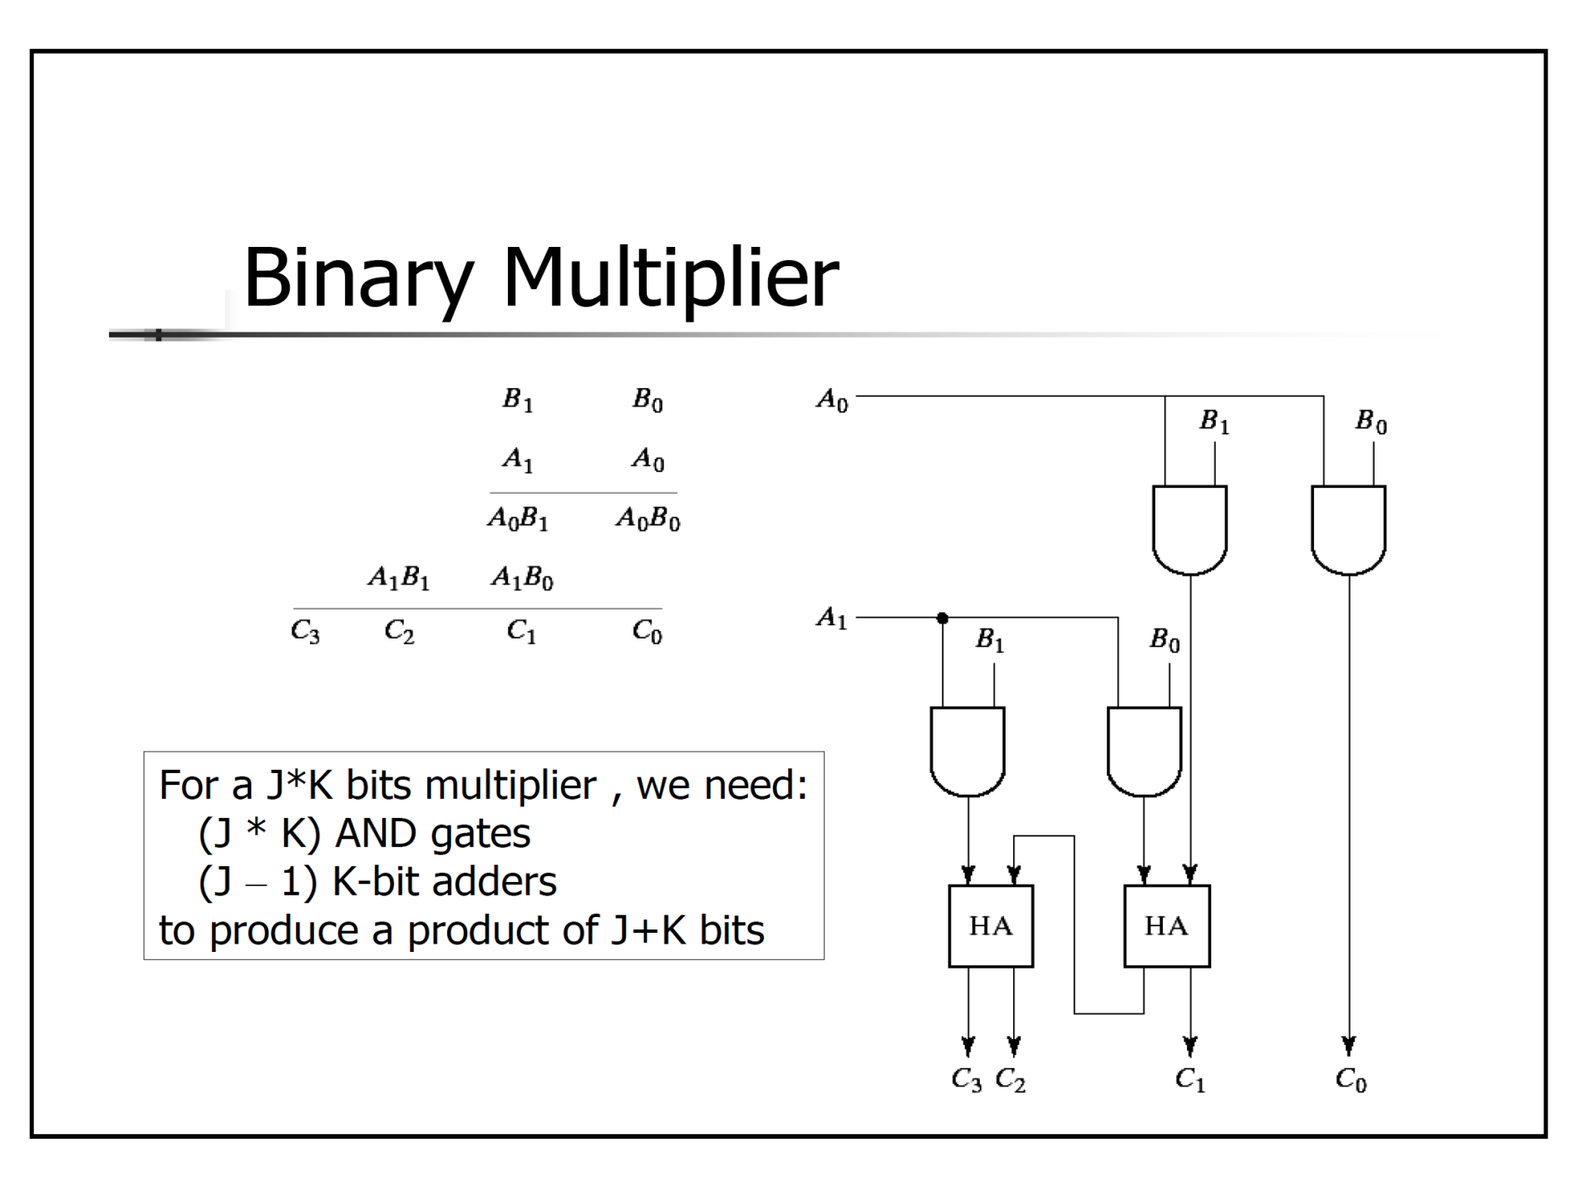

Slide 4
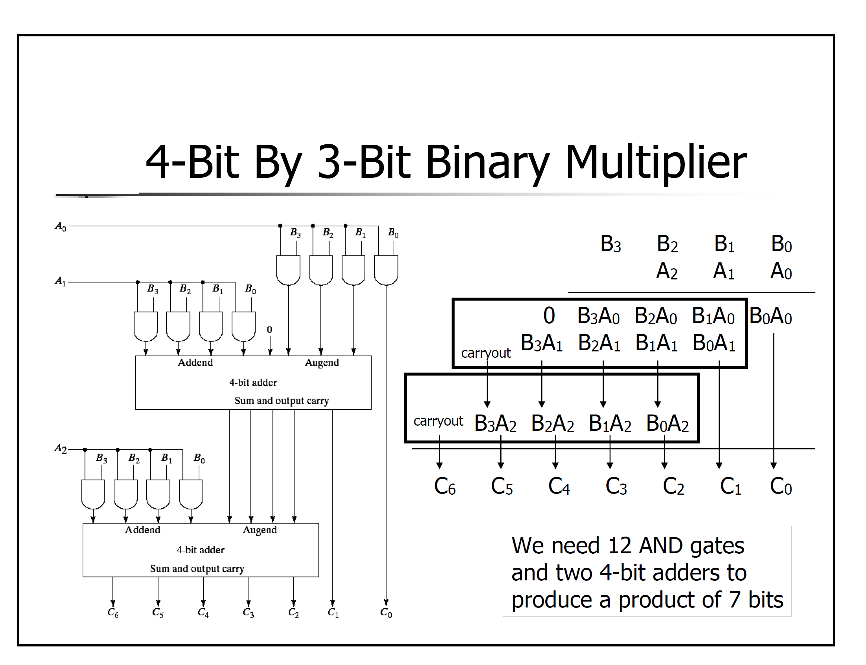

Slide 5
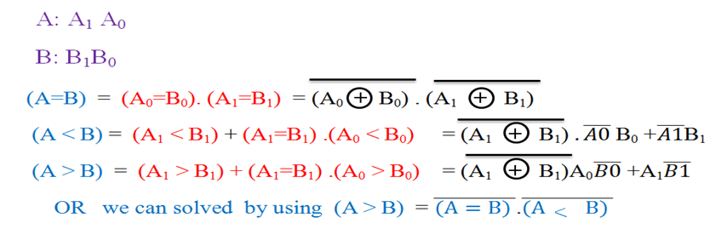
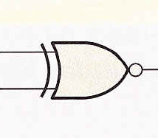
Comparators
The function of a comparator is to compare the magnitudes of two binary numbers to determine the relationship between them. There are three state to compare two numbers A and B
1) A=B 2)A> B 3)A < B
Design compartor that compare between two number each one consist of (2-bits)?
Example

Slide 6
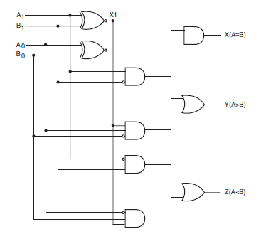

Slide 7
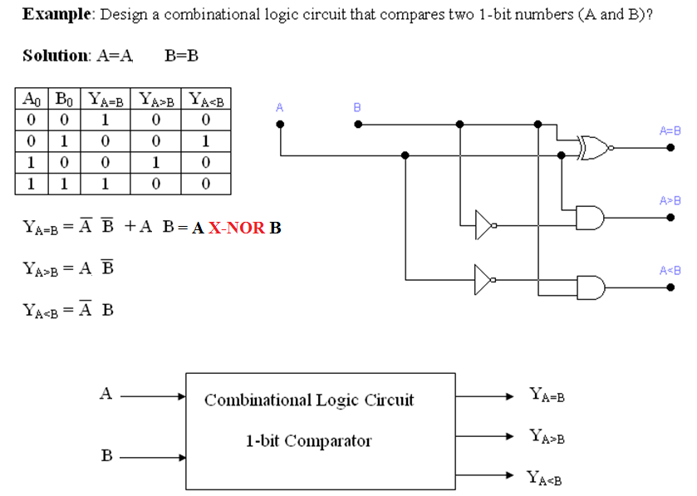

Slide 8
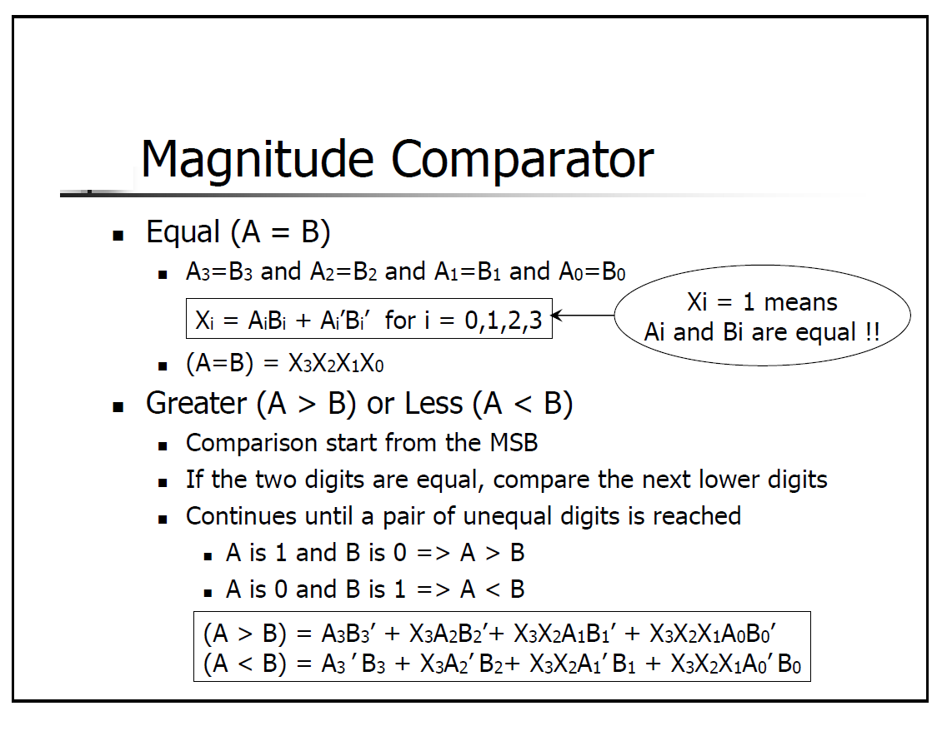

Slide 9
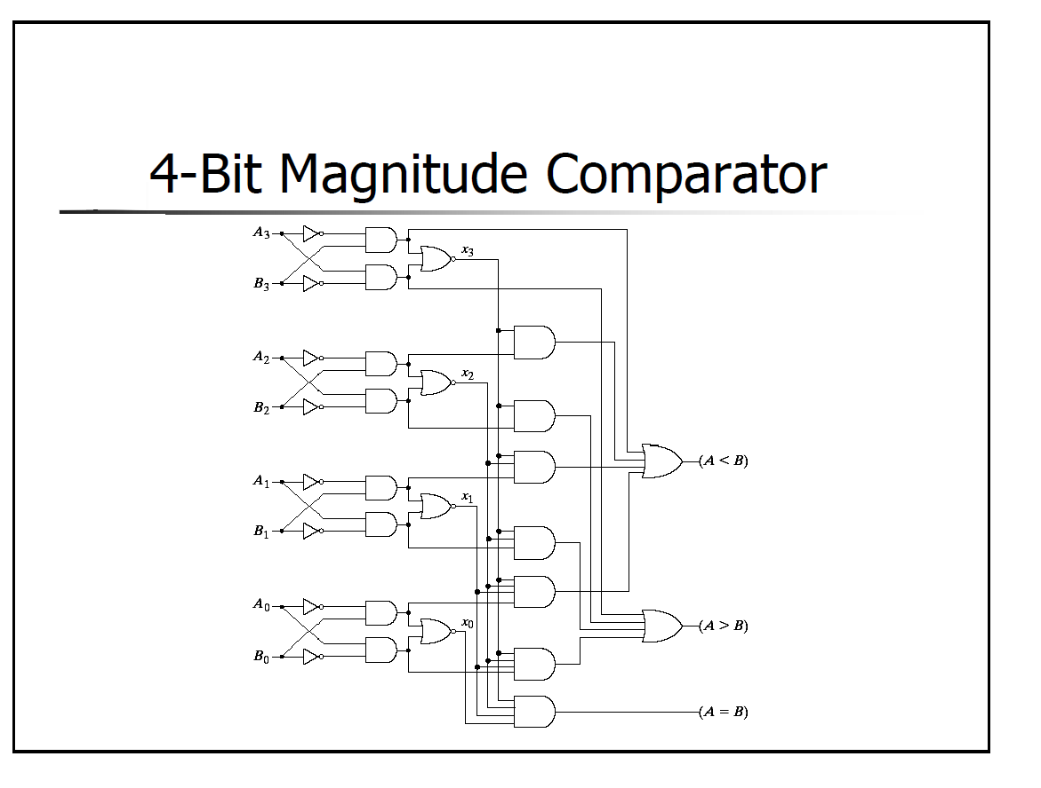

Slide 10
Comparators
IC comparators provide outputs to indicate which of the numbers is larger or if they are equal. The bits are numbered starting at 0, rather than 1 as in the case of adders. Cascading inputs are provided to expand the comparator to larger numbers.
COMP
A₀
0
A₁
A
A₂
A₃
3
Cascading inputs
A > B
A > B
A = B
A = B
Outputs
A < B
A < B
B₀
0
B₁
B
The IC shown is the 4-bit 74LS85.
B₂
B₃
3

Slide 11
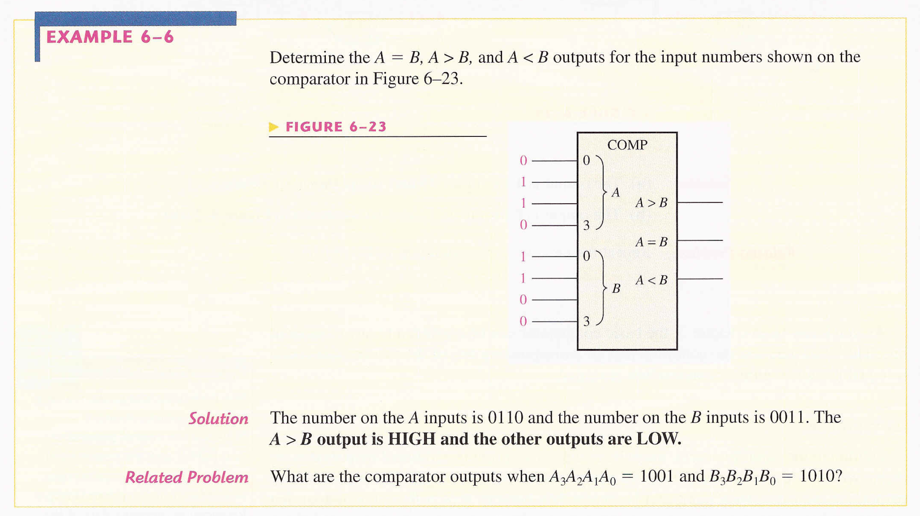

Slide 12
Comparators
IC comparators can be expanded using the cascading inputs as shown. The lowest order comparator has a HIGH on the A = B input.
LSBs
MSBs
A₀
COMP
A₄
COMP
A₁
0
A₅
0
A₂
A
A₆
A
A₃
A₇
3
3
A > B
A > B
A > B
A > B
+5.0 V
A = B
A = B
A = B
A = B
Outputs
B₀
A < B
A < B
B₄
A < B
A < B
0
0
B₁
A
B₅
A
B₂
B₆
B₃
3
B₇
3

Slide 13
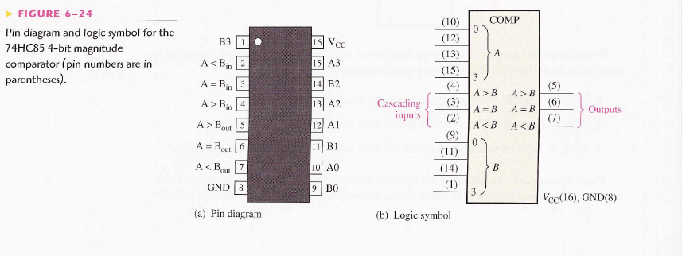

Slide 14
Analysis Procedure Of Combinational Circuit
It requires to determine the function that the circuit implements
To make sure that the given circuit is combinational and not sequential
It is the reverse process of design procedure.
Logic diagram of the circuit is given.
Obtain the truth table from the diagram.
Obtain Boolean function from the Truth Table for output.

Slide 15
EXAMPLE:
Analysis the given combinational circuit :
The circuit has three Inputs, A,B,C and two outputs F1 and F2
The Boolean function for outputs are:
F2=AB+AC+BC
T1=A+B+C
T2=ABC

Slide 16
Outputs functions for gates are :
T3=F2’ T1
F1=T3+T2
To obtain F1 as a function of A. B, and C by Substituting and simplifying, we get:
F2=AB+AC+BC
F1=A’BC’+A’B’C+AB’C’+ABC

Slide 17
Design procedure
The procedure design for any combinational logic circuit involves the following steps:
Find the number of inputs and outputs variables
Labeled these variables
Find the relationship between them
Draw the truth table according to this relationship
Find the most simplified Boolean expression using (K- Maps) and either (SoP) or (PoS) minimization methods.
Draw the logic circuits according to these Boolean expressions.

Slide 18
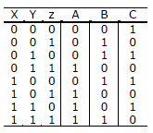
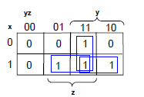
Example
Design a combinational circuit with three inputs, x, y and z, and the three outputs, A, B, and C. when the binary input is 0, 1, 2, or 3, the binary output is one greater than the input. When the binary input is 4, 5, 6, or 7, the binary output is one less than the input.
1. Derive the truth table that defines the required relationship between inputs and outputs.
2. Obtain the simplified Boolean functions for each output as a function of the input variables.
Map for output A:
The simplified expression from the map is:
A=xz+xy + yz

Slide 19
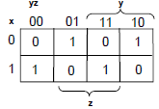
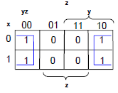
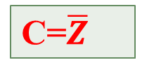

Map for output B :
The simplified expression from the map is:
B= $\overline{X}$ $\overline{Y}$ Z+$\overline{X}$Y$\overline{Z}$+X$\overline{Y}\overline{Z}$+XYZ
Map for output C:
The simplified expression from the map is:
C=$\overline{Z}$

Slide 20
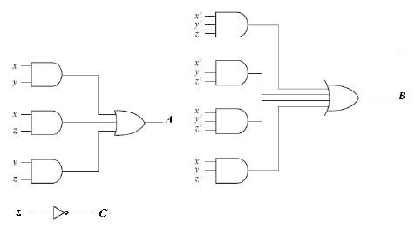


3. Draw the logic diagram.
A= XZ +XY + YZ
B= $\overline{X}$ $\overline{Y}$ Z+$\overline{X}$Y$\overline{Z}$+X$\overline{Y}\overline{Z}$+XYZ
C=$\overline{Z}$

Slide 21
Q/ Design an even and an odd parity check generator circuit?
Odd Parity | Even Parity | C | B | A
1 | 0 | 0 | 0 | 0 | 0
0 | 1 | 1 | 0 | 0 | 1
0 | 1 | 0 | 1 | 0 | 2
1 | 0 | 1 | 1 | 0 | 3
0 | 1 | 0 | 0 | 1 | 4
1 | 0 | 1 | 0 | 1 | 5
1 | 0 | 0 | 1 | 1 | 6
0 | 1 | 1 | 1 | 1 | 7

Slide 22
K-MAP
Even parity K-map
00 01 11 10 |  |  |  | BC A
1 | 0 | 1 | 0 | 0 1
0 | 1 | 0 | 1
Odd parity K-map
00 01 11 10 |  |  |  | BC A
0 | 1 | 0 | 1 | 0 1
1 | 0 | 1 | 0

Slide 23

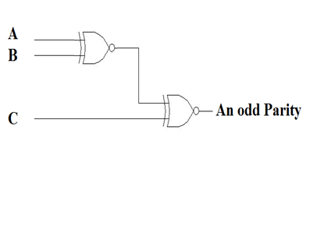
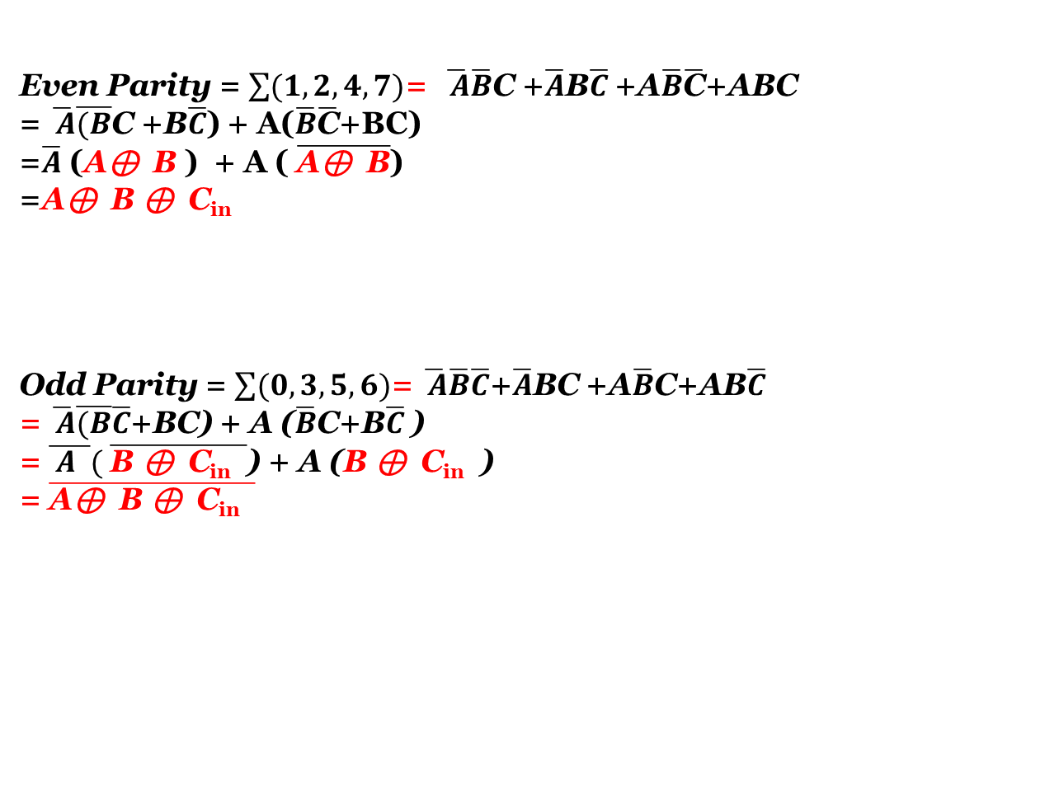
Even Parity = $\sum{(1,2,4,7)}$= $\overline{ A}\overline{B}$C +$\overline{A}$B$\overline{C}$ +A$\overline{B}\overline{\text{C}}$+ABC
= $\overline{ A}\overline{(B}$C +B$\overline{C}$) + A($\overline{B}\overline{\text{C}}$+BC)
=$\overline{A}$ (A⊕ B ) + A ( $\overline{\text{A}\text{⊕ }\text{B}}$)
=A⊕ B ⊕ C_{in}
Odd Parity = $\sum{(0,3,5,6)}$= $\overline{ A}\overline{B}\overline{C}$+$\overline{A}$BC +A$\overline{B}$C+AB$\overline{C}$
= $\overline{ A}\overline{(B}\overline{C}$+BC) + A ($\overline{B}$C+B$\overline{C}$ )
= $\overline{ A }( \overline{\text{B} \text{⊕ }\text{C}\text{in} }$) + A (B ⊕ C_{in} )
= $\overline{\text{A}\text{⊕ }\text{B} \text{⊕ }\text{C}\text{in} }$

Slide 24
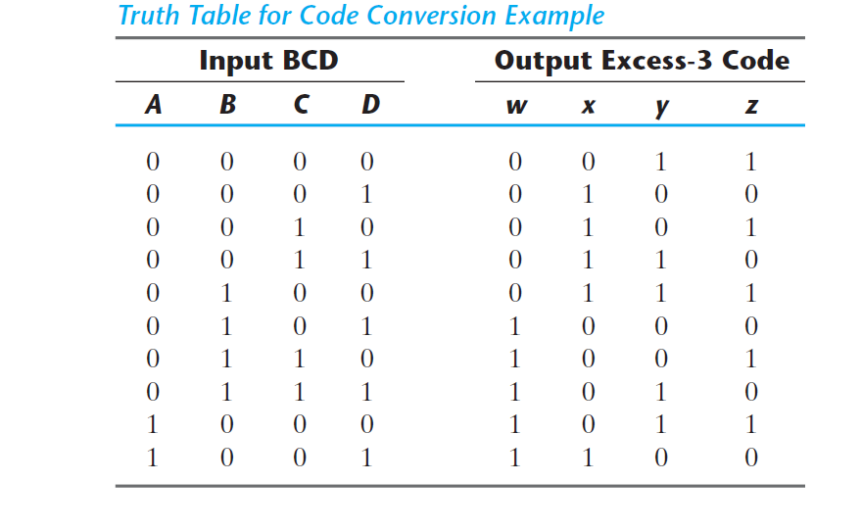
Example/ Design BCD code to EX-3 code conversion circuit?

Slide 25
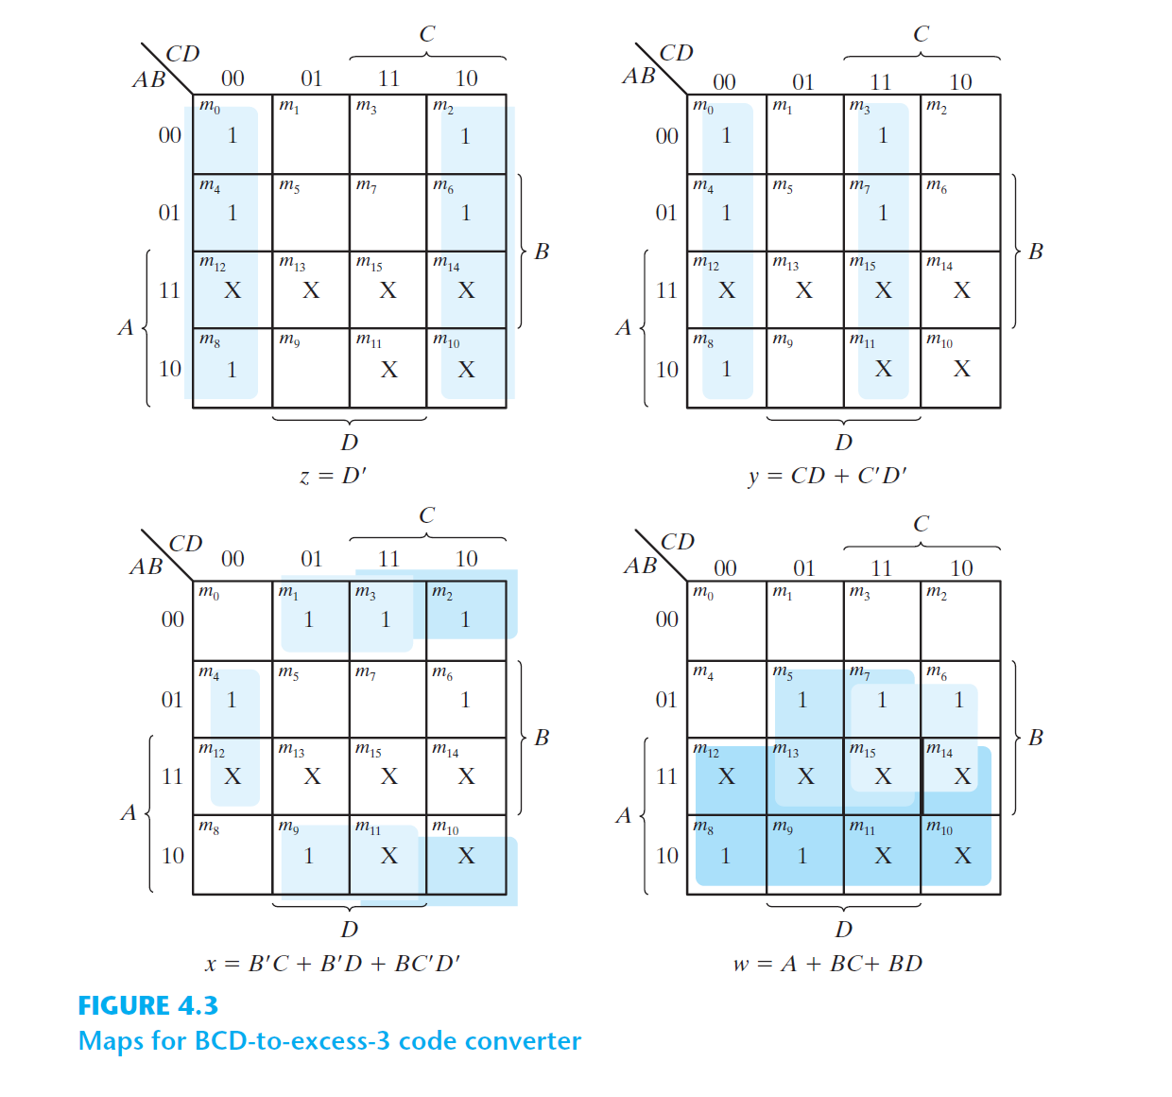

Slide 26
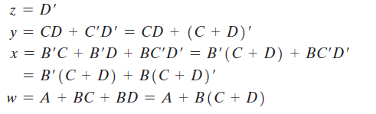
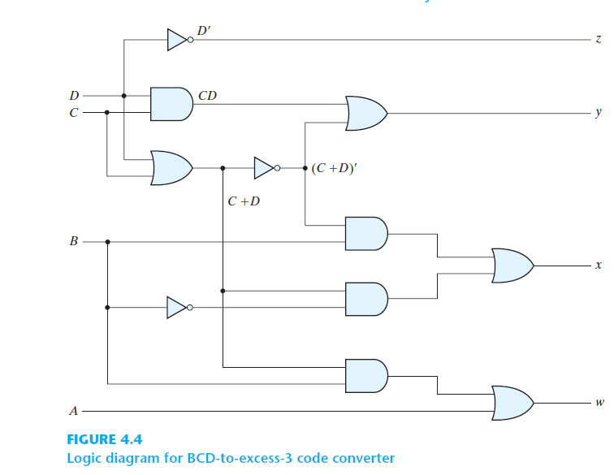

Slide 27
Ex/Design (4-bits) Binary to Gray converter circuit
G0 | G1 | G2 | G3 | B0 | B1 | B2 | B3
0 | 0 | 0 | 0 | 0 | 0 | 0 | 0 | 0
1 | 0 | 0 | 0 | 1 | 0 | 0 | 0 | 1
1 | 1 | 0 | 0 | 0 | 1 | 0 | 0 | 2
0 | 1 | 0 | 0 | 1 | 1 | 0 | 0 | 3
0 | 1 | 1 | 0 | 0 | 0 | 1 | 0 | 4
1 | 1 | 1 | 0 | 1 | 0 | 1 | 0 | 5
1 | 0 | 1 | 0 | 0 | 1 | 1 | 0 | 6
0 | 0 | 1 | 0 | 1 | 1 | 1 | 0 | 7
0 | 0 | 1 | 1 | 0 | 0 | 0 | 1 | 8
1 | 0 | 1 | 1 | 1 | 0 | 0 | 1 | 9
1 | 1 | 1 | 1 | 0 | 1 | 0 | 1 | 10
0 | 1 | 1 | 1 | 1 | 1 | 0 | 1 | 11
0 | 1 | 0 | 1 | 0 | 0 | 1 | 1 | 12
1 | 1 | 0 | 1 | 1 | 0 | 1 | 1 | 13
1 | 0 | 0 | 1 | 0 | 1 | 1 | 1 | 14
0 | 0 | 0 | 1 | 1 | 1 | 1 | 1 | 15

Slide 28
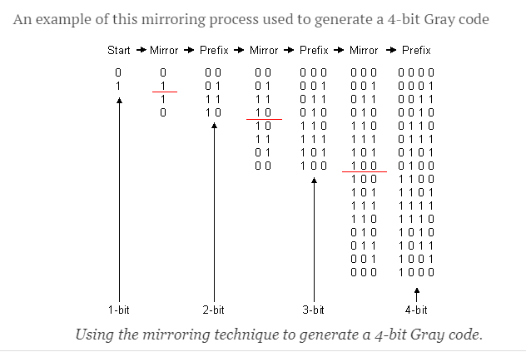

Slide 29
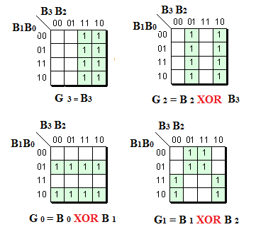

Slide 30
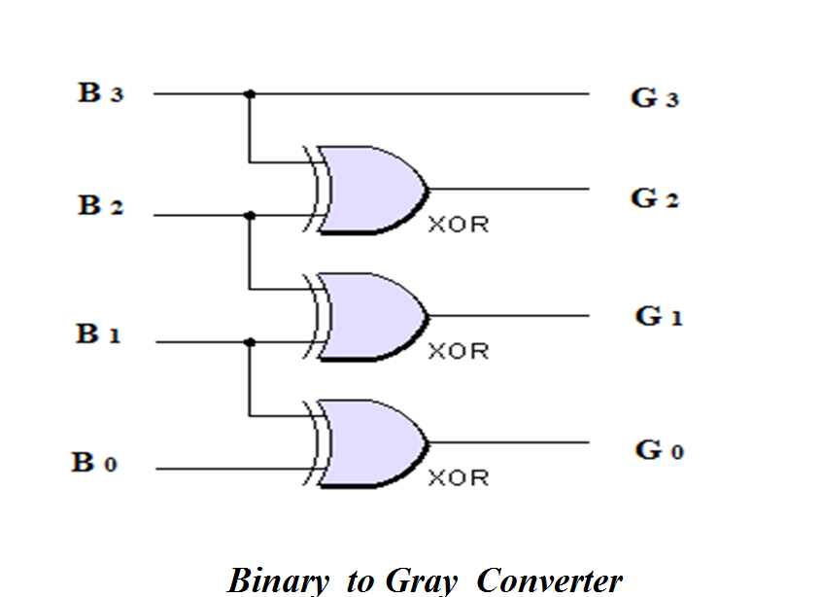

Slide 31
Ex/Design (4-bits) Gray to Binary converter circuit
B0 | B1 | B2 | B3 | G0 | G1 | G2 | G3
0 | 0 | 0 | 0 | 0 | 0 | 0 | 0 | 0
1 | 0 | 0 | 0 | 1 | 0 | 0 | 0 | 1
0 | 1 | 0 | 0 | 1 | 1 | 0 | 0 | 2
1 | 1 | 0 | 0 | 0 | 1 | 0 | 0 | 3
0 | 0 | 1 | 0 | 0 | 1 | 1 | 0 | 4
1 | 0 | 1 | 0 | 1 | 1 | 1 | 0 | 5
0 | 1 | 1 | 0 | 1 | 0 | 1 | 0 | 6
1 | 1 | 1 | 0 | 0 | 0 | 1 | 0 | 7
0 | 0 | 0 | 1 | 0 | 0 | 1 | 1 | 8
1 | 0 | 0 | 1 | 1 | 0 | 1 | 1 | 9
0 | 1 | 0 | 1 | 1 | 1 | 1 | 1 | 10
1 | 1 | 0 | 1 | 0 | 1 | 1 | 1 | 11
0 | 0 | 1 | 1 | 0 | 1 | 0 | 1 | 12
1 | 0 | 1 | 1 | 1 | 1 | 0 | 1 | 13
0 | 1 | 1 | 1 | 1 | 0 | 0 | 1 | 14
1 | 1 | 1 | 1 | 0 | 0 | 0 | 1 | 15

Slide 32
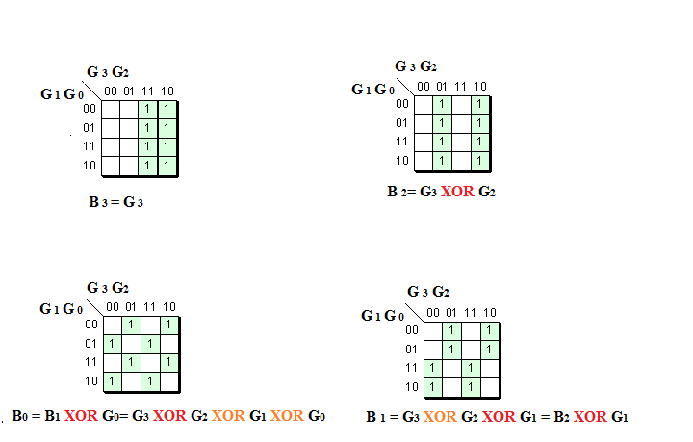

Slide 33
