Slide 1
OOP With JAVA Lecture (01) Introduction to OOP

Slide 2
What is Object Oriented Programming (OOP) ?
Object-oriented programming (OOP) is a programming paradigm based on the concept of "objects“.
A programming paradigm : is a style of programming, a way of thinking about software construction.
A programming paradigm does not refer to a specific language but rather to a way to build a program or a methodology to apply.
Some language make it easy to write in some paradigms but not others.
Some Programming languages allow the programmer to apply more than one Paradigm.

Slide 5
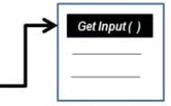
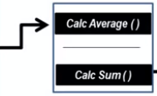
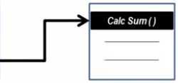
Procedural Programming Example : Program to Calculate Average of Array Items

Slide 6
Object-oriented programming (OOP) is a programming paradigm based on the concept of "objects“.
Object : is a thing (tangible – Intangible)

Slide 7
Object in Student housing management Program
Student housing Environment

Slide 8
Objects in Collage Management Program
Collage Environment

Slide 9
Objects in Super market Program
Super market Environment

Slide 10
Objects in Bike Store Program
Bike Store Environment

Slide 11
Object Is comprised Of?

Slide 12
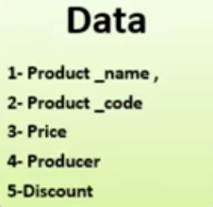
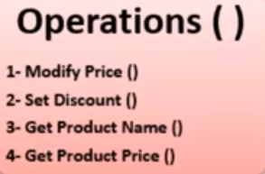
Object Is comprised Of?

Slide 13
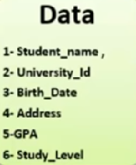
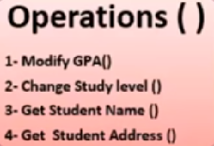
Object Is comprised Of?

Slide 14
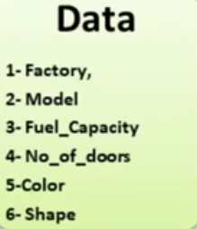
Object Is comprised Of?

Slide 15
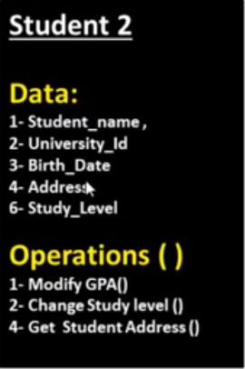
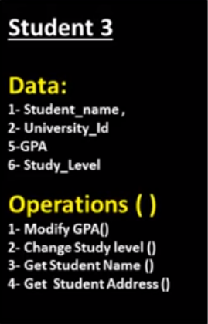
What is Class ? Why we need It ?

Slide 16
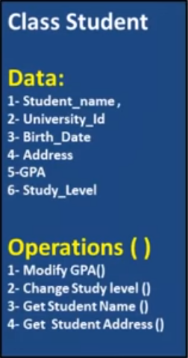
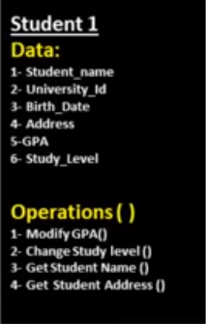
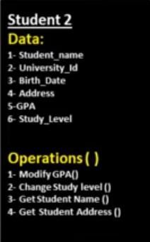
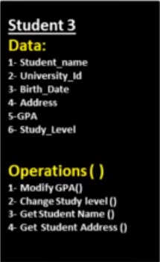
What is Class ? Why we need It ?

Slide 17
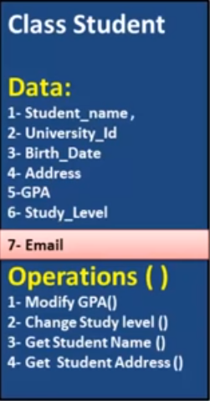
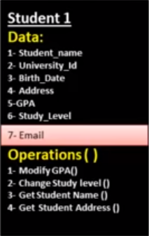
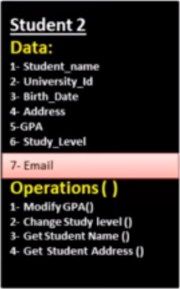
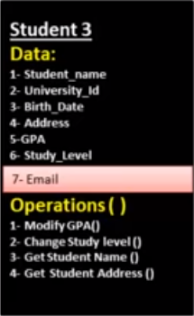
What is Class ? Why we need It ?

Slide 18
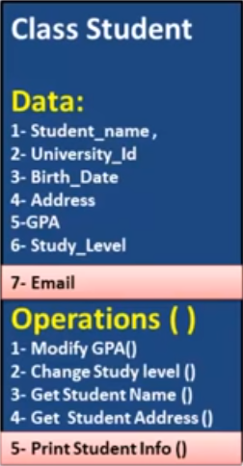
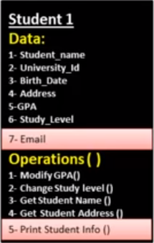
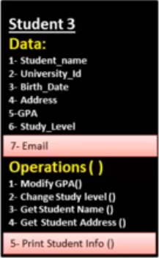
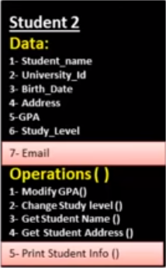
What is Class ? Why we need It ?

Slide 19
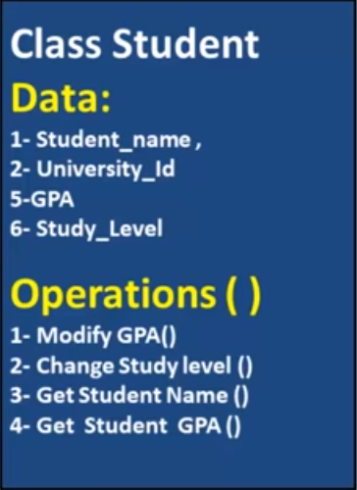
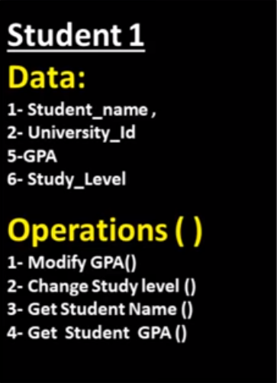
What is Class ? Why we need It ?

Slide 20
Thank you for listening

