Slide 1
OOP With JAVA
Lecture (10)
Arrays and loops

Slide 2
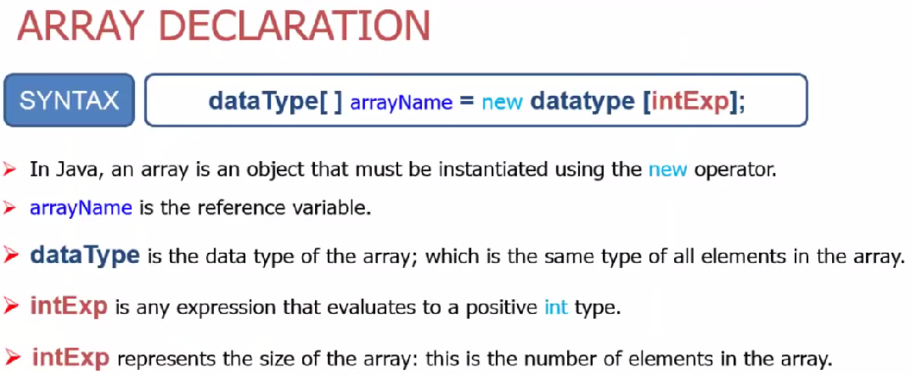
One Dimensional Arrays

Slide 3
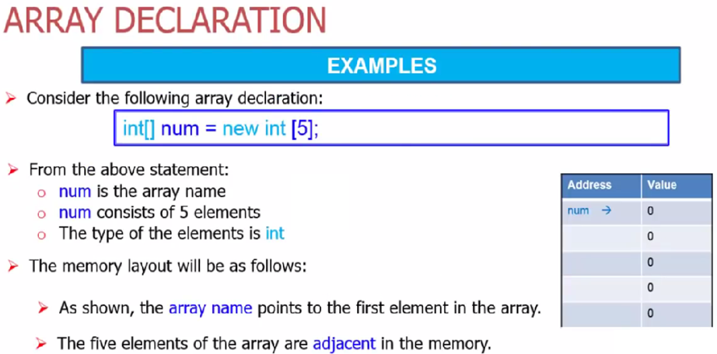


Slide 4
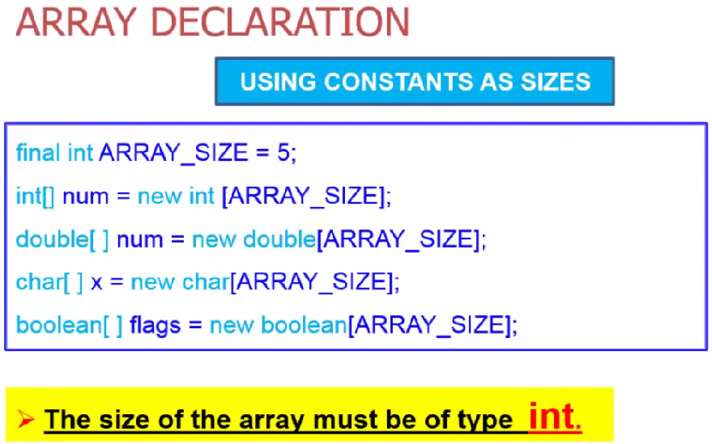

Slide 5
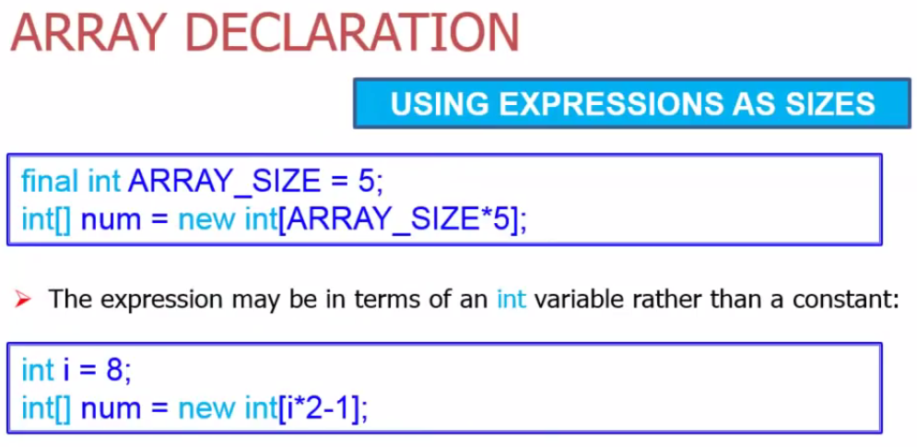

Slide 6
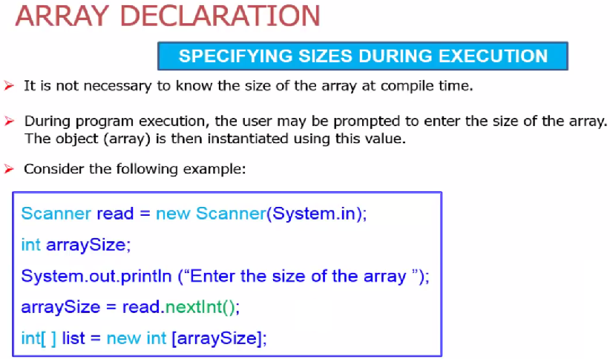

Slide 7
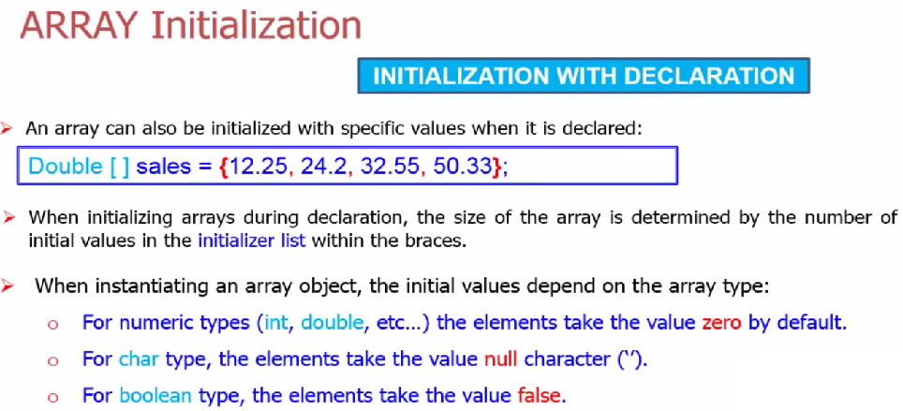

Slide 8
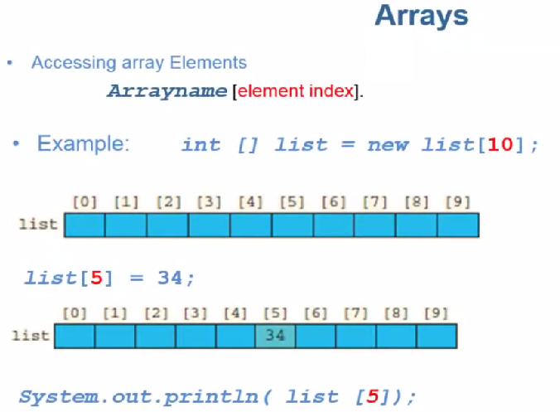

Slide 9
Example - Write a program that finds the sum and the average of positive integers stored in an array of integers.
Example : Write a program that ask the user to enter 10 Employee salaries and store them , then add a bonus of 10 % for each employee and print out the average salary value.

Slide 10
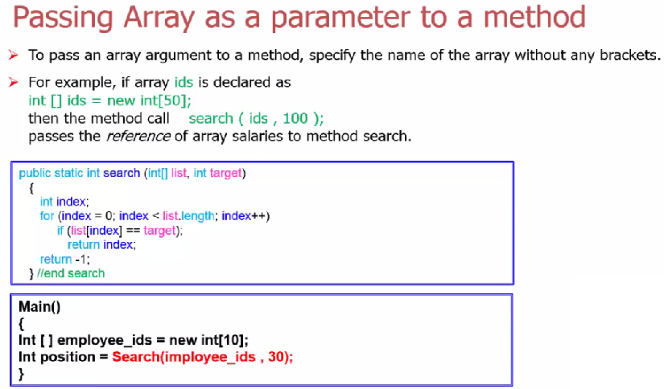

Slide 11
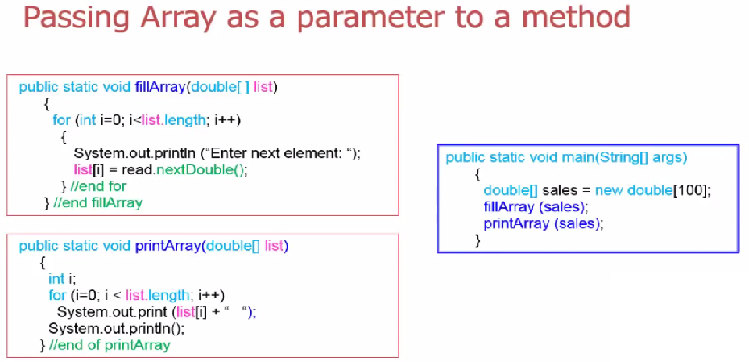

Slide 12
Two Dimensional Arrays
One-dimensional arrays are suitable for data provided in a list form.
Student_IDs
100 | 120 | 135 | 145 | 190 | 210
Two-dimensional arrays are suitable for data provided in a table form.
 | CS1301 | CS1111 | PHY1040 | CE1111
Fahd | A | A+ | B | B-
Ahmed | A+ | A- | C | B+
Faisal | C+ | D | A- | D+
For the above example, you need to know:
  The number of rows in the table (3 in the example)
  The number of columns in the table (4 in the example)
Also, in order to access an array element, you need to know:
  The element lies in which row and in which column
For example, Fahd grade in CE1111 lies in the intersection of the first row with the fourth column.

Slide 13
DECLARATION
SYNTAX
dataType[][] arrayName = new dataType[rows][cols];
rows : indicates the number of rows.
cols: indicates the number of columns.
The following example declares a two-dimensional array marks of 4 rows and 6 columns:
double[][] marks = new double[4][6];

Slide 14
ACCESSING ARRAY ELEMENTS
SYNTAX
arrayName[Row][Col]
1
2
3
4
sales[0][0] = 15.0;
sales[1][2] = 12.0;
sales[2][1] = 21.0;
 | sales[][0] | sales[][1] | sales[][2] | sales[][3] | sales[][4]
sales[0][] | 15.0 | sales[0][1] | sales[0][2] | sales[0][3] | sales[0][4]
sales[1][] | sales[1][0] | sales[1][1] | 12.0 | sales[1][3] | sales[1][4]
sales[2][] | sales[2][0] | 21.0 | sales[2][2] | 430.0 | sales[2][4]
sales[3][] | sales[3][0] | sales[3][1] | sales[3][2] | sales[3][3] | sales[3][4]

Slide 15
length
Consider the following code segment:
int [ ][ ] matrix = new int[20][15];
System.out.printf (“Number of rows = %d”, matrix.length);
System.out.printf (“Number of columns = %d”, matrix[0].length);
arrayName.length gives the number of rows.
arrayName[0].length gives the number of columns.
Output
Number of rows = 20
Number of columns = 15

Slide 16
INITIALIZATION
The two-dimensional array may be initialized as follows:
//Initialize and declare
int[ ][ ] array2 = { {2, 1, 3}, {3, 5, 2}, {4, 2, 2}};
The above example may be depicted as follows:
2
1
3
3
5
2
4
2
2

Slide 17
Let us initialize the elements of row #2 to 7:
int col;
for (col = 0; col < matrix[2].length; col++)
matrix[2][col] = 7;
When processing a row using a loop, the condition is “the number of columns”, which is matrix[2].length in this example.
The number of the row is fixed, and the number of the column varies from 0 to matrix[2].length ➔ col is the loop counter.
Let us initialize the elements of col #1 to 5:
int row;
for (row = 0; row < matrix.length; row++)
matrix[row][1] = 5;

Slide 18
Example : Write a program that build a matrix of 5 rows and 3 columns . Ask the use to enter the values for all the matrix items , print out the sum of all matrix items.

Slide 19
Two dimensional Array as a Parameter to Function
void printMatrix( int [][] array)
{
int row, col;
for (row = 0; row < array.length ; row++)
{
for (col = 0; col < array[0].length; col++)
System.out.println(array [row] [col]) ;
}
System.out.println() ;
}

Slide 20
Thank you for listening

