Slide 1
OOP With JAVA Lecture (02) Classes & Objects

Slide 5
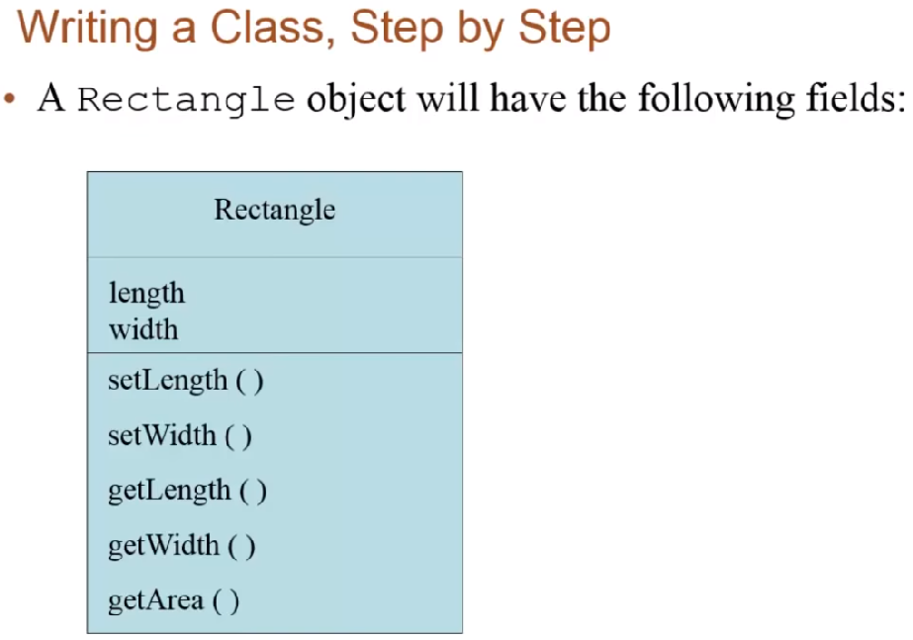

Slide 7
Data hiding

Slide 10
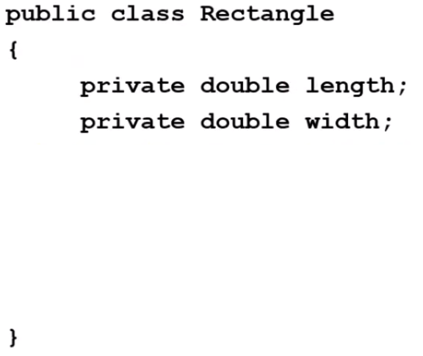

Slide 13
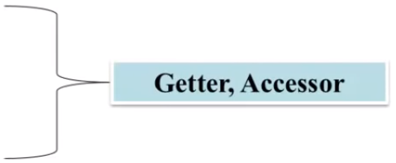

Slide 14
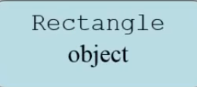

Slide 16
Thank you for listening

