Slide 1
OOP With JAVA Lecture (05) Inheritance & polymorphism

Slide 2
special

Slide 6
create an “is a”

Slide 13
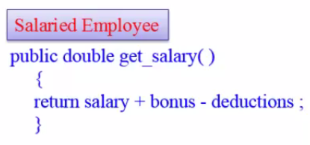
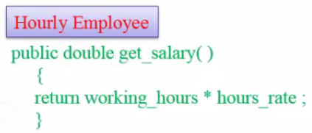

Slide 18
Thank you for listening

