Slide 1
OOP With JAVA Lecture (06) Abstract Class & Interfaces

Slide 3
result

Slide 6
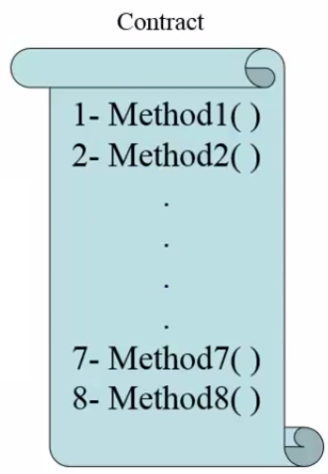
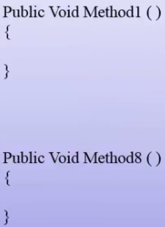
implement
Interface

Slide 11
Thank you for listening

