Slide 1
OOP With JAVA Lecture (07) variables, operators, types (Enumerated Types)

Slide 2
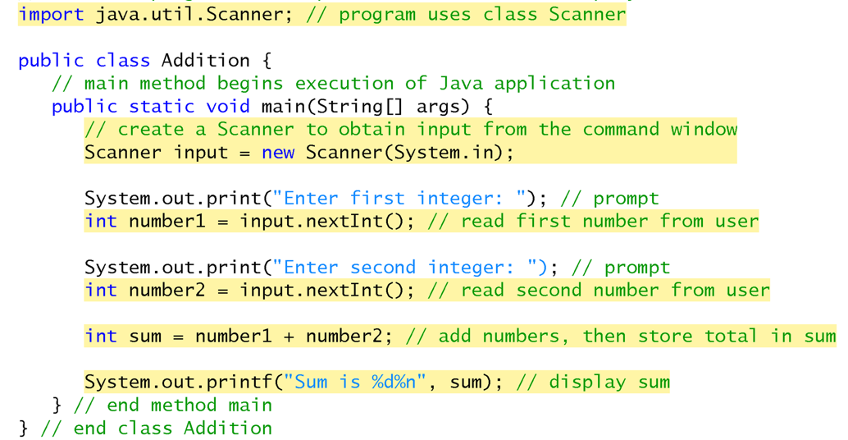

Slide 3
Data types are divided into two groups:
Primitive data types - includes byte, short, int, long, float, double, boolean and char
Non-primitive data types - such as String, Arrays and Classes
char | Character or small integer. | 1byte | signed: -128 to 127 unsigned: 0 to 255
int | Integer. | 4bytes | signed: -2147483648 to 2147483647 unsigned: 0 to 4294967295
short int (short) | Short Integer. | 2bytes | signed: -32768 to 32767 unsigned: 0 to 65535
long int (long) | Long integer. | 4bytes | signed: -2147483648 to 2147483647 unsigned: 0 to 4294967295
boolean | Boolean value. It can take one of two values: true or false. | 1byte | true or false
float | Floating point number. | 4bytes | +/- 3.4e +/- 38 (~7 digits)
double | Double precision floating point number. | 8bytes | +/- 1.7e +/- 308 (~15 digits)
long double | Long double precision floating point number. | 8bytes | +/- 1.7e +/- 308 (~15 digits)

Slide 4
Interacting With User: Accept Input From User
A variable is a location in the computer’s memory where a value can be stored for use by a program.
All variables must be declared with a name and a data type before they can be used in a program.
Declaration : DataType Identifier

Slide 5
Example 1
Write a program to find the Area of a rectangle
The area of the Rectangle are given by the following formula:
Area = Rect Length * Rect Width.
Input :
Rectangle Length , Rectangle Width.
Processing :
Area = Rect Length * Rect Width.
Output :
Print Out The area.

Slide 6
Working With Variable
Int length ;
Int width;
Int area;
Scanner input = new Scanner(System.in);
Length = input.nextInt();
Width = input.nextInt();
Area = Length * width ;
Length
5
Width
10
area
50

Slide 7
Example 2
Write a program to find the perimeter and area of a square
The perimeter and area of the square are given by the following formulas:
perimeter = Side Length * 4
area = Side Length * Side Length
Input:
Square Side Length
Processing:
perimeter = Side Length * 4
area = Side Length * Side Length
Output:
Print Out The Perimeter and Area.

Slide 8
Arithmetic Operations

Slide 9
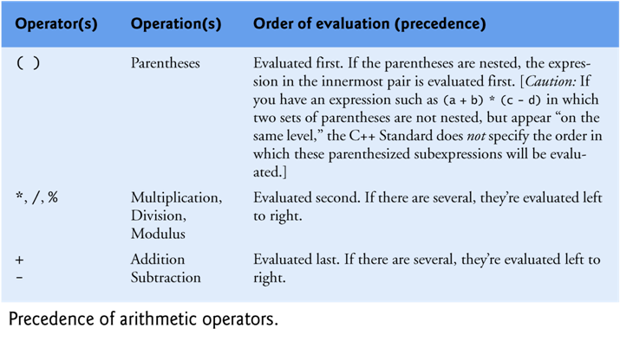
Precedence of arithmetic operations
For example, 2 + 3 * 5 and (2 + 3) * 5
both have different meanings
Lec.07: OOP With JAVA

Slide 10
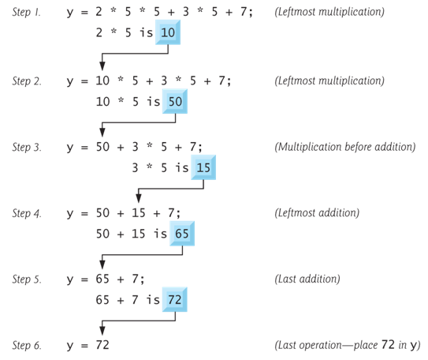
Precedence of arithmetic operations
Example :

Slide 11
Precedence of arithmetic operations
? = 1 + 2 * (3 + 4)
Evaluated as 1 + (2 * (3+4)) and the result is 15
? = 5 * 2 + 9 % 4
Evaluated as (5*2) + (9 % 4) and the result is 11
? = 5 * 2 % ( 7 – 4)
Evaluated as (5 * 2) % (7 – 4) and the result is 1

Slide 12
Data Type of an Arithmetic Expression
Data type of an expression depends on the type of its operands
Data type conversion is done by the compiler
If operators are *, /, +, or – , then the type of the result will be:
integer, if all operands are integer.
Int A , B;
A+ B → Integer.
float, If at least one operand is float and there is no double
Int A ; Float B;
A + B → Float.
double, if at least one operand is double
Int A ; Float B; Double C;
A + B + C → double.

Slide 13
Increment and Decrement Operators
Increment operator: increment variable by 1
Pre-increment: ++variable
Post-increment: variable++
Decrement operator: decrement variable by 1
Pre-decrement: --variable
Post-decrement: variable --
Examples :
++K , K++ → k= K+1
--K , K-- → K= K-1

Slide 14
Increment and Decrement Operators
If the value produced by ++ or – – is not used in an expression, it does not matter whether it is a pre or a post increment (or decrement).
When ++ (or – –) is used before the variable name, the computer first increments (or decrements) the value of the variable and then uses its new value to evaluate the expression.
When ++ (or – –) is used after the variable name, the computer uses the current value of the variable to evaluate the expression, and then it increments (or decrements) the value of the variable.
There is a difference between the following
x = 5;
Print(++x);
x = 5;
Print (x++);

Slide 15
special assignment statements
Java has special assignment statements called compound assignments
+= , -= , *= , /= , %=
Example:
X +=5 ; means x = x + 5;
x *=10; means x = x * 10;
x /=5; means x = x / 5;

Slide 19
Example:

Slide 20
Thank you for listening

