Slide 1
OOP With JAVA Lecture (09) Methods and conditionals

Slide 2
Functions - Methods
Most computer programs that solve real-world problems include hundreds and even thousands of lines.
Experience has shown that the best way to develop and maintain a large program is to construct it from smaller pieces or modules, each of which is more manageable than the original program.
A Function : is a self-contained block of statements that perform a specific task.
Using a function is something like hiring a person to do a specific job for you.

Slide 3
In Real Life
In Programming
Task 4
Task 1
Function ( )
Function ( )
Task 3
Task 2
Function ( )
Function ( )

Slide 4
Why to use Functions ?
Functions allows to write more manageable units of code.
Writing functions avoids rewriting the same code over and over.
Easy maintenance for programs.
Important Tips
1- Don’t try to cram the entire logic in one function. It is a very bad style of programming.
2- Instead, break a program into small units and write functions for each of these isolated subdivisions.
3- Don’t hesitate to write functions that are called only once.

Slide 5
Calculate and print out The sum and the Average of 3 student marks.
Task 4
Task 1
Print_out ( )
Get_Marks( )
Task 3
Task 2
Calc_sum( )
Calc_Average ( )

Slide 6
Functions
Function Definition
return-value-type function-name( parameter-list )
{
Lines of code to be
executed
…
(Body)
}
return-value- Type:
Is the data type for the returned value from the function to the calling program. It is Mandatory, if no returned value expected , we use keyword Void.
Parameter-List : Is a list of data values supplied from the calling program as input to the function. It is Optional
2- Invoking Function ( From The main( ) )
Function name ( Actual Parameter- List );

Slide 7
Function Types
Built in Functions (Ready Made).
For Example : Math Functions Like
int abs (int number) ;
double pow (double base, double exponent) ;
Double floor (double number);
Double sqrt (double number);

Slide 8
User-Defined Functions
Value-returning functions: have a return type
Return a value of a specific data type using the return statement
the returned value can be used in one of the following scenarios:
Save the value for further calculation
Int result;
Result = sum ( x , y );
Use the value in some calculation
Result = sum(x , y) /2;
Print the value
System.out.println (sum(x , y) ) ;
Void functions: do not have a return type
Do not use a return statement to return a value

Slide 9
public class methodOneParameter
{
public static void main(String[] args)
{
System.out.println (“Start of Program”); //output line #1
drawLine(); //method calling
Sysetm.out.println(“Welcome to the First lecture in Functions”);
drawLine(); //method calling
System.out.println (“End of Program”);
} //end of main
//method definition: This method draws a line
public static void drawLine( )
{
int i;
for (i=0; i < 10; i++)
System.out.print (‘*’);
System.out.println();
} //end of drawLine
} //end of class

Slide 10
public class methodOneParameter
{
public static void main(String[] args)
{
System.out.println (“Start of Program”); //output line #1
drawLine(‘*’); //method calling
Sysetm.out.println(“Welcome to the First lecture in Functions”);
drawLine(‘#’); //method calling
System.out.println (“End of Program”);
} //end of main
//method definition: This method draws a line
public static void drawLine( char ch)
{
int i;
for (i=0; i < 10; i++)
System.out.print (ch);
System.out.println();
} //end of drawLine
} //end of class

Slide 11
public class methodOneParameter
{
public static void main(String[] args)
{
System.out.println (“Start of Program”); //output line #1
drawLine(‘*’,15); //method calling
Sysetm.out.println(“Welcome to the First lecture in Functions”);
drawLine(‘#’,20); //method calling
System.out.println (“End of Program”);
} //end of main
//method definition: This method draws a line
public static void drawLine(char ch , integer length )
{
int i;
for (i=0; i < length; i++)
System.out.print (ch);
System.out.println();
} //end of drawLine
} //end of class

Slide 12
For Example : write a program that ask the user to Enter 3 integer numbers and print out their sum and Average.
int main ()
{
int n1 , n2 , n3 ;
System.out.println("Please Enter 3 integer numbers “ );
n1= input.nextInt();
n2= input.nextInt();
n3= input.nextInt();
System.out.println(" The sum of the 3 number is “ || sum (n1, n2,n3) );
System.out.println(" The average of the 3 number is " || average (n1, n2,n3) );
}
Public static int sum (int num1 , int num2, int num3)
{
return num1+num2+num3;
}
Public static double average (int num1, int num2, int num3 )
{
return sum (num1 , num2 , num3)/3 ;
}

Slide 13
Scope of a variable
scope is the context within a program in which a variable is valid and can be used.
Local variable: declared within a function (or block)
can be accessible only within the function or from declaration to the end of the block.
Within nested blocks if no variable with same name exists.
int sum (int x , int y )
{
int result ;
result = x + y;
return result;
}
int main ( )
{
{
Int x ;
}
}
Local
Local

Slide 14
Scope of a variable
Global variable: declared outside of every function definition.
Can be accessed from any function that has no local variables with the same name. In case the function has a local variable with the same name as the global variable ,
static Int z ;
int main ( )
{
{
}
}
int sum (int x , int y )
{
}
Global

Slide 15
Scope of a variable
Static int x = 100 ;
int main ( )
{
int x= 10;
{
int z , x ;
z=100;
y=100;
x= 250;
System.out.println(" inner block " << x ;
}
}
Global
Local
Local

Slide 16
Method Overloading
Method Overloading:
Defining several methods within a class with the same name. As long as every Method has a different signature
Method Signature:
The signature of a method consists of the following:
Method name
Formal parameter list
Note that the method type is not part of its signature.
Examples:
public int Sum(int x, int y)
public int Sum(int x, int y , int z)
public double Sum(double x, double y, double z)
public int Sum(int x, double y)
public int Sum(double y, int x)

Slide 17
The following methods are incorrectly overloaded; the compiler generates an error:
Example (1): The following methods are incorrectly overloaded because they have the same method name and same formal parameter lists:
public void methodABC (int x, double y)
public int methodABC (int x, double y)
Example (2): Changing the names of the formal parameters, does not allow overloading of the previous counter-example:
public void methodABC (int x, double y)
public int methodABC (int num1, double num2)
Counter-example (3): Adding the modifier static does not allow overloading of the previous example:
public static void methodABC (int x, double y)
public int methodABC (int num1, double num2)
Note that the method type and modifiers are not part of the overloading rules

Slide 18
Control Statements
Normally, statements in a program are executed one after the other in the order in which they’re written.
This is called sequential execution.
There are control statements enable you to specify that the next statement to be executed may be other than the next one in sequence.
This is called transfer of control.
The control statements are categorized in almost two groups:
Selection control statements
Repetition control statements

Slide 19
Sequential Execution
Transfer of Control
1
2
3
4
5
6
7
8
9

Slide 20
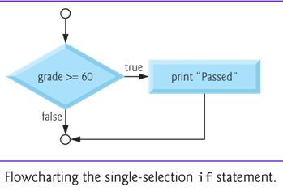
Selection Statements : If Statement
Selection statements are used to choose among alternative courses of action.
For example, suppose the passing mark on an exam is 60. The pseudocode statement
If student’s marks is greater than or equal to 60 Then Print “Passed”

Slide 21
In Java, The syntax for the If statement
if ( Expression) action statement ;
The Expression can be any valid expression including a relational expression and even arithmetic expression
In case of using arithmetic expressions , a non-zero value is considered to be true, whereas a 0 is considered to be false
if ( Expression) {
action statement 1 ;
action statement 2 ;
.
.
action statement n ;
}
if ( grade >= 60 ) System.out.println (“Passed”);

Slide 22
Relational Expression and Relational Operators
Relational expression is an expression which compares 2 operands and returns a TRUE or FALSE answer.
Example : a >= b , a == c , a >= 99 , ‘A’ > ‘a’
Relational expressions are used to test the conditions in selection, and looping statements.
Operator | Means
== | Equal To
!= | Not Equal To
< | Less Than
<= | Less Than or Equal To
> | Greater Than
>= | Greater Than or Equal To

Slide 23
Selection Statements : If Statement
Example : write a program that accept an integer from the user and in case this integer is even print out the following message
“This number is even “ .

Slide 24
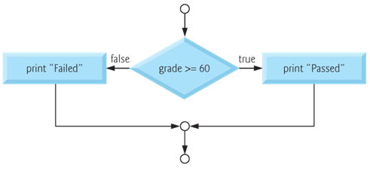
Selection Statements : If .. Else Statement
The IF…Else selection statement allows you to specify that there is a course of actions are to be performed when the condition is true and another course of actions will be executed when the condition is false.
For example, the pseudocode statement
If student’s mark is greater than or equal to 60 Print “Passed” else Print “Failed”

Slide 25
In Java, The syntax for the If…Else statement
if ( Expression) action statement ;
Else
action statement ;
if ( Expression) {
action statements 1 ;
.
action statement n ;
}
Else
{
action statements 1 ;
.
action statement n ;
}
if ( grade >= 60 ) System.out.println("Passed“);
Else
System.out.println(“Failed“);

Slide 26
Selection Statements : If – else Statement
Example : write a program that accept an integer from the user and
print out whether it is Positive or Negative number.

Slide 27
Nested If
Nested If : means to write an if statement within another if statement.
Example : write a program that accept an integer number from the user , in case the number is Positive , check and print out whether it is Even or Odd number.
int main()
{
int number;
System.out.println("Please Enter any number “) ;
Number = input.nextInt();
if ( number >=0)
if (number % 2 == 0)
System.out.println(" This is an Even number “);
else
System.out.println("This is an Odd number“);
}

Slide 28
IF – Else IF statement
For example, write a program that ask the user to Enter 2 numbers and print out whether they are equal or there is one which is greater than the other.
main()
{
int num1, num2;
System.out.println("Enter Number 1 , Number2 “);
Num1= input.nextInt();
Num2= input.nextInt();
if ( num1 == num2 )
System.out.println ("Both Are Equal “);
else if (num1 > num2 )
System.out.println("Number 1 is greater than number 2 “);
else
System.out.println ("Number 2 is greater than number 1 “);
}

Slide 29
IF – Else IF
For example, the following code will print
A for exam grades greater than or equal to 90,
B for grades greater than or equal to 80,
C for grades greater than or equal to 70,
D for grades greater than or equal to 60, and
F for all other grades.
if ( grade >= 90 ) System.out.println( "A“) ; else if ( grade >= 80 ) System.out.println( "B”); else if ( grade >= 70 ) System.out.println("C”); else if ( grade >= 60 ) System.out.println("D”); else System.out.println("F“) ;

Slide 30
Combining more than one condition
To combine more than one condition we use the logical operators.
Operator | Means | Description
&& | And | The Expression Value Is true If and Only IF both Conditions are true
|| | OR | The Expression Value Is true If one Condition Is True
Example : check whether num1 is between 0 and 100
iF ( num1 >= 0 && num1 <=100 )
System.out.println (“The Number Is between 1 and 100”) ;
else
System.out.println( “ The Number Is Larger Than 100”);

Slide 31
Combining more than one condition
Example, print out the student grade according to the following formulas:
A for exam marks greater than or equal 90 and less than or equal 100 ,
B for exam marks greater than or equal 80 and less than 90 ,
C for exam marks than or equal to 70 and less than 80 ,
D for exam marks than or equal to 60, and less than 70 ,
F for all other marks.
if ( marks >= 90 && marks <= 100) System.out.println ( "A“ ); else if (marks >= 80 && marks <90 ) System.out.println ( "B”); else if (marks >= 70 && marks <80 ) System.out.println ( "C”); else if (marks >= 60 && marks <70 ) System.out.println ( "D”); else System.out.println ( "F\n“) ;

Slide 32
Example : A company insures its Employees in the following cases:
Employee is married.
Employee is an Single male above 30 years of age.
Employee is an Single female above 25 years of age.
Conditions :
Marital status = ‘M’; OR
Marital Status =‘S’ and Sex=‘M’ and Age >30 OR
Marital Status =‘S’ and Sex=‘F’ and Age >25

Slide 33
Selection statements: Switch Statement.
The switch control statement allows us to make a decision from the number of choices
Switch (10.0);
float i ;
Switch (i);
switch ( i + j * k )
switch ( 23 + 45 % 4 * k )
Expression It could be an integer constant like 1, 2 or 3, or an expression that evaluates to an integer .
Constant : is a specific value.
Switch (Expression )
{
case constant 1 :
Action statements;
break ;
case constant 2 :
Action statements;
break ;
case constant 3 :
Action statements;
break ;
default :
Action statements;
}
Switch (10);
Int i ;
Switch (i);
switch ( 23 + 45 % 4 * k )
Case >= 50;
Case a+ b;

Slide 34
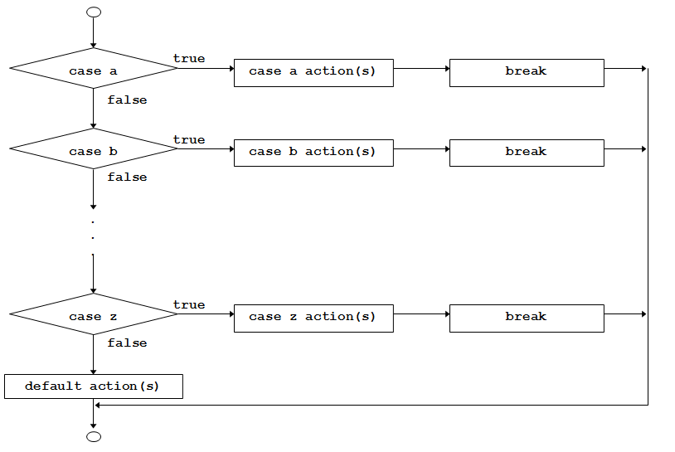

Slide 35
1. The switch Statement
1
2
3
4
5
6
7
8
9
10
11
12
13
14
15
16
17
18
19
20
21
22
23
24
25
26
public static void main (String[] args)
{
//Declaration section
Scanner read = new Scanner (System.in);
char grade;
String message;
//input section
grade = read.next().charAt(0);
//processing section
switch (grade)
{
case ‘A’: message = “Excellent”;
break;
case ‘B’: message = “Very Good”;
break;
case ‘C’: message = “Good”;
break;
case ‘D’: message = “Fair”;
break;
case ‘F’: message = “Failed”;
break;
default: message =“The grade is invalid”;
} //end switch
//output section
System.out.println (message);
} //end main
if (grade == ‘A’)
message = “Excellent”;
Else if (grade == ‘B’)
message = “Very Good”;
else if (grade == ‘C’)
message = “Good”;
else if (grade == ‘D’)
message = “Fair”;
else if (grade == ‘F’)
message = “Fail”;
else message = “The grade is invalid”;
System.out.println (message);

Slide 36
Example: Write a program that displays the following menu, then acts accordingly:
Enter your choice:
Add two numbers
Get the Subtract of two number
Get the square of a number
The program should give an error message for invalid inputs.

Slide 37
public static void main (String[] args)
{
Scanner read = new Scanner (System.in);
int choice, num1, num2, result = -1;
String message = “Invalid input”;
System.out.println (“Enter your choice:”);
System.out.println (“1. Add two numbers”);
System.out.println (“2. Get the double of a positive number”);
System.out.println (“3. Get the square of a number”);
choice = read.nextInt();
//processing section
switch (choice)
{
case 1: System.out.println (“Enter two positive integers”); //prompt
num1 = read.nextInt();
num2 = read.nextInt();
result = num1 + num2; // the value of result is no more equal to -1
break;
case 2: System.out.println (“Enter a positive integer”); //prompt
num1 = read.nextInt();
num2 = read.nextInt();
result = num1 – num2;
break;
case 3: System.out.println (“Enter an integer”); //prompt
num1 = read.nextInt();
result = num1 * num1; // the value of result is no more equal to -1
break;
default: System.out.println (message); //no change to “result” ➔ result=-1
} //end switch

Slide 38
When the same action is to be taken for several case labels, then we may write the program as follows:
public static void main (String[] args)
{
//Declaration section
Scanner read = new Scanner (System.in);
char letter;
String vowel = “This is a vowel”;
//input section
letter = read.next().charAt(0);
//processing section
switch (letter)
{
case ‘a’:
case ‘e’:
case ‘o’:
case ‘i’:
case ‘u’: System.out.println (vowel);
break;
default: System.out.println (“This is not a vowel”);
} //end switch
} //end main
This is equivalent to:
if (letter==‘a’) || (letter==‘e’) || (letter==‘o’) || (letter==‘i’) || (letter==‘u’)
System.out.println (vowel);

Slide 39
switch vs. nested if
The switch statement is an elegant way to apply multiple selections. It is less confusing.
However, the programmer is forced sometimes to use the nested if. Examples of such cases include:
If the selection involves a range of values.
Example: if (score >= 60) && (score < 70)
If the selector’s type is double or float.
Example: if (salary == 5000.25)

Slide 40
Thank you for listening

