Slide 1
Fifth lect The File System , File Permission and Access
Sabah Anwer Abdulkareem
University of Diyala, College of Engineering, Department of Computer Engineering

Slide 2
Command line switches/options
Linux command behavior can be modified using command line switches. Example:-
ls –al
ls --size
ls --help
The command switches affects the output of the ls command.
All Linux command have command switches.

Slide 3
Command line switches/options
It is important to take note of the following. Command line switches can come in 2 forms. Short form or the long form.
-a
--all
Both short and long forms affects the command the same way. Choose which form that suits you best.
Short forms always have a single ‘-’ preceding the switch.
Long forms always have two ‘--’ preceding the switch.

Slide 4
Files
A simple description of the UNIX system, also applicable to Linux, is this:
"On a UNIX system, everything is a file; if something is not a file, it is a process."

Slide 5
The File System
The file system consists of 2 distinct parts:
a collection of files, that store related data.
a directory structure, which organizes and provides information about all the files in the system.

Slide 6
Fundamental Components of A File
Name
Identifier
Type
Location
Size
Protection
Date, Time & user identification

Slide 7
A Linux system, just like UNIX, makes no difference between a file and a directory, since a directory is just a file containing names of other files.
Programs, services, texts, images, and so forth, are all files. Input and output devices, and generally all devices, are considered to be files, according to the system.

Slide 8
Sorts of files
Directories: files that are lists of other files.
Special files: the mechanism used for input and output. Most special files are in /dev.
Links: a system to make a file or directory visible in multiple parts of the system's file tree.

Slide 9
Sorts of Files
(Domain) sockets: a special file type, similar to TCP/IP sockets, providing inter-process networking protected by the file system's access control.
Named pipes: act more or less like sockets and form a way for processes to communicate with each other, without using network socket semantics.

Slide 10
Command line Interface
Command line is one of the many strengths of Linux based systems.
Command line Interface is a tool which is used for sending commands to the kernel.
Command [options][arguments]
mkdir –m 654 test
Command mkdir
Options –m
Arguments 654 test

Slide 11
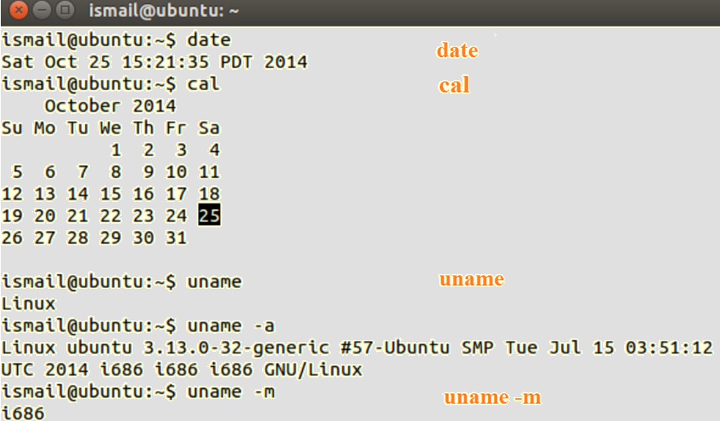
Commands in Linux

Slide 12
Date Command in Linux example (Date +%D) (Date +%d)

Slide 13
File Permission and Access
Introduction Linux is a multi-user system where users can assign different access permission to their files. Access permissions can be set per file for owner, group and others on the basis of read (r), write (w) and execute permissions (x).

Slide 14
File Permission and Access
Every file is owned by a particular user.
File permissions specifies who has the access to file and what type of access the user has.
On a Linux system, there is typically more than one user that provides a mechanism known as file permissions (rwx), which protect user files from accessing by other users.
Types of permissions
r – read
w –write
x –execute

Slide 15
File Permission and Access
read permission
The read permission lets a user read the contents of the file. For directories, read permission lets the user list the contents of the directory (using ls).
write permission
The write permission lets the user write and modify the file. For directories, write permission lets the user create new files or delete files within the directory.
execute permission
The execute permission lets the user run the file as a program or shell script (if the file is a program or shell script). For directories, execute permission lets the user open the directory.

Slide 16
Types of Access
In Linux, every file or folder has access permissions. There are three types of permissions.
read access
write access
execute access
Permissions are defined for three types of users:
owner of the file
group that the owner belongs to
other users

Slide 17
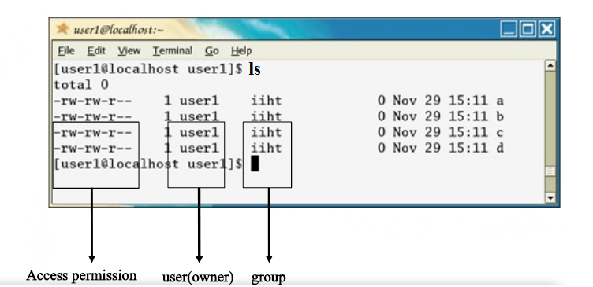
Who has to Access a File?
The owner and the root have the main access rights over a file.
Example
First column gives the access permissions to the user, group and others.
Second column shows the user or owner of the file.
Third column shows the group to which the file belongs.

Slide 18
Who has to Access a File?
Special File Permissions
There are three types of special file permissions
set user identity (SUID)
set group identity (SGID)
sticky bit

Slide 19
Symbolic mode
symbol | Description
u | User or owner
g | group
o | other
a | All (u, g, and o)
+ | Add permission
- | Delete or subtract permission
= | Change permission

Slide 20
Symbolic mode
Read =4 write =2 execute= 1
SYMBOL | DESCRIPTION
0 | None
1 | Execute
2 | Write
4 | Read
3 | Write and Execute ( 2+ 1 = 3)
5 | Read and Execute (4 + 1 = 5)
7 | Read, Write and Execute (4 + 2 + 1 = 7)

Slide 21
Octal and binary system

Slide 22
Value | Meaning
777 | (rwx rwx rwx) No Restrictions on permission. Everyone can perform each and every function.
755 | (rwx r-x r-x) The files owner may read, write and execute the file. All others may read and execute the file. The setting is common for programs that are used by all users.
700 | (rwx --- ---) the file owner have permission to read, write and execute the files. Nobody else has any rights. This setting is useful for programs that only the owner may use and must be kept private from others.
666 | (rw- rw- rw-) All users may read and write the file.
644 | (rw- r-- r--) the owner may read ad write the file. A common setting for data that everybody may read, but only the owner may change.
600 | (rw- --- ---) the owner may read and write the file. All others have no rights. A common setting for data files that the owner wants to keep private.

Slide 23
Types of Access
Default file permissions By default, the Linux system assigns certain permissions to a newly created file. The maximum permissions that we can set for an ordinary file is 666 and for directories and an executable files is 777.
The default file permission for an ordinary user is 664 and for root it is 644.
Displaying the umask
The default umask file permissions for ordinary users are 002 and for root it is 022. where,
002 imply masking write permission for others and
022 implies masking write permission for the group and others.

Slide 24
umask
octal numbers are preceded by a 0 (in the same way hex would be preceded by 0x), so the umask value itself is actually 002.
This value is an octal (base 8, digits 0-7) value which is subtracted from a base value of 777 for directories, or subtracted from a base value of 666 for files.
A umask of 002 basically means don't remove any permissions from the base value for "user" or "group", but "other" is not allowed write permission (write permission is octal 2, or binary 010 meaning -w-).

Slide 25
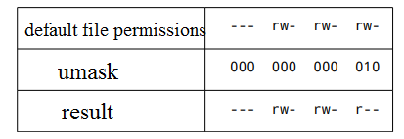
example
me@linuxbox ̴ $ ls foo.txt
-rw-rw-rw- 1 me me 0 2019-03-06 14:58 foo.txt
the umask value itself is actually 0002.

Slide 26
example
the umask value itself is actually 0022.

Slide 27
Who has to Access a File?
chmod command
chmod changes the access permissions according to the options for directories and files.
Syntax # chmod o+w Who has to Access a File?

Slide 28
Who has to Access a File?
The chmod command can be used with alphanumeric or numeric options.
Example of symbolic method
chmod u+rw, g-rwx,o-rwx file1 The above example, adds the read and write permission to the user (owner) removes the read, write and execute permission from the group to which the file belongs and removes the read, write and execute permissions for others.
Example of numeric method
# chmod 600 file1
.6 indicates user (owner), 0 indicates group and the last number 0 indicates others.

Slide 29
Examples

Slide 30
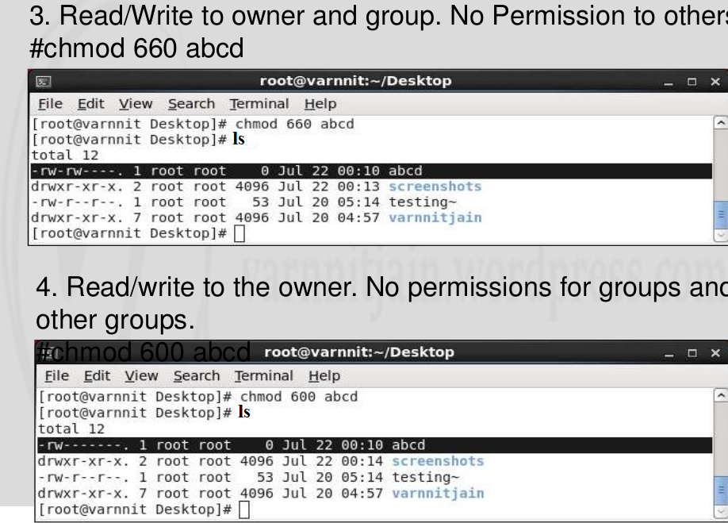

Slide 31
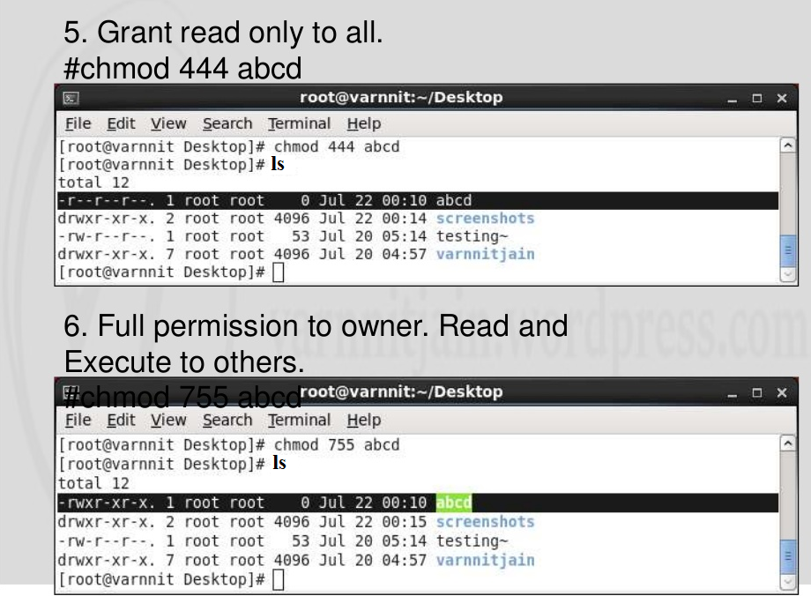

Slide 32
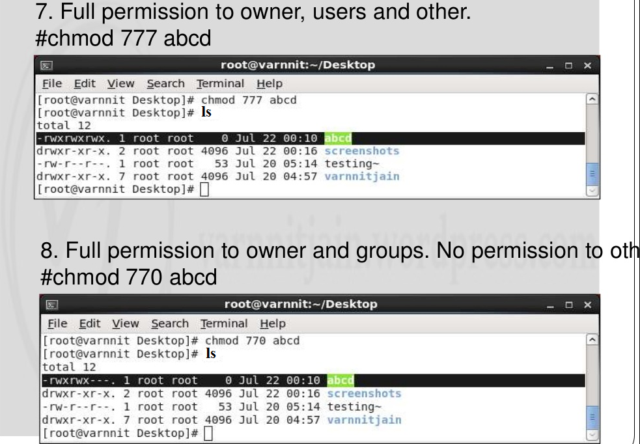

Slide 33
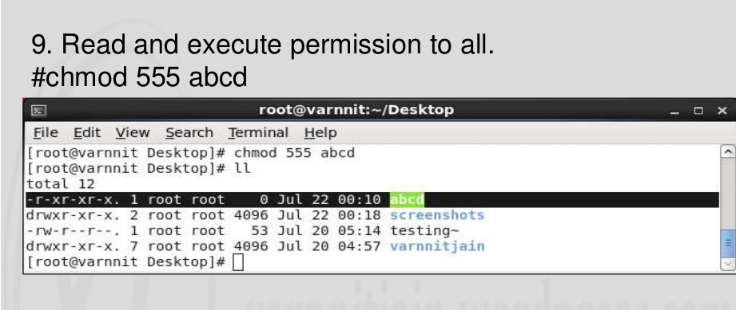

Slide 34
Examples
Change the permission of the following file using chmod command.
-rwxrw-r-- file2.txt
From the following example change the permissions to
User – read, write, execute
Group – read and execute
Others - only execute

