Slide 1
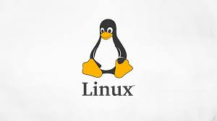
Sabah Anwer Abdulkareem
University of Diyala, College of Engineering, Department of Computer Engineering

Slide 2
What is an Operating System?
An Operating system (OS) is a software which acts as an interface between the end user and computer hardware.
Every computer must have at least one OS to run other programs.
An application like Chrome, MS Word, Games, etc needs some environment in which it will run and perform its task.
The OS helps you to communicate with the computer without knowing how to speak the computer's language.
It is not possible for the user to use any computer or mobile device without having an operating system.

Slide 3
list of Operating Systems
Windows
Unix
Linux
Android
iOS
Mac OS
Chrome OS
Windows Phone OS

Slide 4
History Of OS
Operating systems were first developed in the late 1950s to manage tape storage
The General Motors Research Lab implemented the first OS for their IBM 701
In the mid-1960s, operating systems started to use disks
In the late 1960s, the first version of the Unix OS was developed

Slide 5
History Of OS
The first OS built by Microsoft was DOS. It was built in 1981 by purchasing the 86-DOS software from a Seattle company
The present-day popular OS Windows first came to existence in 1985 when a GUI was created and paired with MS-DOS.

Slide 6
Features of Operating System
Here is a list commonly found important features of an Operating System:
Protected and supervisor mode
Allows disk access and file systems Device drivers Networking Security
Program Execution
Memory management Virtual Memory Multitasking
Handling I/O operations
Manipulation of the file system
Error Detection and handling
Resource allocation
Information and Resource Protection

Slide 7
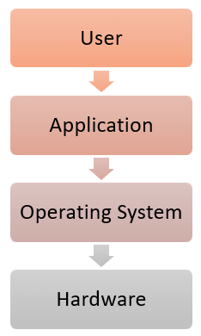
OS Location

Slide 8
What is a Kernel?
The kernel is the central component of a computer operating systems.
The only job performed by the kernel is to the manage the communication between the software and the hardware.
A Kernel is at the nucleus of a computer. It makes the communication between the hardware and software possible.

Slide 9
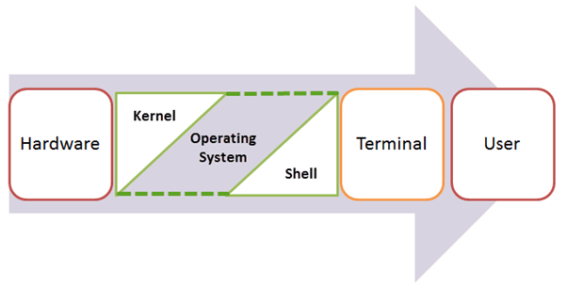
While the Kernel is the innermost part of an operating system, a shell is the outermost one.
What is a Kernel?

Slide 10
Types of Operating system
Batch Operating System
Multitasking/Time Sharing OS
Multiprocessing OS
Real Time OS
Distributed OS
Network OS
Mobile OS

Slide 11
Difference between 32-Bit vs. 64 Bit Operating System
Parameters | 32. Bit | 64. Bit
Architecture and Software | Allow 32 bit of data processing simultaneously | Allow 64 bit of data processing simultaneously
Compatibility | 32-bit applications require 32-bit OS and CPUs. | 64-bit applications require a 64-bit OS and CPU.
Systems Available | All versions of Windows 8, Windows 7, Windows Vista, and Windows XP, Linux, etc. | Windows XP Professional, Vista, 7, Mac OS X and Linux.
Memory Limits | 32-bit systems are limited to 3.2 GB of RAM. | 64-bit systems allow a maximum 17 Billion GB of RAM.

Slide 12
Disadvantages of using Operating System
If any issue occurs in OS, you may lose all the contents which have been stored in your system
Operating system's software is quite expensive for small size organization which adds burden on them. Example Windows
It is never entirely secure as a threat can occur at any time

Slide 13
UNIX
The initial version of “Unics” was developed in 1969 by ken Thompson and Dennis Ritchie at the bell Labs in the USA.
It became very popular inside bell labs
it had multi– user and multitasking operating system from beginning on.
It has been steadily improved, and forked into a vast number of different “Unix-like” operating system.

Slide 14
UNIX
It was written in Assembler Language .
It was ported to the C programming Language and the name changed to “Unix”
In 1975 ,it was first released outside Bell Labs.
In 1978,already 600 computers world –wide were running Unix.
Big companies like HP,IBM, Siemens and even Microsoft developed their own versions of Unix.

Slide 15
UNIX
From 1981 on, Unix was sold under a commercial licence which inhibited the free exchange of software among all its users and developers.
This led Richard Stallman to quit his job at the
MIT(Massachusetts Institute of Technology)and to found the GNU project(stands for GNU’s Not Unix).
He aimed at developing a complete OS which as Free Software to replace Unix.
he founded the Free Software Foundation which its developers and the development of software licences with the GNU GPL(General Public Licence)as the most famous.

Slide 16
UNIX
Many other organizations, universities and corporations developed their own flavors Unix, mostly based on the Unix code from before 1981.
hundreds of Unix versions have been created ,and many of them still are active and alive and being futher devel - open today :
The BSD family(NetBSD, FreeBSD, OpenBSD)
Solaris.
HP-UX, Irix.
MacOSX (Darwin/ NextSTEP)to name a few.

Slide 17
UNIX
In the early 1990’s , a Finnish student at Helsinki University ,Linus Torvalds, added hard disk drivers and low level hardware I/O functionalities and thus was on the best way to develop an operating system kernel.
In 1991 ,he made version V0.01of his kernel, which he called "Linux“ publicly available on the university's FTP server under the term of the GNU GPL.

Slide 18
Free Software
Free Software is a matter of the users’ freedom to run, copy, distribute, study, change and improve the software.
It refers to four kinds of freedom: Freedom :
1. to run the program
2. to study how the program works, and adapt it to your needs.
3. to redistribute copies so you can help your neighbor.
4. to improve the program, and release your improvements to the public so that the whole community benefits. Access to the source code is a precondition for this.

Slide 19
Operating system approach
Linux is the most famous open source OS.
Microsoft windows is a well-known closed –source OS.
Apple’s Mac OS X and iO OS are a hybrid approach. They contain an open source kernel Named Darwin yet include proprietary , closed –source components as well

Slide 20
Linux
Linux and Unix are closely connected to the “Free Software ”movement.
Linux(GNU/Linux) ,a flavor of Unix-like operating systems, is the most widely used operating system of this family, for a number of reasons:
it is freely available as ”open Source” software.
It is designed for security, robustness and reliability especially (but not only) in the area of network services and server systems(its strengths).
It is very flexible and versatile for all kinds of devices use:
desktop PCs
mobile devices.
cellphones.
multimedia devices
cars and etc.
Its popularity is constantly increasing .
Many big corporations (HP, IBM, Sun, Intel, and many more are officially supporting the Linux community and/ or even its development.

Slide 21
Linux
Many commercial companies are offering services, packages(“Distributions”), documentation etc.
Linux today has a growing power and influence of the whole IT world.
GNU project produced many UNIX- compatible tools, including compiler ,editors, and utilities but never released a kernel.

Slide 22
Linux
the resulting GNU/Linux operating system has spawned hundreds of unique distributions,or custom builds, of the system .
major distributions include:
RedHat
SUSE
Fedora
Debian
Slackware and
Ubuntu

Slide 23
Linux
distributions vary in function, utility, installed, applications, hardware support, user inter- face, and purpose.
For example
RedHat Enterprise Linux is geared to large commercial use.
PCLinuxOS is a LiveCD– an operating system that can be booted and run from a CD-ROM without being installed on a system ‘s hard disk.
one variant of PCLinuxOS-called "PCLinuxOS Supergamer DVD"- is a LiveDVD that includes graphics drivers and games

Slide 24
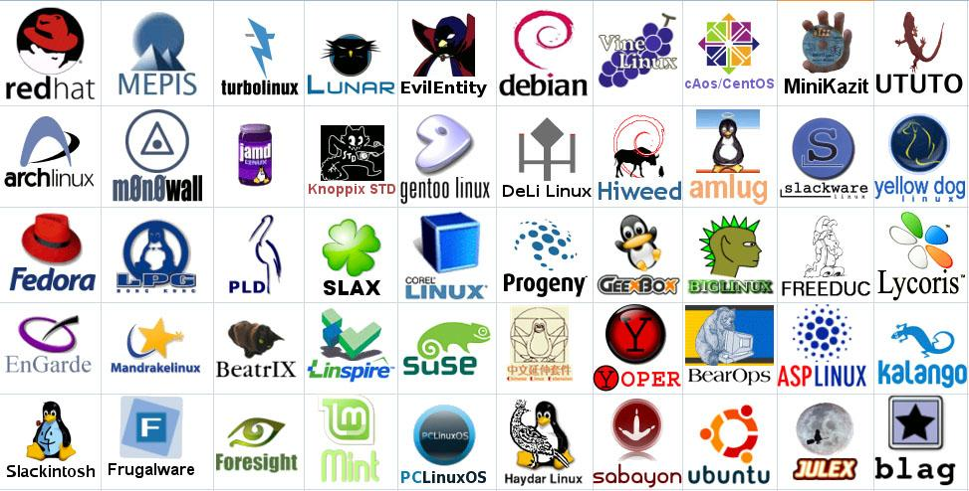
Linux Has Many Distributions
Notes:
Logos source: http://www.muylinux.com/wp-content/uploads/2009/04/logos-distros.jpg

Slide 25
Linux
Linux is a true 32 bit UNIX-like OS developed originally for home PCs, but now it runs on a variety of platforms including PowerPC, Macintosh, Amiga, DEC Alpha, Sun Sparc, ARM, and many others. The source code for Linux is freely available to everyone. Linux was created by Linus Torvalds in 1991, and it has been developed with the help of many programmers across the Internet. Now it has evolved into a very functional, powerful and usable clone of Unix which has at least 10 million users worldwide.

Slide 26
Linux
A Linux Distribution has thousands of dollars worth of software for no cost.
Linux is a complete operating system:
stable - the crash of an application is much less likely to bring down the OS under Linux.
Reliable - Linux servers are often up for hundreds of days compared with the regular reboots required with a Windows system.
extremely powerful
Linux provides a complete development environment.

Slide 27
Why Linux (continued)
Excellent networking facilities
Ideal environment to run servers such as a web server, or an FTP server.
A wide variety of commercial software is available if not satisfied by the free software
Easily upgradeable.
Supports multiple processors.
True multi-tasking, multi-user OS, Virtual Memory , Shared libraries, TCP/IP .
An excellent window system called X, the equivalent of Windows but much more flexible.
Full source code is provided and free.

