Slide 1
Second Lecture
Getting started using Linux commands
Sabah Anwer Abdulkareem
University of Diyala, College of Engineering, Department of Computer Engineering

Slide 2
The Linux command line
The Linux command line is a text interface to your computer. Often referred to as the shell, terminal, console, prompt or various other names, it can give the appearance of being complex and confusing to use.
one of the early operating systems was called Unix. It was designed to run as a multi-user system on mainframe computers, with users connecting to it remotely via individual terminals.
These terminals were pretty basic by modern standards: just a keyboard and screen, with no power to run programs locally. Instead they would just send keystrokes to the server and display any data they received on the screen. There was no mouse, no fancy graphics, not even any choice of color. Everything was sent as text, and received as text. Obviously, therefore, any programs that ran on the mainframe had to produce text as an output and accept text as an input.
users in the 70s could do everything entirely with a textual interface.

Slide 3
pwd
Use the pwd command to find the path of your current working directory. Simply entering pwd will return the full current path – a path of all the directories that starts with a forward slash (/). For example, /home/username.
The pwd command uses the following syntax:
pwd [option]
It has two acceptable options:
-L or –logical prints environment variable content, including symbolic links.
-P or –physical prints the actual path of the current directory.

Slide 4
(cd): to change directories
To navigate through the Linux files and directories, use the cd command. Depending on your current working directory, it requires either the full path or the directory name.
Running this command without an option will take you to the home folder. Keep in mind that only users with sudo privileges can execute it.
Let’s say you’re in /home/username/Documents and want to go to Photos, a subdirectory of Documents. To do so, enter the following command:
cd Photos.
If you want to switch to a completely new directory, for example, /home/username/Movies, you have to enter cd followed by the directory’s absolute path:
cd /home/username/Movies
Here are some shortcuts to help you navigate:
cd ~[username] goes to another user’s home directory.
cd .. moves one directory up.
cd- moves to your previous directory.

Slide 6
(ls): to list their contents
The ls command lists files and directories within a system. Running it without a flag or parameter will show the current working directory’s content.
To see other directories’ content, type ls followed by the desired path. For example, to view files in the Documents folder, enter:
ls /home/username/Documents
Here are some options you can use with the ls command:
ls -R lists all the files in the subdirectories.
ls -a shows hidden files in addition to the visible ones.
ls -lh shows the file sizes in easily readable formats, such as MB, GB, and TB.

Slide 7
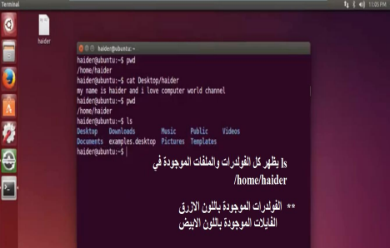

Slide 8
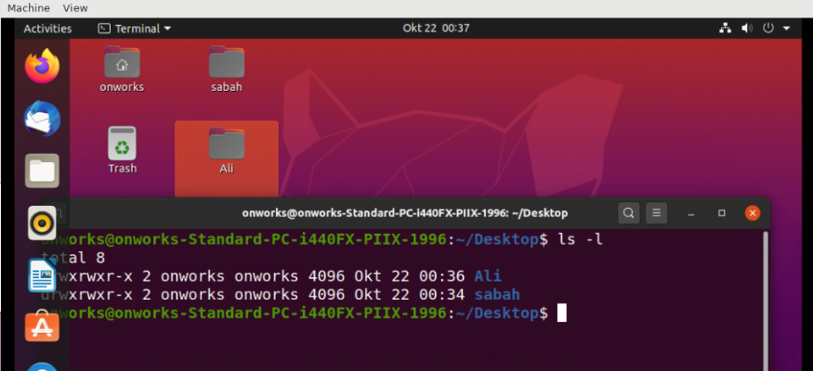

Slide 10
(mv): to rename or move files
The primary use of the mv command is to move and rename files and directories. Additionally, it doesn’t produce an output upon execution.
Simply type mv followed by the filename and the destination directory. For example, you want to move filename.txt to the /home/username/Documents directory:
mv filename.txt /home/username/Documents.
You can also use the mv command to rename a file:
mv old_filename.txt new_filename.txt

Slide 11
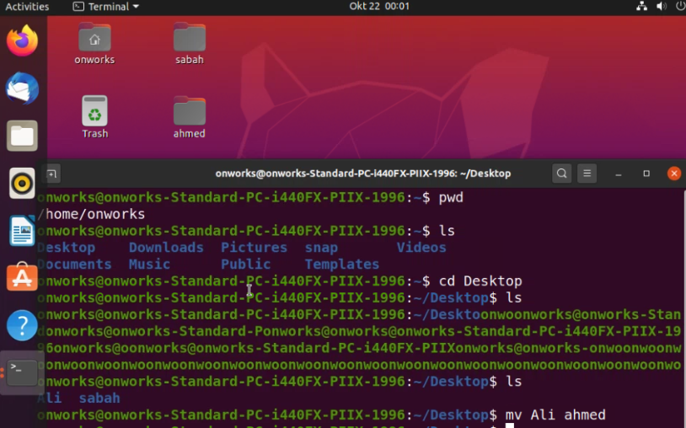

Slide 13
cat command
Concatenate, or cat, is one of the most frequently used Linux commands. It lists, combines, and writes file content to the standard output. To run the cat command, type cat followed by the file name and its extension. For instance:
cat filename.txt.
Here are other ways to use the cat command:
cat > filename.txt creates a new file.
cat filename1.txt filename2.txt > filename3.txt merges filename1.txt and filename2.txt and stores the output in filename3.txt.
tac filename.txt displays content in reverse order.

Slide 14
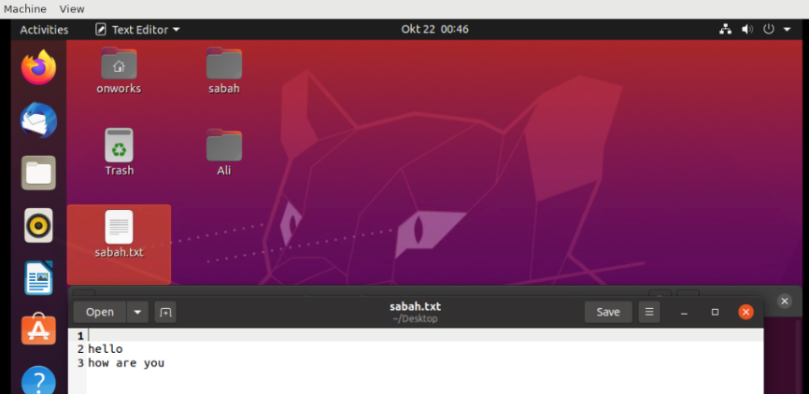

Slide 15
For back to main screen
Press ctrl+z

Slide 16
mkdir command
Use the mkdir command to create one or multiple directories at once and set permissions for each of them. The user executing this command must have the privilege to make a new folder in the parent directory, or they may receive a permission denied error.
Here’s the basic syntax:
mkdir [option] directory_name
For example, you want to create a directory called Music:
mkdir Music
To make a new directory called Songs inside Music, use this command:
mkdir Music/Songs
The mkdir command accepts many options, such as:
-p or –parents create a directory between two existing folders. For example, mkdir -p Music/2020/Songs will make the new “2020” directory.
-m sets the file permissions. For instance, to create a directory with full read, write, and execute permissions for all users, enter mkdir -m777 directory_name.
-v prints a message for each created directory.

Slide 17
rmdir command
To permanently delete an empty directory, use the rmdir command. Remember that the user running this command should have sudo privileges in the parent directory.
For example, you want to remove an empty subdirectory named personal1 and its main folder mydir:
rmdir -p mydir/personal1

Slide 18
rm command
The rm command is used to delete files within a directory. Make sure that the user performing this command has write permissions.
Remember the directory’s location as this will remove the file(s) and you can’t undo it.
Here’s the general syntax:
rm filename
To remove multiple files, enter the following command:
rm filename1 filename2 filename3
Here are some acceptable options you can add:
-i prompts system confirmation before deleting a file.
-f allows the system to remove without a confirmation.
-r deletes files and directories recursively.

Slide 19
touch command
The touch command allows you to create an empty file or generate and modify a timestamp in the Linux command line.
For example, enter the following command to create an HTML file named Web in the Documents directory:
touch /home/username/Documents/Web.html

Slide 20
cp command
Use the cp command to copy files or directories and their content. Take a look at the following use cases.
To copy one file from the current directory to another, enter cp followed by the file name and the destination directory. For example:
cp filename.txt /home/username/Documents
To copy files to a directory, enter the file names followed by the destination directory:
cp filename1.txt filename2.txt filename3.txt /home/username/Documents
To copy the content of a file to a new file in the same directory, enter cp followed by the source file and the destination file:
cp filename1.txt filename2.txt
To copy an entire directory, pass the -R flag before typing the source directory, followed by the destination directory:
cp -R /home/username/Documents /home/username/Documents_backup

Slide 21
locate command
The locate command can find a file in the database system.
Moreover, adding the -i argument will turn off case sensitivity, so you can search for a file even if you don’t remember its exact name.
To look for content that contains two or more words, use an asterisk (*). For example:
locate -i school*not
The command will search for files that contain the words school and note, whether they use uppercase or lowercase letters.

Slide 22
find command
Use the find command to search for files within a specific directory and perform subsequent operations. Here’s the general syntax:
find [option] [path] [expression]
For example, you want to look for a file called notes.txt within the home directory and its subfolders:
find /home -name notes.txt
Here are other variations when using find:
find -name filename.txt to find files in the current directory.
find ./ -type d -name directoryname to look for directories.

Slide 23
grep command
Another basic Linux command on the list is grep or global regular expression print. It lets you find a word by searching through all the texts in a specific file.
Once the grep command finds a match, it prints all lines that contain the specific pattern. This command helps filter through large log files.
For example, you want to search for the word blue in the notepad.txt file:
grep blue notepad.txt
The command’s output will display lines that contain blue.

Slide 24
df command
Use the df command to report the system’s disk space usage, shown in percentage and kilobyte (KB). Here’s the general syntax:
df [options] [file]
For example, enter the following command if you want to see the current directory’s system disk space usage in a human-readable format:
df -h
These are some acceptable options to use:
df -m displays information on the file system usage in MBs.
df -k displays file system usage in KBs.
df -T shows the file system type in a new column.

Slide 25
diff command
Short for difference, the diff command compares two contents of a file line by line. After analyzing them, it will display the parts that do not match.
Programmers often use the diff command to alter a program instead of rewriting the entire source code.
Here’s the general format:
diff [option] file1 file2
For example, you want to compare two text files – note.txt and note_update.txt:
diff note.txt note_update.txt
Here are some acceptable options to add:
-c displays the difference between two files in a context form.
-u displays the output without redundant information.
-i makes the diff command case insensitive.

Slide 26
chmod command
chmod is a common command that modifies a file or directory’s read, write, and execute permissions. In Linux, each file is associated with three user classes – owner, group member, and others.
Here’s the basic syntax:
chmod [option] [permission] [file_name]
For example, the owner is currently the only one with full permissions to change note.txt. To allow group members and others to read, write, and execute the file, change it to the -rwxrwxrwx permission type, whose numeric value is 777:
chmod 777 note.txt
This command supports many options, including:
-c or –changes displays information when a change is made.
-f or –silent suppresses the error messages.
-v or –verbose displays a diagnostic for each processed file.

Slide 27
man command
The man command provides a user manual of any commands or utilities you can run in Terminal, including the name, description, and options.
It consists of nine sections:
Executable programs or shell commands
System calls
Library calls
Games
Special files
File formats and conventions
System administration commands
Kernel routines
Miscellaneous
To display the complete manual, enter:
man [command_name]
For example, you want to access the manual for the ls command:
man ls
Enter this command if you want to specify the displayed section:
man [option] [section_number] [command_name]
For instance, you want to see section 2 of the ls command manual:
man 2 ls

Slide 28
echo command
The echo command is a built-in utility that displays a line of text or string using the standard output. Here’s the basic syntax:
echo [option] [string]
For example, you can display the text Hostinger Tutorials by entering:
echo “Hostinger Tutorials”
This command supports many options, such as:
-n displays the output without the trailing newline.
-e enables the interpretation of the following backslash escapes:
\a plays sound alert.
\b removes spaces in between a text.
\c produces no further output.
-E displays the default option and disables the interpretation of backslash escapes.

