Slide 1
Sixth Lecture
Intro to bash shell programming
Sabah Anwer Abdulkareem
University of Diyala, College of Engineering, Department of Computer Engineering

Slide 2
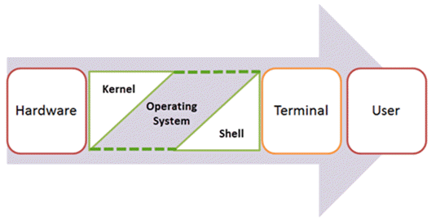
Intro to shell scripts
Shell is a UNIX term for an interface between a user and an operating system service. Shell provides users with an interface and accepts human-readable commands into the system and executes those commands which can run automatically and give the program’s output in a shell script..
An Operating is made of many components, but its two prime components are –
Kernel
Shell
Components of Shell Program

Slide 3
A Kernel is at the nucleus of a computer. It makes the communication between the hardware and software possible. While the Kernel is the innermost part of an operating system, a shell is the outermost one.

Slide 4
A shell in a Linux operating system takes input from you in the form of commands, processes it, and then gives an output. It is the interface through which a user works on the programs, commands, and scripts. A shell is accessed by a terminal which runs it.
When you run the terminal, the Shell issues a command prompt (usually $), where you can type your input, which is then executed when you hit the Enter key. The output or the result is thereafter displayed on the terminal.

Slide 5
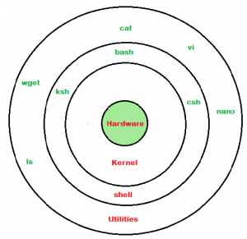
The Shell wraps around the delicate interior of an Operating system protecting it from accidental damage. Hence the name Shell.
Linux shell

Slide 6
Types of Shell
There are two main shells in Linux:
1. The Bourne Shell: The prompt for this shell is $ and its derivatives are listed below:
POSIX shell also is known as sh
Korn Shell also knew as ksh
Bourne Again Shell also knew as bash (most popular)
2. The C shell: The prompt for this shell is %, and its subcategories are:
C shell also is known as csh
Tops C shell also is known as tcsh
Notes:
command execution program, often called a command interpreter )

Slide 7
How to Write Shell Script in Linux/Unix
Shell Scripts are written using text editors. On your Linux system, open a text editor program, open a new file to begin typing a shell script or shell programming, then give the shell permission to execute your shell script and put your script at the location from where the shell can find it.
Let us understand the steps in creating a Shell Script:
Create a file using a vi editor(or any other editor). Name script file with extension .sh
Start the script with #! /bin/sh
Write some code.
Save the script file as filename.sh
For executing the script type bash filename.sh

Slide 8
“#!” is an operator called shebang which directs the script to the interpreter location. So, if we use”#! /bin/sh” the script gets directed to the bourne-shell.
Let’s create a small script –
#!/bin/sh
ls

Slide 9
#comment
Let’s see the steps to create Shell Script Programs in Linux/Unix –
OR

Slide 10
Commenting is important in any program. In Shell programming, the syntax to add a comment is # comment Let understand this with an example.
Ctrl+x

Slide 11
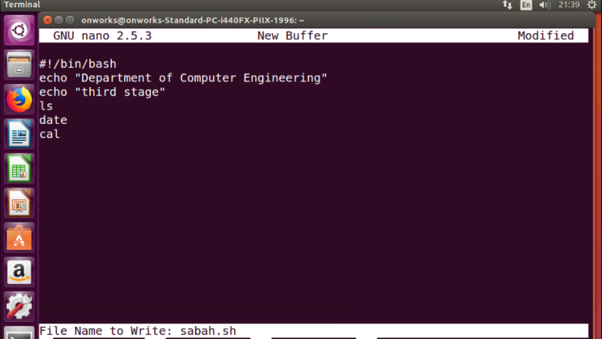

Slide 12
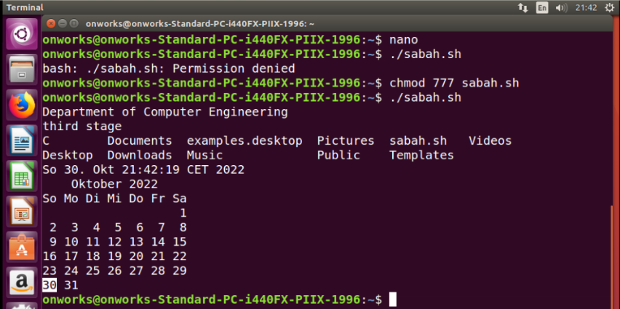

Slide 13
the following creates a shell variable and then prints it:
variable ="Hello"
echo $variable
Below is a small script which will use a variable.
For example,
#!/bin/sh
echo "what is your name?"
read name
echo "How do you do, $name?"
read remark
echo "I am $remark too!"

Slide 15
Summary:
Kernel is the nucleus of the operating systems, and it communicates between hardware and software
Shell is a program which interprets user commands through CLI like Terminal
The Bourne shell and the C shell are the most used shells in Linux
Linux Shell scripting is writing a series of command for the shell to execute
Shell variables store the value of a string or a number for the shell to read
Shell scripting in Linux can help you create complex programs containing conditional statements, loops, and functions
Basic Shell Scripting Commands in Linux: cat, more, less, head, tail, mkdir, cp, mv, rm, touch, grep, sort, wc, cut and, more.

Slide 16
Variables

