Slide 1
GNSS Application
1st Lecture
Introduction to GNSS System
By:
Dr. Ali Albu-Rghaif
Department of Computer Engineering
College of Engineering
University of Diyala

Slide 2
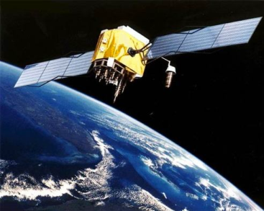
Outline
GNSS Concept
GNSS Architecture/Segments
Space Segment
Control Segment
User Segment
GNSS Constellation
GPS Constellation
GLONASS Constellation
Galileo Constellation

Slide 3
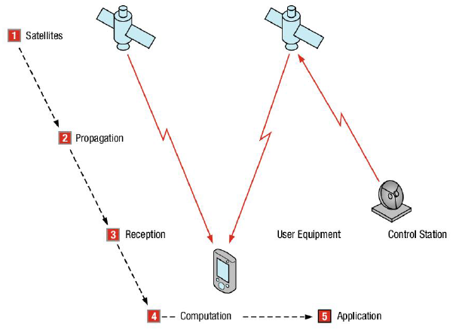
GNSS Concept
An Introduction to GNSS: GPS, GLONASS, BeiDou, Galileo and other Global Navigation Satellite Systems

Slide 4
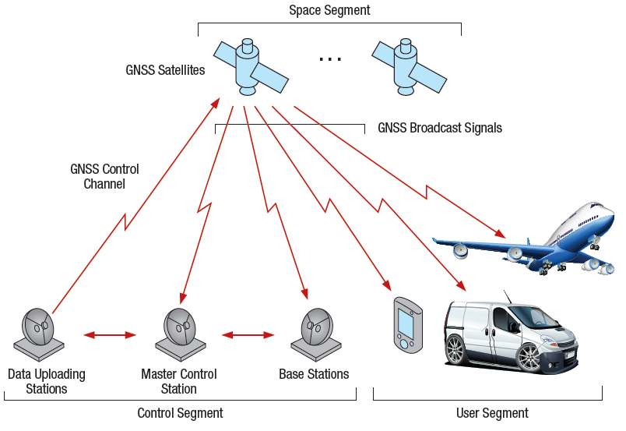
GNSS Architecture
Space Segment
Control Segment
User Segment
An Introduction to GNSS: GPS, GLONASS, BeiDou, Galileo and other Global Navigation Satellite Systems

Slide 5
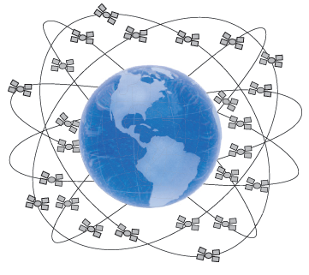
GNSS Segments
Space Segment
The space segment consists of GNSS satellites,
orbiting about 20,000 km above the earth
Each GNSS has its own “constellation” of satellites,
arranged in orbits to provide the desired coverage
Each satellite in a GNSS constellation broadcasts a signal.
the signal provides its time, orbit and status
An Introduction to GNSS: GPS, GLONASS, BeiDou, Galileo and other Global Navigation Satellite Systems

Slide 6
GNSS Segments
Control Segment
The control segment comprises a ground-based network of
master control stations (in GPS system 2 stations )
adjusts the satellites’ orbit parameters
onboard high-precision clocks when necessary to maintain accuracy.
data uploading stations (in GPS system 4 stations )
monitor stations (in GPS system 16 stations )
monitor the satellites’ signals
monitor the satellites’ status
An Introduction to GNSS: GPS, GLONASS, BeiDou, Galileo and other Global Navigation Satellite Systems

Slide 7
GNSS Segments
User Segment
The user segment consists of equipment that processes the received signals from the GNSS satellites and uses them to derive and apply location and time information.
The equipment ranges from smartphones and handheld receivers, specialized receivers used for high-end survey and mapping applications.
An Introduction to GNSS: GPS, GLONASS, BeiDou, Galileo and other Global Navigation Satellite Systems

Slide 8
GNSS Constellation
GPS
(United States)
constellation of 27 satellites
GLONASS
(Russia)
constellation of 24 satellites
Galileo
(European Union)
constellation of 27 satellites
An Introduction to GNSS: GPS, GLONASS, BeiDou, Galileo and other Global Navigation Satellite Systems

Slide 9
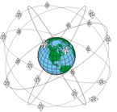
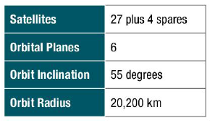
GNSS Constellation
GPS Constellation
An Introduction to GNSS: GPS, GLONASS, BeiDou, Galileo and other Global Navigation Satellite Systems

Slide 10
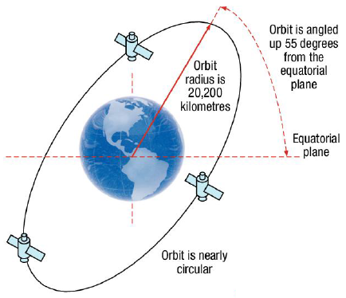
GPS Constellation
Each inclined at nominally 55° to the equator
Separated by 60° of longitude
Each plane contains at least 4 satellites
This constellation provides 5-14 GPS satellites are visible at most times
An Introduction to GNSS: GPS, GLONASS, BeiDou, Galileo and other Global Navigation Satellite Systems

Slide 11
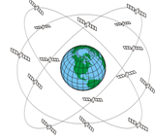
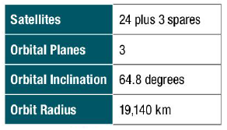
GNSS Constellation
GLONASS Constellation
An Introduction to GNSS: GPS, GLONASS, BeiDou, Galileo and other Global Navigation Satellite Systems

Slide 12
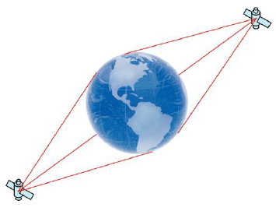
GLONASS Constellation
Each inclined at nominally 64.8° to the equator
Separated by 120° of longitude
Each plane will contain 9 satellites
An Introduction to GNSS: GPS, GLONASS, BeiDou, Galileo and other Global Navigation Satellite Systems

Slide 13
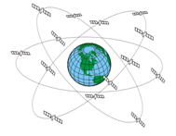
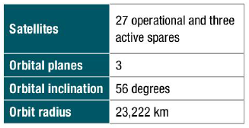
GNSS Constellation
GALILEO Constellation
An Introduction to GNSS: GPS, GLONASS, BeiDou, Galileo and other Global Navigation Satellite Systems

Slide 14
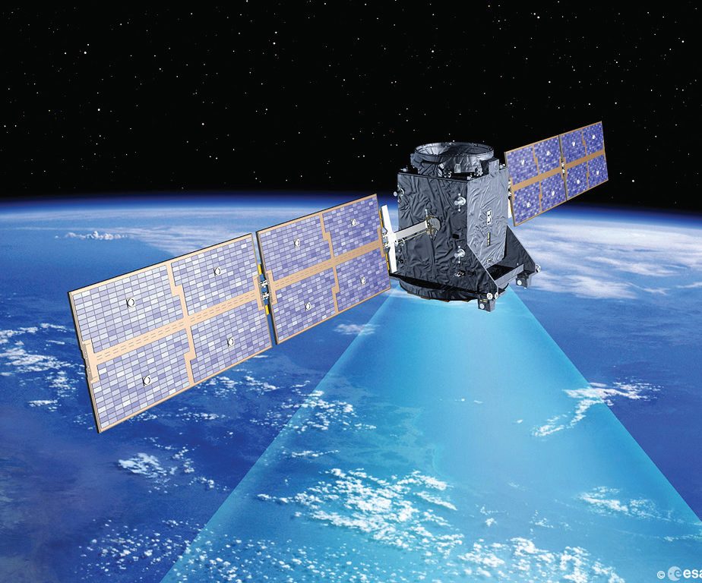
Galileo Constellation
Each inclined at nominally 56° to the equator
Separated by 120° of longitude
Each plane will contain 9 satellites
An Introduction to GNSS: GPS, GLONASS, BeiDou, Galileo and other Global Navigation Satellite Systems

Slide 15
Summary
You know now the main concepts and components of the GNSS system
You has been a tough about the GNSS constellations that have been implemented or are planned
You able now to distinguish between different GNSS systems and signals

Slide 16
Reference
An Introduction to GNSS: GPS, GLONASS, BeiDou, Galileo and other Global Navigation Satellite Systems
“Second Edition by NovAtel Inc.”

