Slide 1
GNSS Application
2nd Lecture
Civilian GNSS signals
By:
Dr. Ali Albu-Rghaif
Department of Computer Engineering
College of Engineering
University of Diyala

Slide 2
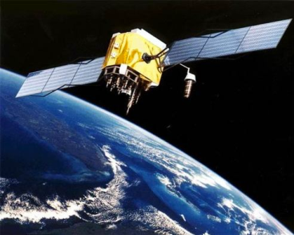
Outline
Civilian GNSS Signals
GPS Signals
GLONASS Signals
Galileo Signals
GPS Signal Modulation
GPS Signal Generation
GPS Signal Scheme
GPS Signal Receiving & De-Modulation
Acquiring
Tracking
De-Modulation

Slide 3
GNSS Civilian Signals
GPS Signal
Spreading sequences
L1-C/A Signal (BPSK - CDMA)
Modernized L1C Signal
Modernized L2C Signal
Modernized L5 Signal
Modulation
A Software-Defined GPS and Galileo Receiver A Single-Frequency Approach

Slide 4
GNSS Civilian Signals
GLONASS Signal
L1 Signal (BPSK - FDMA)
Modernized L1 Signal (CDMA)
Modernized L3 Signal (CDMA) centered at 1202.025 MHz
Modernized L5 Signal
A Software-Defined GPS and Galileo Receiver A Single-Frequency Approach

Slide 5
GNSS Civilian Signals
Galileo Signal
L1-OS Signal (BOC - CDMA)
E5-SOL Signal centered at 1207.14 MHz
A Software-Defined GPS and Galileo Receiver A Single-Frequency Approach

Slide 6
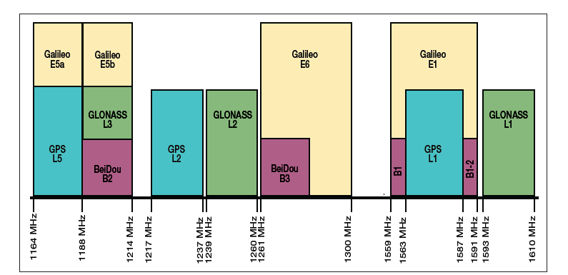
GNSS Frequencies
A Software-Defined GPS and Galileo Receiver A Single-Frequency Approach

Slide 7
GPS Signal Modulation
Signals and Data
The GPS signals are transmitted on two radio frequencies in the UHF band.
The UHF band covers the frequency band from 500MHz to 3GHz.
These frequencies are referred to as L1 and L2 and are derived from a common frequency, $f_{0}$ = 10.23MHz:
$f_{L1}$ = 154 $f_{0}$ = 1575.42 MHz
$f_{L2}$ = 120 $f_{0}$ = 1227.60 MHz
The signals are composed of the following three parts:
Carrier
Navigation data
Spreading sequence
A Software-Defined GPS and Galileo Receiver A Single-Frequency Approach

Slide 8
GPS Signal Modulation
Carrier:
The carrier wave with frequency $f_{L1}$ or $f_{L2}$
Navigation data
The navigation data contain information regarding satellite orbits.
This information is uploaded to all satellites from the ground stations in the GPS Control Segment.
The navigation data have a bit rate of 50bps the time of 1bit is 20ms
Spreading sequence
Each satellite has two unique spreading sequences or codes.
The first one is the coarse acquisition code (C/A), and the other one is the encrypted precision code (P(Y)).
The C/A code is a sequence of 1023 chips and repeated each ms
chipping rate of the C/A is 1.023 MHz.
A Software-Defined GPS and Galileo Receiver A Single-Frequency Approach

Slide 9
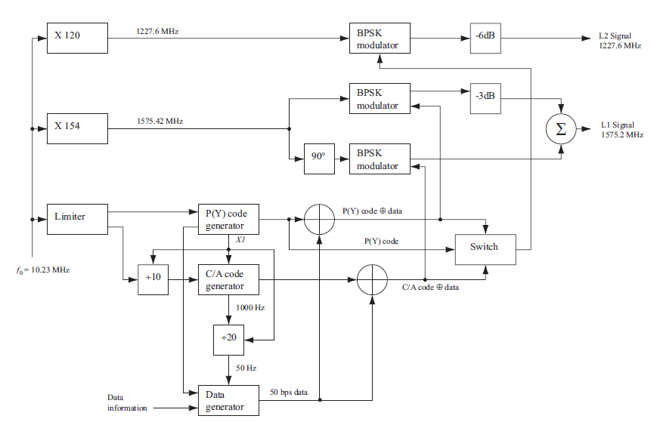
GPS Signal Modulation
A Software-Defined GPS and Galileo Receiver A Single-Frequency Approach

Slide 10
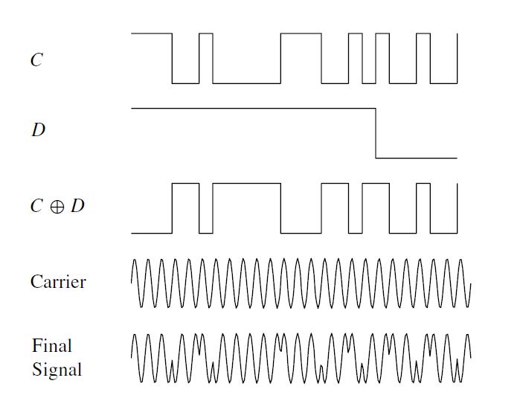
GPS Signal Modulation
BPSK Modulation
A Software-Defined GPS and Galileo Receiver A Single-Frequency Approach

Slide 11
GPS Signal Receiving & De-Modulation
Receiver Channels
The figure below illustrate one receiver channel. The acquisition gives rough estimates of signal parameters. These parameters are refined by the two tracking blocks. After tracking, the navigation data can be extracted and pseudoranges can be computed.
A Software-Defined GPS and Galileo Receiver A Single-Frequency Approach

Slide 12
GPS Signal Receiving & De-Modulation
Acquisition
The purpose of acquisition is to identify all satellites visible to the user. If a satellite is visible, the acquisition must determine the following two properties of the signal:
Frequency: The signals are affected by the relative motion of the satellite, causing a Doppler effect. The Doppler frequency shift can in the case of maximum velocity approach values 10 kHz. For a stationary receiver on Earth will never exceed 5 kHz.
Code Phase: The code phase denotes the point in the current data block where the C/A code begins. If a data block of 1 ms is examined, the data include an entire C/A code and thus one beginning of a C/A code.
A Software-Defined GPS and Galileo Receiver A Single-Frequency Approach

Slide 13
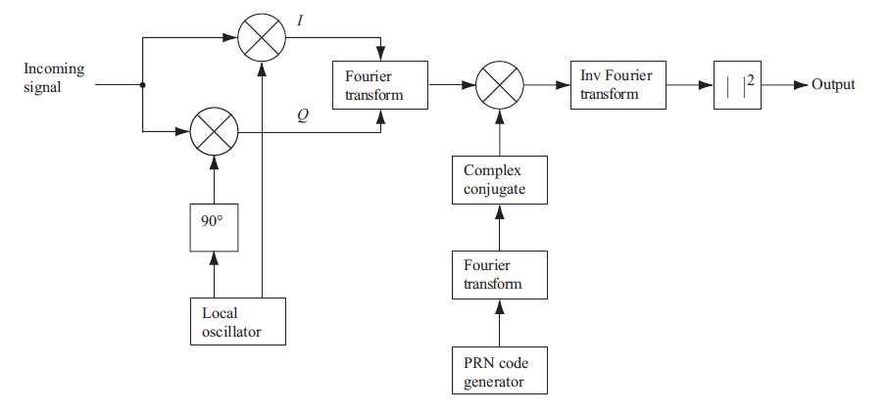
GPS Signal Receiving & De-Modulation
Parallel Code Phase Search Acquisition
A Software-Defined GPS and Galileo Receiver A Single-Frequency Approach

Slide 14
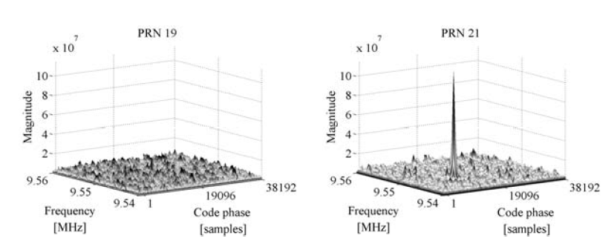
GPS Signal Receiving & De-Modulation
Parallel Code Phase Search Acquisition
A Software-Defined GPS and Galileo Receiver A Single-Frequency Approach

Slide 15
GPS Signal Receiving & De-Modulation
Tracking
The acquisition provides only rough estimates of the frequency and code phase parameters. The main purpose of tracking is to refine these values, keep track, and demodulate the navigation data from the specific satellite (and provide an estimate of the pseudorange)
A Software-Defined GPS and Galileo Receiver A Single-Frequency Approach

Slide 16
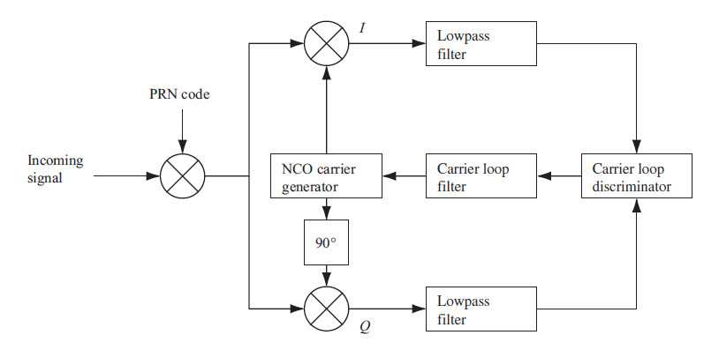
GPS Signal Receiving & De-Modulation
Carrier Tracking
A Software-Defined GPS and Galileo Receiver A Single-Frequency Approach

Slide 17
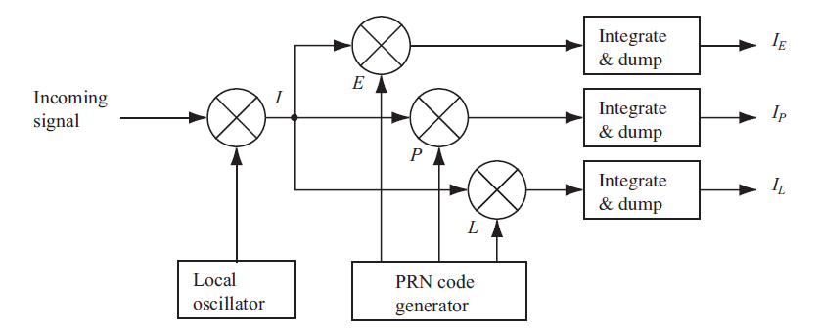
GPS Signal Receiving & De-Modulation
Code Tracking
A Software-Defined GPS and Galileo Receiver A Single-Frequency Approach

Slide 18
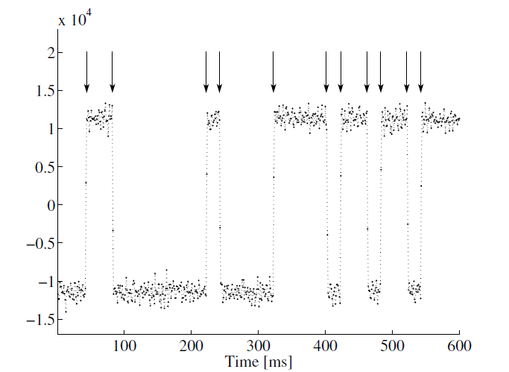
GPS Signal Receiving & De-Modulation
Navigation Data Decoding
The output from the tracking loop is the value of the in-phase arm of the tracking block truncated to the values 1 and −1. Theoretically we could obtain a bit value every ms.
A Software-Defined GPS and Galileo Receiver A Single-Frequency Approach

Slide 19
Summary
You be able to distinguish between different types of Civilian GNSS signals
The modulation of the GPS signal is illustrated and you know that the L1C/A code signal is based BPSK modulation
We have explained the demodulation process such as “Receiving, Acquiring, Tracking and Decoding”

Slide 20
Reference
A Software-Defined GPS and Galileo Receiver A Single-Frequency Approach
Birkhauser
Boston • Basel • Berlin
2007

