Slide 1
GNSS Application
4th Lecture
General GNSS Applications onboard Smartphones/Tablets- Part1
By:
Dr. Ali Albu-Rghaif
Department of Computer Engineering
College of Engineering
University of Diyala

Slide 2
Outline
Location Based Services
Location Based Services Applications
Outdoor/Indoor Environments
Non-Intrusive User Interfaces
Challenges

Slide 3
Location Based Services LBS
Location-based services are any service that takes into account the geographic location of an entity.
First, the term “entity” can be human or non-human, a non-human object that often needs to be tracked for logistical purposes.
Second, there are always at least two entities involved in a location-based service. In a generic geographic grid (such as longitude and latitude), entity A is always in relative position to entity B.
Location based services: ongoing evolution and research agenda

Slide 4
Location Based Services LBS
Third, each of the entities can be either static or moving. Static can imply two things: either they are truly static or they are only temporarily static.
Fourth, one of the entities, whether human or nonhuman, is always the object of LBS, that is, it is the entity about which location information is recorded. Moreover, one of the entities is always a recipient of the location information.
Location based services: ongoing evolution and research agenda

Slide 5
Location Based Services LBS
Location based services: ongoing evolution and research agenda

Slide 6
Location-Tracking Services vs. Position-Aware Services
Location-tracking services provide information about a user’s whereabouts to entities other than the user.
while location-aware services supply the user (the information requester) with personal location data.
Location based services: ongoing evolution and research agenda

Slide 7
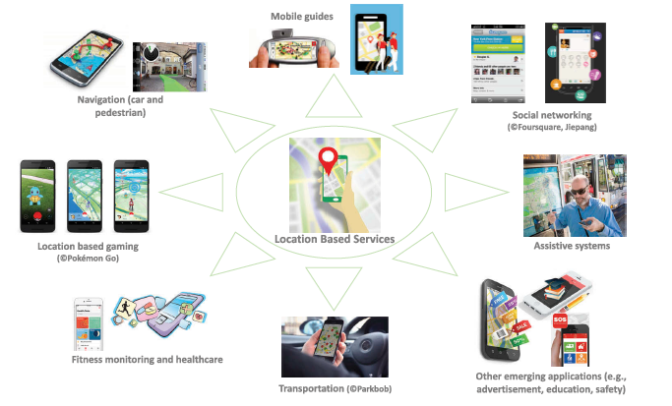
Location Based Services Applications
Location based services: ongoing evolution and research agenda

Slide 8
Location Based Services Applications
Location based social networks (LBSN)
The increasing availability of location-aware technology (e.g. GPS) enables people to add a location dimension to existing online social networks in various ways, e.g. uploading geotagged contents (e.g. photos, videos, and recorded routes), sharing the present location (e.g. Facebook, Google), commenting on an event at the place where it is happening (e.g. via Twitter), or leaving ratings/tips/reviews for a location (e.g. a restaurant)
Location based services: ongoing evolution and research agenda

Slide 9
Location Based Services Applications
Location based gaming (LBG)
Typically, LBG maps real-world environments into a virtual world, where players must move in real life to explore the virtual world and accomplish tasks related to the game itself. The maps, tasks, and other contents presented on the mobile devices are adapted to the location of the player. According to the game objectives, players may collect virtual objects, such as weapons, ammunition, or treasures.
Location based services: ongoing evolution and research agenda

Slide 10
Location Based Services Applications
Location based fitness monitoring and healthcare
Another rapidly growing group of LBS applications focuses on healthcare, particularly on outdoor exercise and fitness monitoring (e.g. Running app and Moves), remote health monitoring supporting dementia patients and their caregivers in wandering events, and emergency situation detecting and reporting (e.g. fall detection).
Location based services: ongoing evolution and research agenda

Slide 11
Location Based Services Applications
Transport LBS
By tradition, transport has been one of the main application fields of LBS. Applications include those for driver assistance, passenger information, and vehicle management. Car navigation systems are probably the most popular LBS applications, which provide wayfinding assistance for drivers, and are still being improved with new features, such as real-time traffic information. For example, crowdsources traffic and road information to provide drivers with real-time navigation supports. LBS and tracking techniques have now been extensively used for vehicle management and logistic tracking.
Location based services: ongoing evolution and research agenda

Slide 12
Location Based Services Applications
Location based assistive technology
LBS are also being used as assistive technology to enable visually impaired people, and disabled and elderly people to perform their daily living activities independently and to experience an improved quality of life. These assistive systems provide assisted-living functions, such as personalized navigation and wayfinding, obstacle detection, space perception, and independent shopping. With the increasingly ageing population, one can expect that more and more location-based assistive systems will be developed and employed in the future.
Location based services: ongoing evolution and research agenda

Slide 13
Outdoor to Indoor and Mixed Outdoor/Indoor Environments
In the early 2000s, research on LBS had been mainly focused on outdoor environments, also due to the lack of reliable indoor positioning methods. In recent years, LBS have become more and more popular not only in outdoor environments, but also in shopping malls, museums, airports, many other indoor environments, and even mixed outdoor/indoor environments.
Different location sensor technologies have been developed and tested for estimating the location of a smartphone in indoor environments, such as Wi-Fi, RFID and Bluetooth
Location based services: ongoing evolution and research agenda

Slide 14
Non-Intrusive User Interfaces
Early LBS applications mainly communicated information to the users via visual (e.g. maps) and auditory (e.g. verbal instructions) interfaces on smartphones. Recent years have seen rapid advances towards more ‘natural’ and non-intrusive user interfaces for LBS, particularly on the aspects of representation forms (e.g. visual, auditory, and tactile), interface technologies and devices (e.g. smartphones and smartwatches), and interaction modality (e.g. touch, gesture, and gaze-based).
Location based services: ongoing evolution and research agenda

Slide 15
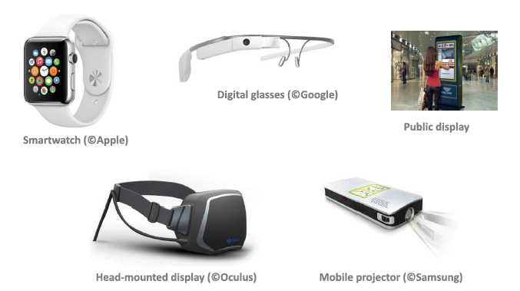
Non-Intrusive User Interfaces
Emerging interface technologies in LBS
Location based services: ongoing evolution and research agenda

Slide 16
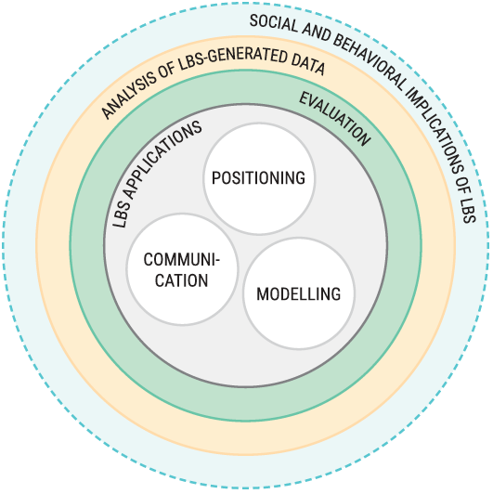
Developer/Researcher Challenges
The challenges can be classified into seven broad areas :
Positioning
Modelling
Communication
Evaluation
Applications
Analysis of LBS-generated data
Social and Behavioral Implications of LBS.
Location based services: ongoing evolution and research agenda

Slide 17
Summary
As mobile devices and communication technologies seem to continuously be improved at a very fast speed, as well as the increasing smartness of our environments and cities (e.g. with different kinds of sensors), leads to expect the demand of LBS in different aspects of our daily life will continue to be very strong, which will push LBS towards the 4A vision (anytime, anywhere, for anyone and anything).

Slide 18
Reference
Location based services: ongoing evolution and research agenda

