Slide 1
GNSS Application
5th Lecture
General GNSS Applications onboard Smartphones/Tablets- Part2
By:
Dr. Ali Albu-Rghaif
Department of Computer Engineering
College of Engineering
University of Diyala

Slide 2
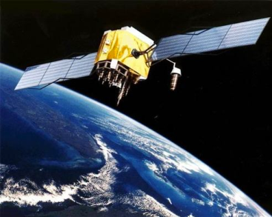
Outline
Current GNSS Applications
Aviation Application
Automotive Application
Marine Application
Geodesy and Surveying
Agriculture, Forestry, and Natural Resource Exploration
Aerial Photogrammetry & Mapping
Space Application
Scientific Application
DGNSS, A-GNSS & GNSS/INS
Qualitative Comparison of Performance Enhancement

Slide 3
Current GNSS Applications
Currently, GPS is the GNSS primarily used by both military and civilian users. However, future users will have several additional GNSS options at their disposal as new systems come online. These GNSS signals, which, in many cases, are free and globally available, will be used to advance applications that were pioneered using GPS. Regardless of the GNSS used, in this lecture are grouped applications of GNSS into the following categories:
GNSS Applications and Methods

Slide 4
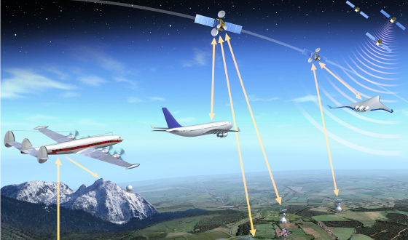
Current GNSS Applications
Aviation Application
This includes en-route navigation as well as the precision approach and landing applications, which demand a very high level of performance in terms of accuracy and robustness.
GNSS Applications and Methods

Slide 5
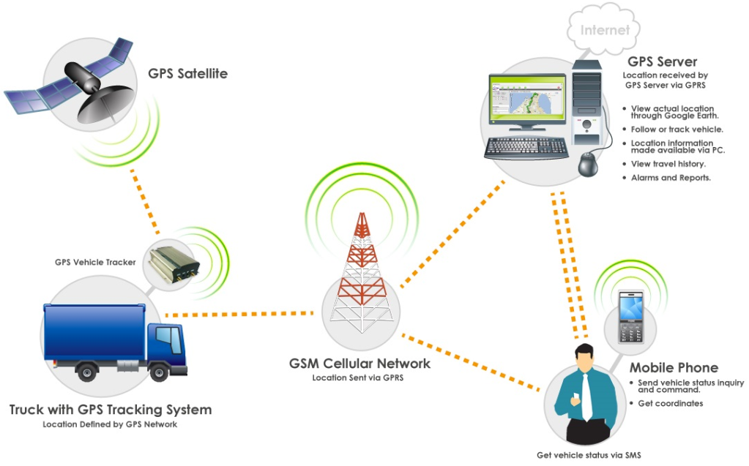
Current GNSS Applications
Automotive Application
GNSS-based systems have enabled the development of many automotive applications that enhance ease of operation. The simplest and most widely used systems provide drivers with instructions to get from departure point
to destination with a minimum of detours. There are, however, more sophisticated GNSS based applications that can enhance the safety of automotive operations.
GNSS Applications and Methods

Slide 6
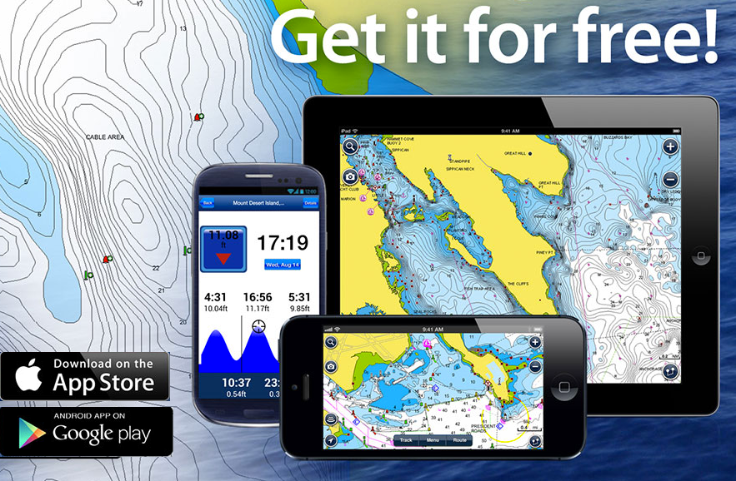
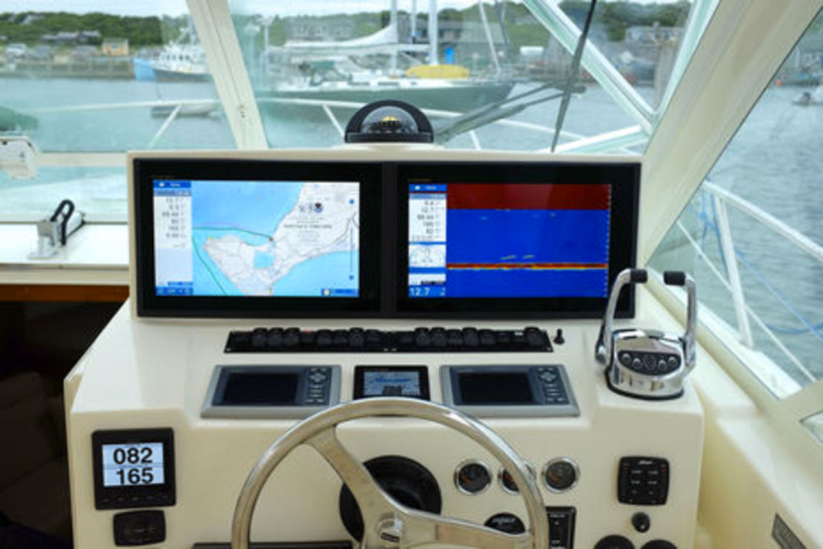
Current GNSS Applications
Marine Application
This is one of the original civil applications for GPS, and GPS is well-suited to this use. This is because of the clear views of the sky and modest accuracy requirements of most maritime applications. GPS receivers have
become standard equipment on boats of all sizes today.
GNSS Applications and Methods

Slide 7
Current GNSS Applications
Geodesy and Surveying
his application is perhaps the best example of the direct benefits that have resulted from the public availability of GPS signals.
Geodesy applications require precision positioning information at the centimeter or millimeter level and include applications such as the monitoring of the movements of the Earth’s crustal plates or ice shelves, often involving extensive post-processing.
Similarly, GNSS surveying has become widespread and generally has more relaxed accuracy requirements.
GNSS Applications and Methods

Slide 8
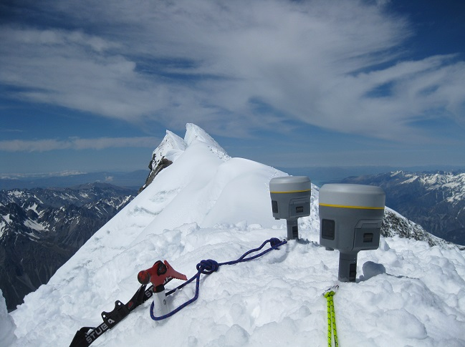
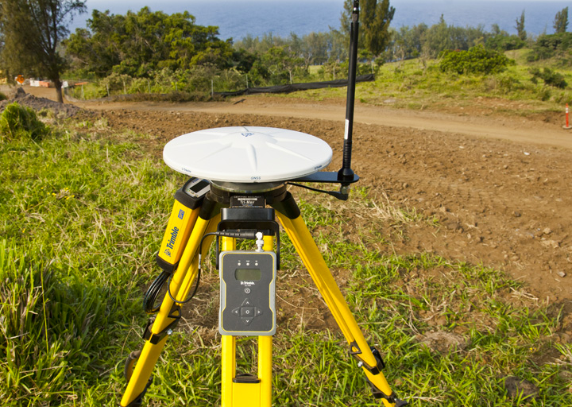
Current GNSS Applications
Geodesy and Surveying
GNSS Applications and Methods

Slide 9
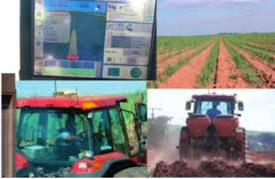
Current GNSS Applications
Agriculture, Forestry, and Natural Resource Exploration
These diverse applications include geological monitoring, forest management, mining, and oil exploration. These applications often combine
GNSS field measurements with geographic information system tools to produce accurate regional maps for resource monitoring and management.
GNSS Applications and Methods

Slide 10
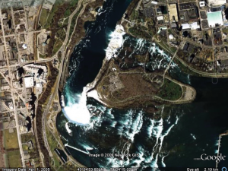
Current GNSS Applications
Aerial Photogrammetry & Mapping
Aircraft or spacecraft are used to photograph large areas of the Earth’s surface. This technology has been developed using GPS augmented by accurate INS. The generation of road maps, or any other kind of feature
map, is now extremely easy, achieved simply by recording a series of positions as a receiver is moved over the area to be mapped.
GNSS Applications and Methods

Slide 11
Current GNSS Applications
Space Application
GPS receivers have proven to be a very valuable tool on board Earth-orbiting satellites. They have been principally used in low Earth orbit (LEO) satellites, but their use is currently expanding into space vehicles operating at higher altitudes. In space applications, GPS has the potential to be used as an attitude determination sensor.
Scientific Application
In addition to geodesy and surveying there have been attempts to use GPS in a number of scientific research fields. These include using GPS signals for remote sensing of the environment and space weather studies.
GNSS Applications and Methods

Slide 12
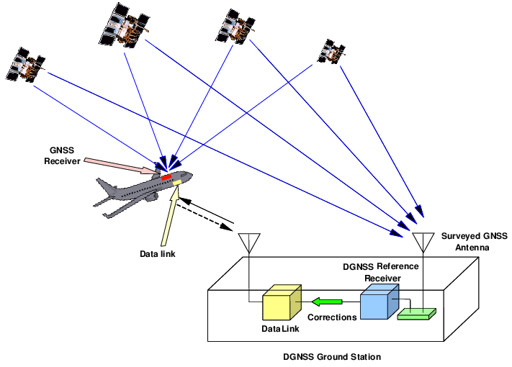
DGNSS, A-GNSS & GNSS/INS
Differential GNSS (DGNSS)
In standard DGNSS implementations, the reference receiver and antenna are in fixed locations. The location of the reference receiver antenna is
carefully established in advance by GPS surveying techniques to within
1–2 cm, so that any errors in the estimated location of the antenna are negligible compared to the DGNSS errors.
GNSS Applications and Methods

Slide 13
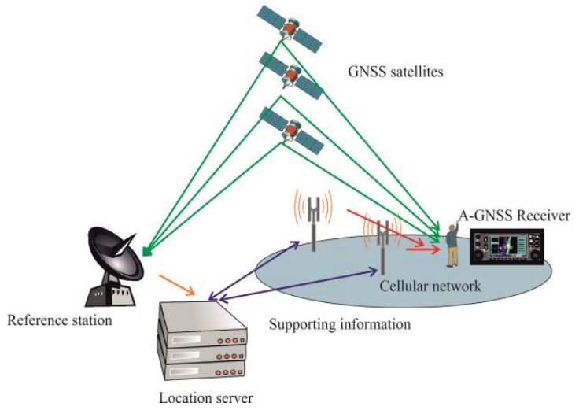
DGNSS, A-GNSS & GNSS/INS
Assisted GNSS (A-GNSS)
A-GNSS is sending assistance data from a server via the radio network a device is able to perform a “hot start” and acquire a position fix within
seconds rather than the lengthy
time-to-fix-first usually required
with a cold start under normal situations. Moreover, A-GNSS also helps in increasing the sensitivity of the receiver and in acquiring signals within buildings.
GNSS Applications and Methods

Slide 14
DGNSS, A-GNSS & GNSS/INS
GNSS/INS
A GNSS + INS (Inertial Navigation System) provides cm-level reliable positions together with attitude angles (heading, roll and pitch) showing the object’s global 3D orientation and movement. This system is specifically designed to be robust in challenging environments and provides continuous positioning even during short GNSS outages. To enable inertial functionality a GNSS receiver is integrated together with an industry leading IMU (Inertial Measurement Unit).
At the heart of an INS system is an IMU device which measures rotation and acceleration by using gyroscopes and accelerometers.
GNSS Applications and Methods

Slide 15
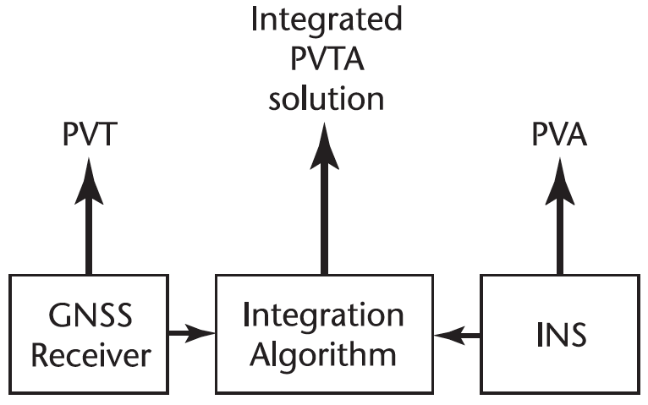
DGNSS, A-GNSS & GNSS/INS
GNSS/INS
GNSS Applications and Methods

Slide 16
Qualitative Comparison of Performance Enhancement
 | Accuracy | Availability | Integrity | Coverage
DGNSS | Increased | Increased | Increased | Same
A-GNSS | Same | Increased | N/A | Increased
GNSS/INS | Same/Increased | Increased | Same/Increased | Same/Increased

Slide 17
Reference
GNSS Applications and Methods
Scott Gleason
Demoz Gebre-Egziabher

