Slide 1
Chapter 2 – Software Processes
Lecture 2

Slide 2
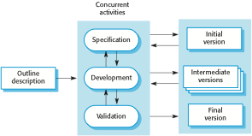
Incremental development

Slide 3
Incremental development benefits
The cost of accommodating changing customer requirements is reduced.
The amount of analysis and documentation that has to be redone is much less than is required with the waterfall model.
It is easier to get customer feedback on the development work that has been done.
Customers can comment on demonstrations of the software and see how much has been implemented.
More rapid delivery and deployment of useful software to the customer is possible.
Customers are able to use and gain value from the software earlier than is possible with a waterfall process.

Slide 4
Incremental development problems
The process is not visible.
Managers need regular deliverables to measure progress. If systems are developed quickly, it is not cost-effective to produce documents that reflect every version of the system.
System structure tends to degrade as new increments are added.
Unless time and money is spent on refactoring to improve the software, regular change tends to corrupt its structure. Incorporating further software changes becomes increasingly difficult and costly.

Slide 5
Reuse-oriented software engineering
Based on systematic reuse where systems are integrated from existing components or COTS (Commercial-off-the-shelf) systems.
Process stages
Component analysis;
Requirements modification;
System design with reuse;
Development and integration.
Reuse is now the standard approach for building many types of business system
Reuse covered in more depth in Chapter 16.

Slide 6
Reuse-oriented software engineering

Slide 7
Types of software component
Web services that are developed according to service standards and which are available for remote invocation.
Collections of objects that are developed as a package to be integrated with a component framework such as .NET or J2EE.
Stand-alone software systems (COTS) that are configured for use in a particular environment.

Slide 8
Process activities
Real software processes are inter-leaved sequences of technical, collaborative and managerial activities with the overall goal of specifying, designing, implementing and testing a software system.
The four basic process activities of specification, development, validation and evolution are organized differently in different development processes. In the waterfall model, they are organized in sequence, whereas in incremental development they are inter-leaved.

Slide 9
Software specification
The process of establishing what services are required and the constraints on the system’s operation and development.
Requirements engineering process
Feasibility study
Is it technically and financially feasible to build the system?
Requirements elicitation and analysis
What do the system stakeholders require or expect from the system?
Requirements specification
Defining the requirements in detail
Requirements validation
Checking the validity of the requirements

Slide 10
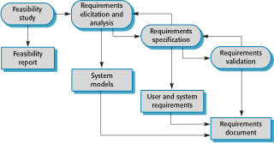
The requirements engineering process

