Slide 1
Chapter 2 – Software Processes
Lecture 3

Slide 2
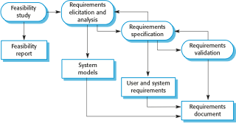
The requirements engineering process

Slide 3
Software design and implementation
The process of converting the system specification into an executable system.
Software design
Design a software structure that realises the specification;
Implementation
Translate this structure into an executable program;
The activities of design and implementation are closely related and may be inter-leaved.

Slide 4
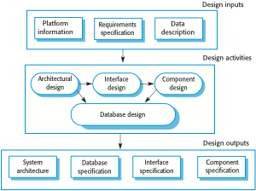
A general model of the design process

Slide 5
Design activities
Architectural design, where you identify the overall structure of the system, the principal components (sometimes called sub-systems or modules), their relationships and how they are distributed.
Interface design, where you define the interfaces between system components.
Component design, where you take each system component and design how it will operate.
Database design, where you design the system data structures and how these are to be represented in a database.

Slide 6
Software validation
Verification and validation (V & V) is intended to show that a system conforms to its specification and meets the requirements of the system customer.
Involves checking and review processes and system testing.
System testing involves executing the system with test cases that are derived from the specification of the real data to be processed by the system.
Testing is the most commonly used V & V activity.

Slide 7
Stages of testing

Slide 8
Testing stages
Development or component testing
Individual components are tested independently;
Components may be functions or objects or coherent groupings of these entities.
System testing
Testing of the system as a whole. Testing of emergent properties is particularly important.
Acceptance testing
Testing with customer data to check that the system meets the customer’s needs.

Slide 9
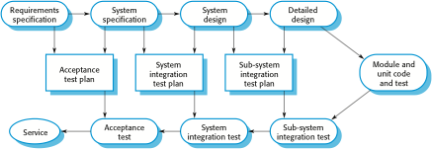
Testing phases in a plan-driven software process

Slide 10
Software evolution
Software is inherently flexible and can change.
As requirements change through changing business circumstances, the software that supports the business must also evolve and change.
Although there has been a demarcation between development and evolution (maintenance) this is increasingly irrelevant as fewer and fewer systems are completely new.

Slide 11
System evolution

Slide 12
Key points
Software processes are the activities involved in producing a software system. Software process models are abstract representations of these processes.
General process models describe the organization of software processes. Examples of these general models include the ‘waterfall’ model, incremental development, and reuse-oriented development.

Slide 13
Key points
Requirements engineering is the process of developing a software specification.
Design and implementation processes are concerned with transforming a requirements specification into an executable software system.
Software validation is the process of checking that the system conforms to its specification and that it meets the real needs of the users of the system.
Software evolution takes place when you change existing software systems to meet new requirements. The software must evolve to remain useful.

