Slide 1
محاضرة بمادة التقنيات الرقمية
م. د حسين فالح مهدي
جامعة ديالى
كلية الهندسة –قسم هندسة الحاسوب
2022-2023
Karnaugh map -1

Slide 2
Karnaugh Map Method
Systematic method to obtain simplified Boolean expressions so reduce logic gates .
No zeros allowed in SOP
No ones allowed in POS .
No diagonals.
Only power of 2 number of cells in each group1,2,4,8,16...etc.
Groups should be as large as possible.
Every one must be in at least one group.
Overlapping allowed.
Wrap around allowed.
Fewest number of groups possible..

Slide 3
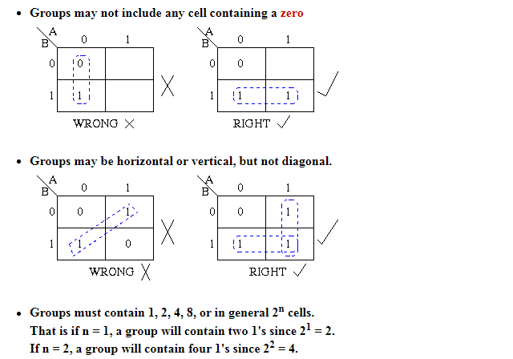

Slide 4
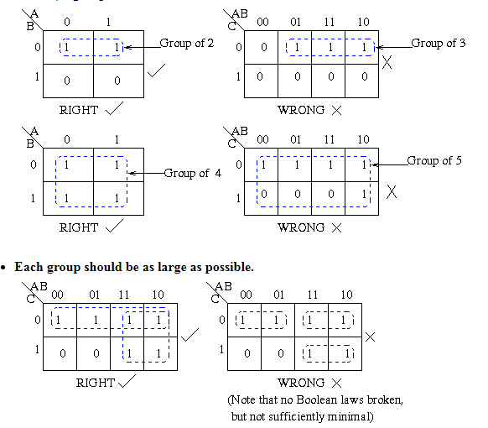
exdZ

Slide 5
Simplification Using K-maps
Other possible valid groupings of a 4-variable K-map include:
1
1
1
1
1
1
1
1
1
1
1
1
1
1
1
1
1
1
1
1
P
P
P

Slide 6
Simplification Using K-maps
Groups of minterms must be
(1) rectangular, and
(2) have size in powers of 2’s.
Otherwise they are invalid groups. Some examples of invalid groups:
1
1
1
1
1
1
1
1
1
1
1
1
1
1
1
1
O
O

Slide 7
Simplest SOP Expressions
A prime implicant is a product term obtained by combining the maximum possible number of minterms from adjacent squares in the map.
1
1
1
1
1
1
1
1
1
O
1
1
1
P

Slide 8
Simplest SOP Expressions
No redundant groups:.
1
1
1
1
1
1
O
1
1
P
1
1
1
1
1
1
1
1
Essential prime implicants

Slide 9
2-variable K-maps
Equivalent labeling:
A
B
0 1
equivalent to:
0
1
B
A
1 0
0
1

Slide 10
The 3 Variable K-Map
There are 8 cells as shown:
C AB | 0 | 1
00
01
11
10

Slide 11
K-maps for four and five variables

Slide 12
Mapping a Standard SOP Expression (full example)
The expression:
C AB | 0 | 1
00
01
11
10
000
001
110
100
1
1
Practice:
1
1

Slide 13
Mapping Directly from a Truth Table
I/P |  |  | O/P
A | B | C | X
0 | 0 | 0 | 1
0 | 0 | 1 | 0
0 | 1 | 0 | 0
0 | 1 | 1 | 0
1 | 0 | 0 | 1
1 | 0 | 1 | 0
1 | 1 | 0 | 1
1 | 1 | 1 | 1
C AB | 0 | 1
00
01
11
10
1
1
1
1

Slide 14
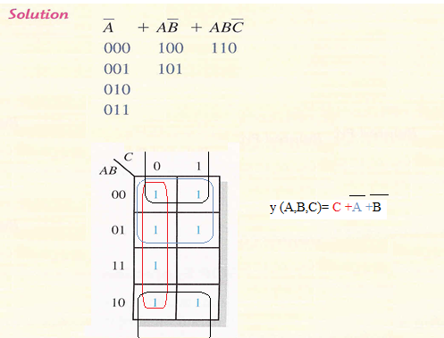

Slide 15
Example /
f(A,B,C) = ∑m(1,2,3,6)
001,010,011,110
f(A,B,C) = $\overline{A}$C + B$\overline{C}$

Slide 16
Quick Review Questions (1)
5-1. The K-map of a 3-variable function
F (A,B,C)= $\overline{A}\overline{B}\overline{C}$ + $\overline{A}B\overline{C}$+A$\overline{B}C$is shown below.
F (A,B,C)= $\overline{A}\overline{C}$ +A$\overline{B}C$
b
BC
A
00 01 11 10
0
1
1
0
0
1
a
0
1
0
0
c

Slide 17
Determining the Minimum SOP Expression from the Map (exercises)
C AB | 0 | 1
00 | 1
01 |  | 1
11 | 1 | 1
10
C AB | 0 | 1
00 | 1 | 1
01 | 1
11 |  | 1
10 | 1 | 1

