Slide 1
محاضرة بمادة التقنيات الرقمية
م. د حسين فالح مهدي
جامعة ديالى
كلية الهندسة –قسم هندسة الحاسوب
2022-2023
LOGIC GATES

Slide 2
Logic gates
- Gate
A device that performs a basic operation on electrical signals.
- Circuits
Gates combined to perform more complicated tasks.

Slide 3
How do we describe the behavior of gates and circuits?
Boolean expressions
Uses Boolean algebra, a mathematical notation for expressing two-valued logic
Logic diagrams
A graphical representation of a circuit; each gate has its
own symbol
Truth tables
A table showing all possible input value and the associated
output values

Slide 4
Gates
Seven types of gates
NOT
AND
OR
XOR
XNOR
NAND
NOR
Typically, logic diagrams are black and white with gates distinguished only by their shape
We use color for emphasis (and fun)

Slide 5
NOT Gate
A NOT gate accepts one input signal (0 or 1) and returns the opposite signal as output

Slide 6
A
X
The Inverter
Example waveforms:
A
X
A group of inverters can be used to form the 1’s complement of a binary number:
Binary number
1 0 0 0 1 1 0 1
0 1 1 1 0 0 1 0
1’s complement

Slide 7
AND Gate
An AND gate accepts two input signals
If both are 1, the output is 1; otherwise,
the output is 0
Figure 4.2 Various representations of an AND gate

Slide 8
A
A
The AND Gate
X
X
B
B
Example waveforms:
A
B
X
The AND operation is used in computer programming as a selective mask. If you want to retain certain bits of a binary number but reset the other bits to 0, you could set a mask with 1’s in the position of the retained bits.

Slide 9
OR Gate
An OR gate accepts two input signals
If both are 0, the output is 0; otherwise,
the output is 1
Figure 4.3 Various representations of a OR gate

Slide 10
The OR Gate
A
X
A
X
B
B
Example waveforms:
A
B
X
The OR operation can be used in computer programming to set certain bits of a binary number to 1.

Slide 11
NAND Gate
The NAND gate accepts two input signals
If both are 1, the output is 0; otherwise,
the output is 1
Figure 4.5 Various representations of a NAND gate

Slide 12
A
X
A
X
The NAND Gate
B
B
Example waveforms:
A
B
X
The NAND gate is particularly useful because it is a “universal” gate – all other basic gates can be constructed from NAND gates.
Question
How would you connect a 2-input NAND gate to form a basic inverter?

Slide 13
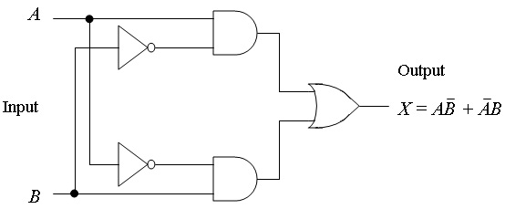
NOR Gate
The NOR gate accepts two input signals
If both are 0, the output is 1; otherwise,
the output is 0
Figure 4.6 Various representations of a NOR gate

Slide 14
The NOR Gate
A
X
A
X
B
B
Example waveforms:
A
B
X
The NOR operation will produce a LOW if any input is HIGH.

Slide 15
The XOR Gate
A
X
A
X
B
B
The XOR gate produces a HIGH output only when both inputs are at opposite logic levels. The truth table is
0 0
0 1
1 0
1 1
0
1
1
0
The XOR operation is written as X = AB + AB. Alternatively, it can be written with a circled plus sign between the variables as X = A + B.

Slide 16
The XOR Gate
A
X
A
X
B
B
Example waveforms:
A
B
X
Notice that the XOR gate will produce a HIGH only when exactly one input is HIGH.
Question
If the A and B waveforms are both inverted for the above waveforms, how is the output affected?
There is no change in the output.

Slide 17
The XNOR Gate
A
X
A
X
B
B
The XNOR gate produces a HIGH output only when both inputs are at the same logic level. The truth table is
0 0
0 1
1 0
1 1
1
0
0
1
The XNOR operation shown as X = AB + AB. Alternatively, the XNOR operation can be shown with a circled dot between the variables. Thus, it can be shown as X = A . B.

Slide 18
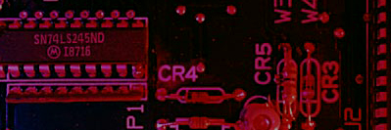
Summary
The XNOR Gate
A
X
A
X
B
B
Example waveforms:
A
B
X
Notice that the XNOR gate will produce a HIGH when both inputs are the same. This makes it useful for comparison functions.
Question
If the A waveform is inverted but B remains the same, how is the output affected?
The output will be inverted.

Slide 19
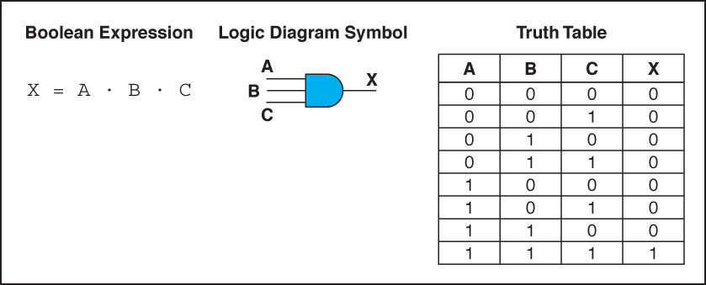
Gates with More Inputs
Gates can be designed to accept three or more input values
A three-input AND gate, for example, produces an output of 1 only if all input values are 1
Figure 4.7 Various representations of a three-input AND gate

Slide 20
Thank you

