Slide 1
محاضرة بمادة التقنيات الرقمية
م. د حسين فالح مهدي
جامعة ديالى
كلية الهندسة –قسم هندسة الحاسوب
2022-2023
Boolean Algebra and Simplification Techniques

Slide 2
Boolean Algebra and Simplification Techniques
Boolean algebra is mathematics of logic. It is one of the most basic tools available to the logic designer and thus can be effectively used for simplification of complex logic expressions. Other useful and widely used techniques based on Boolean theorems include the use of Karnaugh maps in what is known as the mapping method of logic simplification.

Slide 3
Theorems of Boolean Algebra
Theorem 1 (Operations with ‘0’ and ‘1’):
(a) 0.X = 0
(b) 1+X = 1
Theorem 2 (Operations with ‘0’ and ‘1’):
(a) 1.X = X
(b) 0+X = X
Theorem 3 (Idempotent or Identity Laws):
X.X.X… .……… .X = X
X+X+X +··· +X = X
Theorem 4 (Complementation Law):
(a) $\overline{X}$X = 0
(b) X+$\overline{X}$ = 1

Slide 4
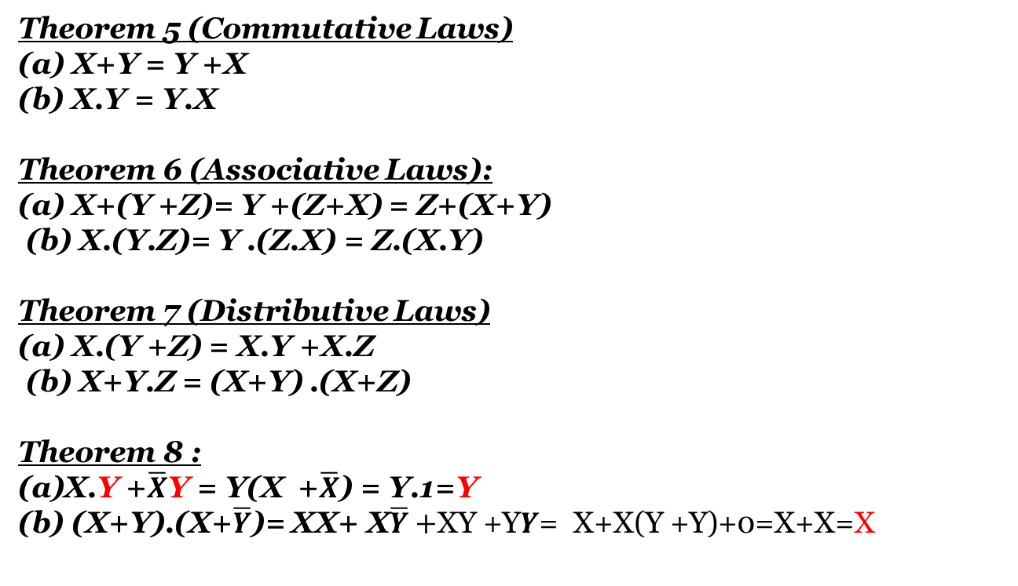
Theorems of Boolean Algebra
Theorem 5 (Commutative Laws)
(a) X+Y = Y +X
(b) X.Y = Y.X
Theorem 6 (Associative Laws):
(a) X+(Y +Z)= Y +(Z+X) = Z+(X+Y)
(b) X.(Y.Z)= Y .(Z.X) = Z.(X.Y)
Theorem 7 (Distributive Laws)
(a) X.(Y +Z) = X.Y +X.Z
(b) X+Y.Z = (X+Y) .(X+Z)
Theorem 8 :
X.Y +$\overline{X}$Y = Y(X +$\overline{X}$) = Y.1=Y
(X+Y).(X+$\overline{Y}$)= XX+ X$\overline{Y}+$XY +Y$Y$= X+X(Y +Y)+0=X+X=X

Slide 5
Theorems of Boolean Algebra
Theorem 9 :
A) (X+$\overline{Y}$ ).Y = X .Y
B)X.$\overline{Y}$ +Y = X+Y
[ X.$\overline{Y}$+Y(1+X) ]= X.$\overline{Y}$ +Y +XY = X($\overline{Y}$ + Y)+Y ]= X+Y
Theorem 10 (Absorption Law or Redundancy Law) :
X+X.Y = X
X.(X+Y) = X
Theorem 11:
(a) Z.X+ Z.$\overline{X}$.Y = Z.X+Z.Y
(b) (Z+X) . (Z+$\overline{X}$+Y) = (Z+X ).(Z+Y)
Theorem 12 (Consensus Theorem):
(a) X.Y + $\overline{X}$.Z +Y.Z = X.Y +X.$\overline{Z}$
(b) (X+Y).($\overline{X}$+Z).(Y +Z) = (X+Y).($\overline{X}$+Z)

Slide 6
Theorems of Boolean Algebra
Theorem 13 (DeMorgan’s Theorem):
(a) $\overline{(X1+X2 +X3+………… + Xn )}$= $\overline{X1}$.$\overline{X2}$.$\overline{X3}$……………………..$\overline{Xn}$
(b) $\overline{(X1.X2.X3.X4………………..Xn) }$ =$\overline{X1}$+$\overline{X2}$ +$\overline{X3}$………………….+$\overline{Xn}$
Theorem 14 (Transposition Theorem):
(a) X.Y + $\overline{X}$.Z = (X+Z) . ($\overline{X}$+Y)
(b) (X+Y).( $\overline{X}$+Z) = X.Z+ $\overline{X}$Y
Theorem 15 (Involution Law) :
X = $\overset{̿}{X}$

Slide 7
Rules of Boolean Algebra
which states that (A + B)(A + C) = A + BC, can be proven by applying earlier rules as follows:
(A + B)(A + C) = AA + AC + AB + BC
= A + AC + AB + BC
= A(1 + C + B) + BC
= A . 1 + BC
= A + BC
This rule is a little more complicated, but it can also be shown with a Venn diagram, as given on the following slide…

Slide 8
DeMorgan’s Theorem
DeMorgan’s 1st Theorem
The complement of a product of variables is equal to the sum of the complemented variables.
AB = A + B
Applying DeMorgan’s first theorem to gates:

Slide 9
DeMorgan’s Theorem
DeMorgan’s 2nd Theorem
The complement of a sum of variables is equal to the product of the complemented variables.
A + B = A . B
Applying DeMorgan’s second theorem to gates:

Slide 10
DeMorgan’s Theorem
Example
Apply DeMorgan’s theorem to remove the overbar covering both terms from the
expression X = C + D.
Solution
To apply DeMorgan’s theorem to the expression, you can break the overbar covering both terms and change the sign between the terms. This results in
X = C . D. Deleting the double bar gives X = C . D.
=

Slide 11
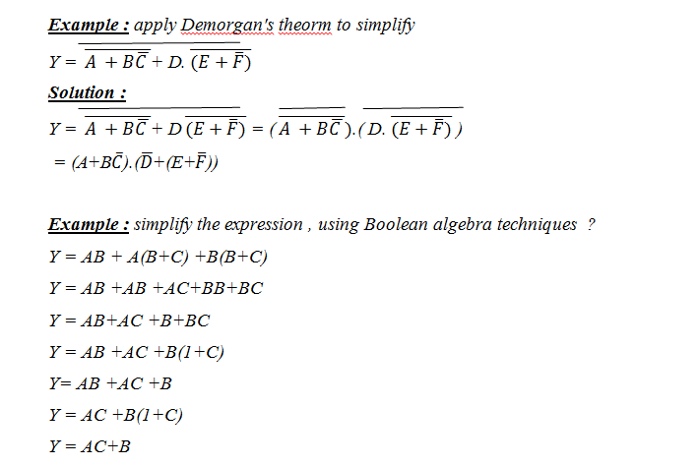

Slide 12
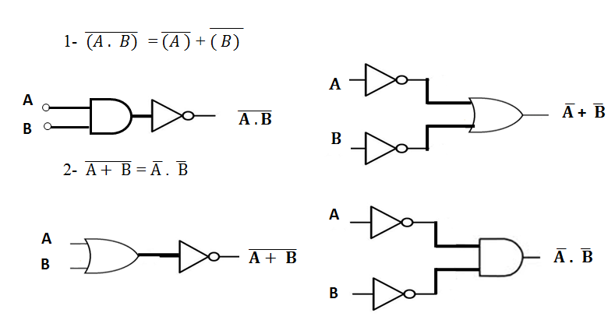

Slide 13
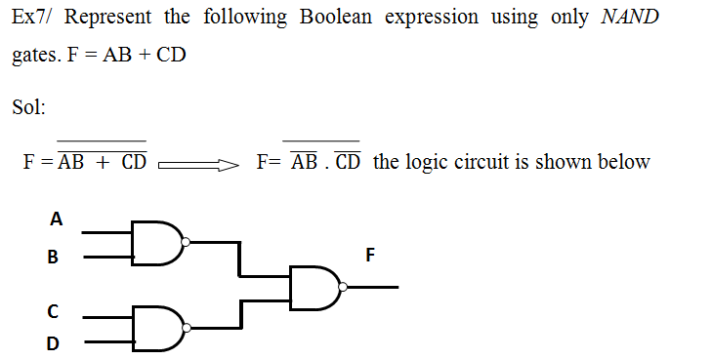

Slide 15
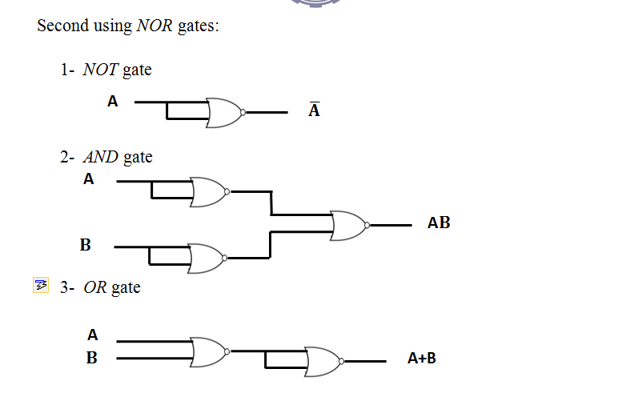

Slide 16
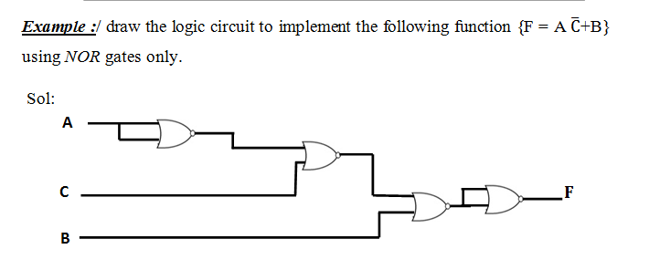

Slide 17
Boolean Analysis of Logic Circuits
Combinational logic circuits can be analyzed by writing the expression for each gate and combining the expressions according to the rules for Boolean algebra.
Example
Apply Boolean algebra to derive the expression for X.
Solution
Write the expression for each gate:
(A + B )
C (A + B )
= C (A + B )+ D
X
Applying DeMorgan’s theorem and the distribution law:
X = C (A B) + D = A B C + D

Slide 18
SOP and POS forms
Boolean expressions can be written in the sum-of-products form (SOP) or in the product-of-sums form (POS). These forms can simplify the implementation of combinational logic, particularly with PLDs. In both forms, an overbar cannot extend over more than one variable.
An expression is in SOP form when two or more product terms are summed as in the following examples:
A B C + A B A B C + C D C D + E
An expression is in POS form when two or more sum terms are multiplied as in the following examples:
(A + B)(A + C) (A + B + C)(B + D) (A + B)C

Slide 19
SOP Standard form
In SOP standard form, every variable in the domain must appear in each term. This form is useful for constructing truth tables or for implementing logic in PLDs.
You can expand a nonstandard term to standard form by multiplying the term by a term consisting of the sum of the missing variable and its complement.
Example
Convert X = A B + A B C to standard form.
Solution
The first term does not include the variable C. Therefore, multiply it by the (C + C), which = 1:
X = A B (C + C) + A B C
= A B C + A B C + A B C

Slide 20
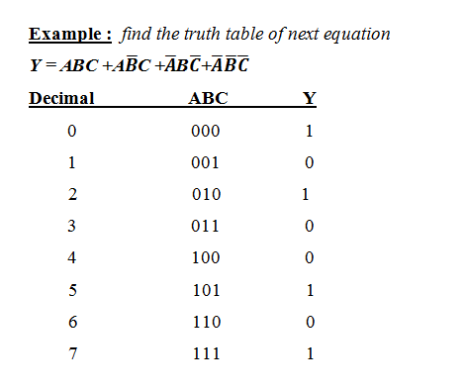
SOP Standard form

Slide 21
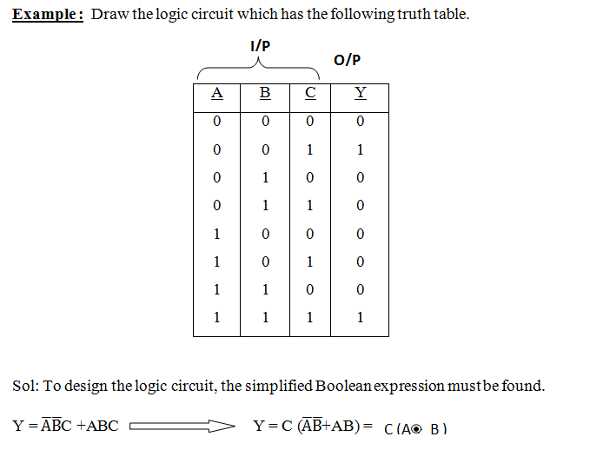
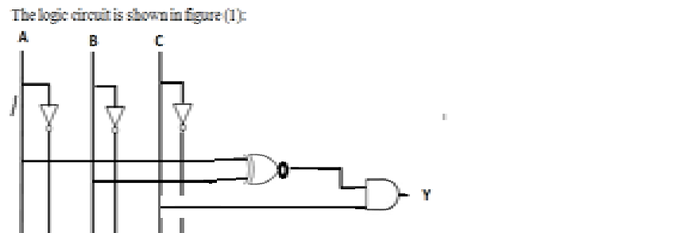

Slide 22
POS Standard form
In POS standard form, every variable in the domain must appear in each sum term of the expression.
You can expand a nonstandard POS expression to standard form by adding the product of the missing variable and its complement and applying rule 12, which states that (A + B)(A + C) = A + BC.
Example
Convert X = (A + B)(A + B + C) to standard form.
Solution
The first sum term does not include the variable C. Therefore, add C C and expand the result by rule 12.
X = (A + B + C C)(A + B + C)
= (A +B + C )(A + B + C)(A + B + C)

Slide 23
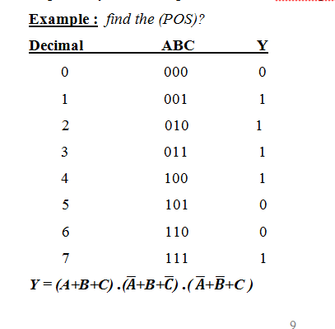

Slide 24
∑and $π$ Nomenclature
∑and $π$ Nomenclature
∑ and notations are respectively used to represent sum-of-products and
$π$ product-of-sums Boolean expressions. So for last example
Y(A,B,C)=$π$( 0, 5,6 )
Y(A,B,C)= =$∑$( 1,2,3,4,7)

Slide 25
Thank you

