Slide 1
محاضرة بمادة التقنيات الرقمية
م. د حسين فالح مهدي
جامعة ديالى
كلية الهندسة –قسم هندسة الحاسوب
2022-2023
Karnaugh map -3

Slide 2
Normal Term
A normal term is a product or sum term in which no variable appears more than once.
Examples of non-normal terms:
W．X．X．$\overline{Y}$
W + W + X’ + Y
Examples of normal terms:
W$\overline{X}\overline{Y}$
W +$\overline{X}+\overline{Y}$

Slide 3
Minterm
An n-variable minterm is a normal product term with n literals.
Examples (4-variable minterms):
W$\overline{X}\overline{Y}$ Z
W$\overline{X}\overline{Y}\overline{Z}$

Slide 4
Maxterm
An n-variable maxterm is a normal sum term with n literals.
Examples (4-variable maxterms):
$\overline{W}$+ $\overline{X}$+ Y+ Z
W + $\overline{X}$+ Y’ + Z

Slide 5
Minterms and Maxterms

Slide 6
Determining Standard Expression from a Truth Table (example)
I/P |  |  | O/P
A | B | C | X
0 | 0 | 0 | 0
0 | 0 | 1 | 0
0 | 1 | 0 | 0
0 | 1 | 1 | 1
1 | 0 | 0 | 1
1 | 0 | 1 | 0
1 | 1 | 0 | 1
1 | 1 | 1 | 1
There are four 1s in the output and the corresponding binary value are 011, 100, 110, and 111.
There are four 0s in the output and the corresponding binary value are 000, 001, 010, and 101.
SOP
POS

Slide 7
Converting POS Expressions to Truth Table Format (example)
Develop a truth table for the standard SOP expression
Inputs |  |  | Output | Product Term
A | B | C | X
0 | 0 | 0 | 0
0 | 0 | 1 | 1
0 | 1 | 0 | 0
0 | 1 | 1 | 0
1 | 0 | 0 | 1
1 | 0 | 1 | 0
1 | 1 | 0 | 0
1 | 1 | 1 | 1
Inputs |  |  | Output | Product Term
A | B | C | X
0 | 0 | 0 | 0
0 | 0 | 1
0 | 1 | 0 | 0
0 | 1 | 1 | 0
1 | 0 | 0
1 | 0 | 1 | 0
1 | 1 | 0 | 0
1 | 1 | 1
Inputs |  |  | Output | Product Term
A | B | C | X
0 | 0 | 0
0 | 0 | 1
0 | 1 | 0
0 | 1 | 1
1 | 0 | 0
1 | 0 | 1
1 | 1 | 0
1 | 1 | 1
Inputs |  |  | Output | Product Term
A | B | C | X
0 | 0 | 0
0 | 0 | 1
0 | 1 | 0
0 | 1 | 1
1 | 0 | 0
1 | 0 | 1
1 | 1 | 0
1 | 1 | 1

Slide 8
Mapping a Standard POS Expression (full example)
The expression:
C AB | 0 | 1
00
01
11
10
000
010
110
101
0
0
0
0

Slide 10
K-map Simplification of POS Expression
C AB | 0 | 1
00
01
11
10
0
0
0
0
0
1
1
1

Slide 12
2
1
3

Slide 13
Don’t-care Conditions
In certain problems, some outputs are not specified.
These outputs can be either ‘1’ or ‘0’.
They are called don’t-care conditions, denoted by X (or sometimes, d).
Example: An odd parity generator for BCD code which has 6 unused combinations.

Slide 14
“Don’t Care” Conditions
CD AB | 00 | 01 | 11 | 10
00
01 |  |  | 1
11 | x | x | x | x
10 | 1 | 1 | x | x
INPUTS |  |  |  | O/P
A | B | C | D | Y
0 | 0 | 0 | 0 | 0
0 | 0 | 0 | 1 | 0
0 | 0 | 1 | 0 | 0
0 | 0 | 1 | 1 | 0
0 | 1 | 0 | 0 | 0
0 | 1 | 0 | 1 | 0
0 | 1 | 1 | 0 | 0
0 | 1 | 1 | 1 | 1
1 | 0 | 0 | 0 | 1
1 | 0 | 0 | 1 | 1
1 | 0 | 1 | 0 | X
1 | 0 | 1 | 1 | X
1 | 1 | 0 | 0 | X
1 | 1 | 0 | 1 | X
1 | 1 | 1 | 0 | X
1 | 1 | 1 | 1 | X
Without “don’t care”
With “don’t care”

Slide 15
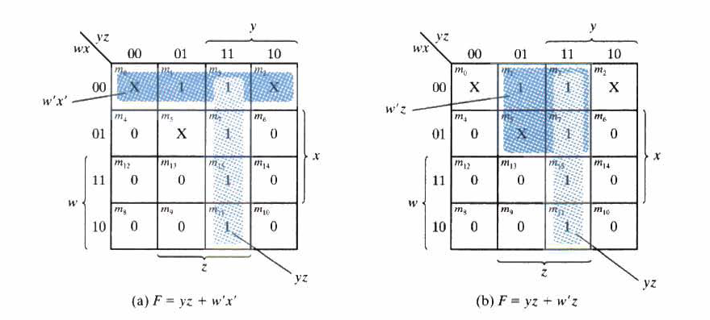
2
5
1
4
3
6

