Slide 1

محاضرة بمادة التقنيات الرقمية
م. د حسين فالح مهدي
جامعة ديالى
كلية الهندسة –قسم هندسة الحاسوب
2022-2023
Karnaugh map -2

Slide 2
4-Variable K-Map
CD AB | 00 | 01 | 11 | 10
00 | 0 | 1 | 3 | 2
01 | 4 | 5 | 7 | 6
11 | 12 | 13 | 15 | 14
10 | 8 | 9 | 11 | 10

Slide 3
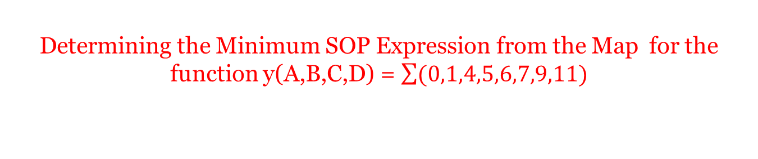
Determining the Minimum SOP Expression from the Map for the function y(A,B,C,D) = $\sum{(0,1,4,5,6,7,9,11)}$
CD AB | 00 | 01 | 11 | 10
00 | 1 | 1
01 | 1 | 1 | 1 | 1
11
10 |  | 1 | 1

Slide 4
CD AB | 00 | 01 | 11 | 10
00 | 1 |  |  | 1
01 | 1 | 1 |  | 1
11 | 1 | 1 |  | 1
10 | 1 |  | 1 | 1

Slide 5
Determining the Minimum SOP Expression from the Map (example)
CD AB | 00 | 01 | 11 | 10
00 |  |  | 1 | 1
01 | 1 | 1 | 1 | 1
11 | 1 | 1 | 1 | 1
10 |  | 1

Slide 6



f(A,B,C,D) = $\sum{(0,1,8,9,7,15,2,10)}$
$\overline{B}$ $\overline{C}$
BCD
$\overline{B}$ $\overline{D}$
f(A,B,C,D) = $\overline{B}$ $\overline{D}$+ $\overline{B}$ $\overline{C}$+ BCD

Slide 7

Simplification Using K-maps
y
yz
wx
00 01 11 10
00
01
11
10
$$\overline{W}X\overline{Y}$$
1
1
x
1
1
w
1
1
YW
z

Slide 8



Simplest SOP Expressions
A
AB
$\overline{A}$B$\overline{C}$
CD
00 01 11 10
00
01
11
10
1
1
A$\overline{B}\overline{D}$
1
1
D
1
1
1
C
1
1
BD
B
$\overline{A}\overline{B}$C
F(A,B,C,D) = BD + $\overline{A}\overline{B}$C + $\overline{A}$B$\overline{C}$+ A$\overline{B}\overline{D}$

Slide 9

Converting to Minterms Form
Example:
f(A,B,C,D) = A$\overline{\text{(}\text{C}\text{+}\text{D}\text{)}}$($\overline{B}$+$\overline{D}$) + C(B+$\overline{C}$+$\overline{A}$D)
= A($\overline{C}\overline{D}$) ($\overline{B}$+$\overline{D}$) + BC + CC' + $\overline{A}$CD
= A$\overline{B}\overline{C}\overline{D}$ + A$\overline{C}\overline{D}$ + BC + $\overline{A}$C
= A$\overline{B}\overline{C}\overline{D}$ + A$\overline{C}\overline{D}$(B+$\overline{B}$ )+ BC(A+$\overline{A}$)($\overline{D}$ +D)+ $\overline{A}$CD(B+$\overline{B}$ )
= A$\overline{B}\overline{C}\overline{D}$ + A$\overline{C}\overline{D}$B+ A$\overline{C}\overline{D} \overline{B}$ )+ (ABC+$\overline{A}\text{BC}$)($\overline{D}$ +D)+ $\overline{A}$CDB+$\overline{A}$CD$\overline{B}$
= A$\overline{B}\overline{C}\overline{D}$ + AB$\overline{C}\overline{D}$+ A$\overline{B}\overline{C}\overline{D}$+ $\overline{A}\text{B}\text{C}\overline{D}$+$\overline{A}\text{BC}\text{D}\text{ +}$ABC$\overline{D}$ + ABCD+ $\overline{A}$BCD+$\overline{A}$ $\overline{B}$CD
FROM MAP
F= BC+$\overline{A}$CD +A$\overline{C}\overline{D}$
A
AB
CD
00 01 11 10
00
01
11
10
1
1
D
1
1
1
C
1
1
B

Slide 10
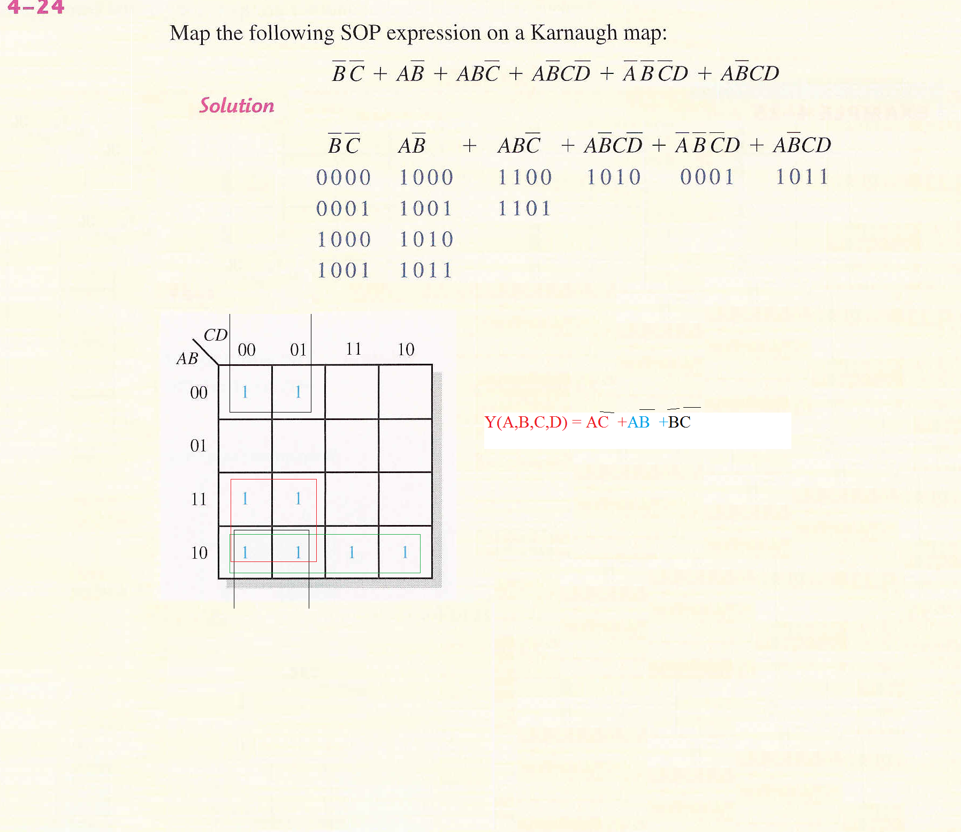



A$\overline{C}$
$$\overline{B}\overline{C}$$
A$\overline{B}$

Slide 11
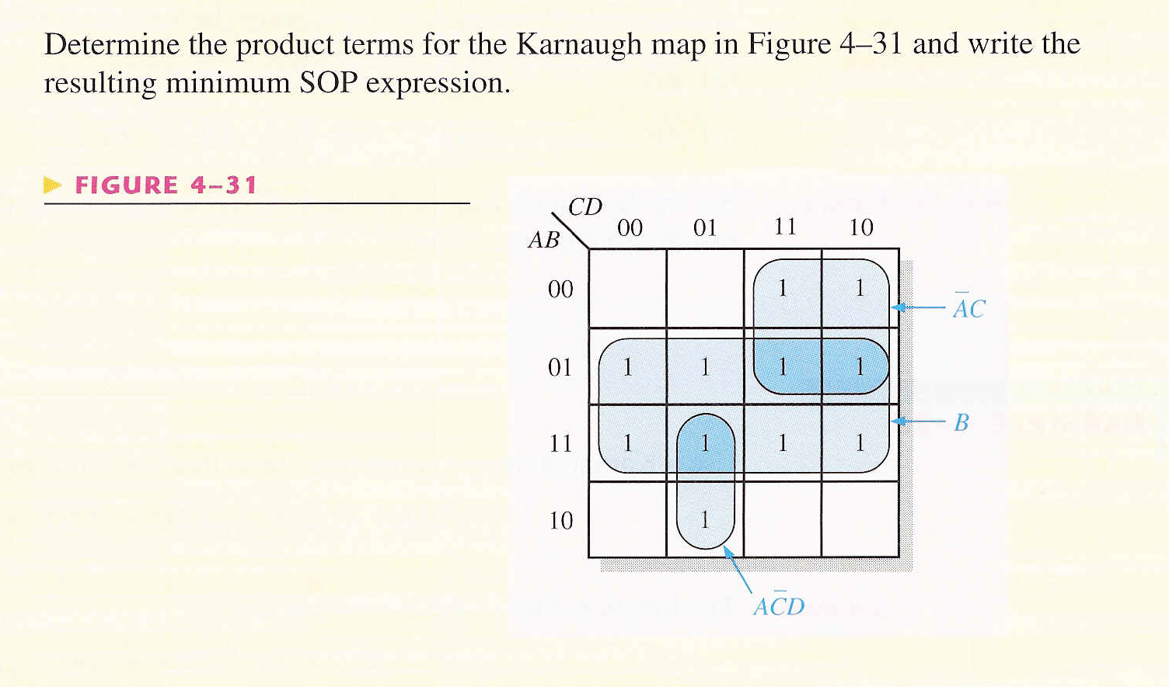

Y(A,B,C,D)= $\overline{A}$C+B+A$\overline{C}$D

Slide 12
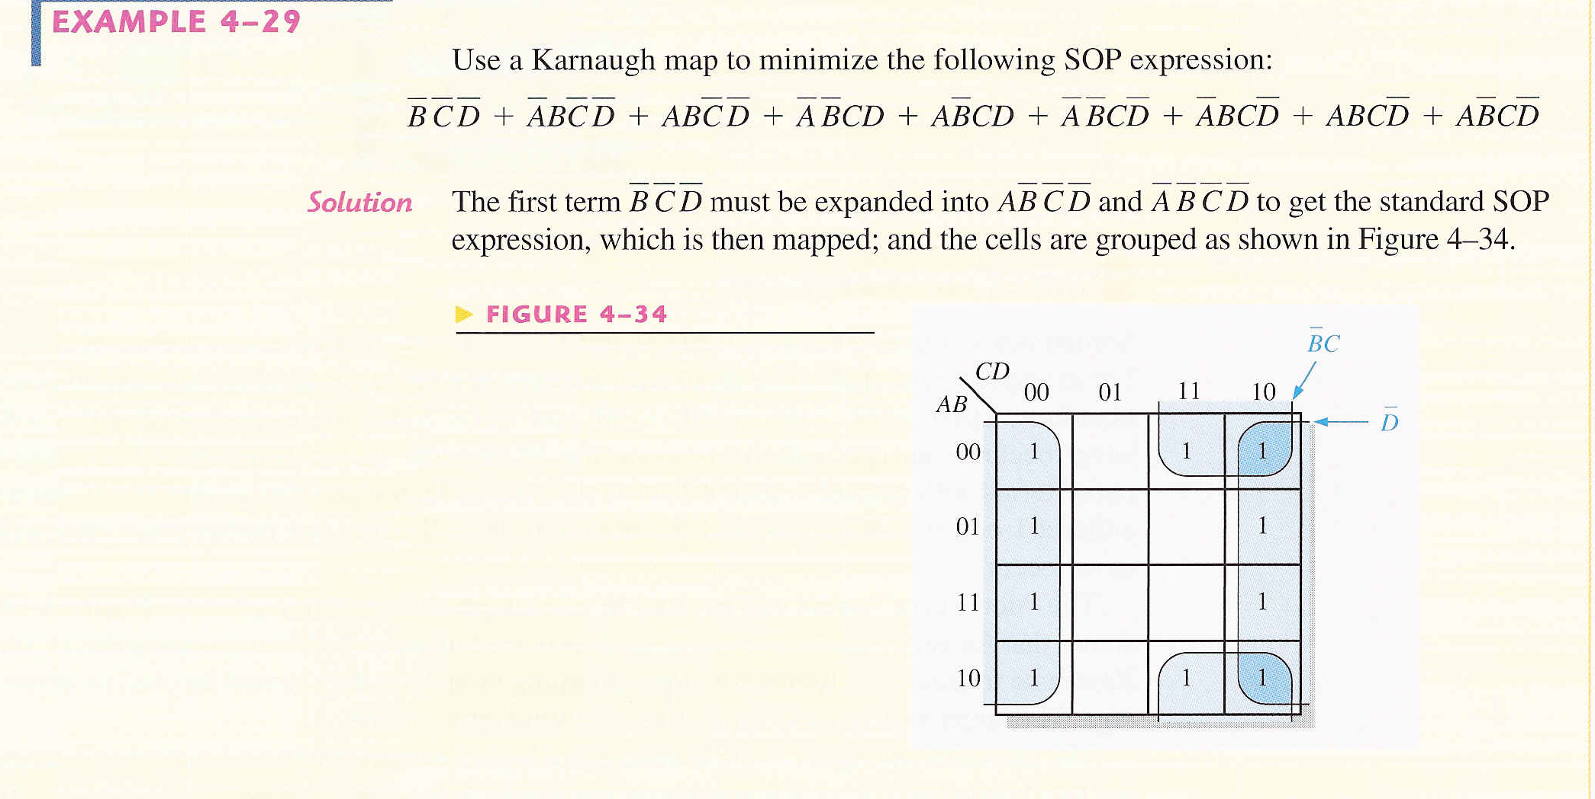


$\overline{B}\overline{C}\overline{D}$= $\overline{B}\overline{C}\overline{D}$(A+$\overline{A}$) =$A\overline{B}\overline{C}\overline{D}$+$\overline{A}\overline{B}\overline{C}\overline{D}$
Y(A,B,C,D)= $\overline{B}$C+$\overline{\text{D} }$

Slide 14
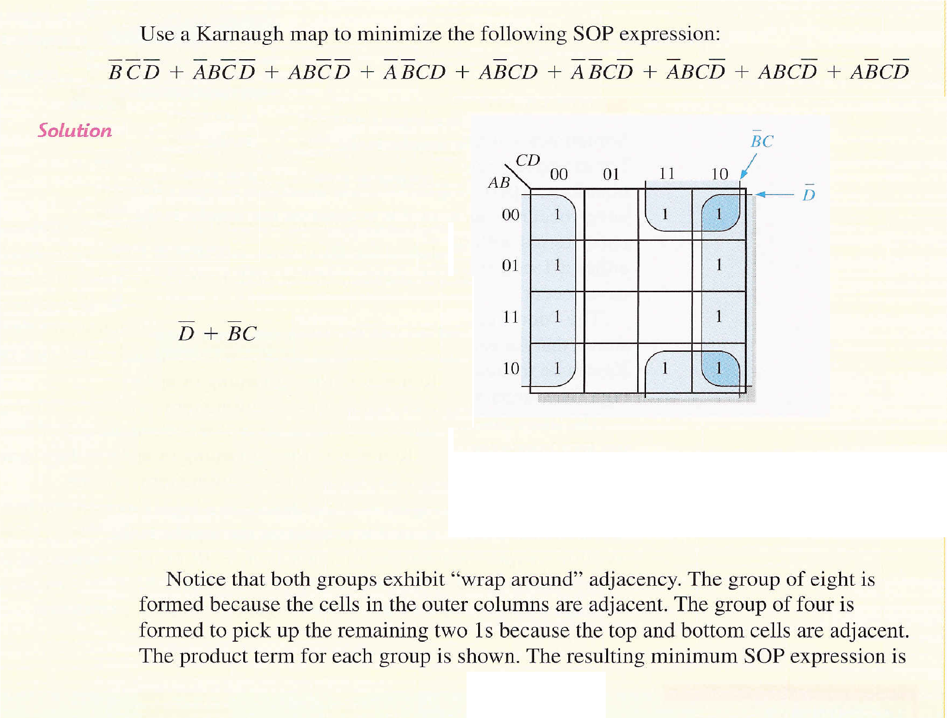

Slide 15
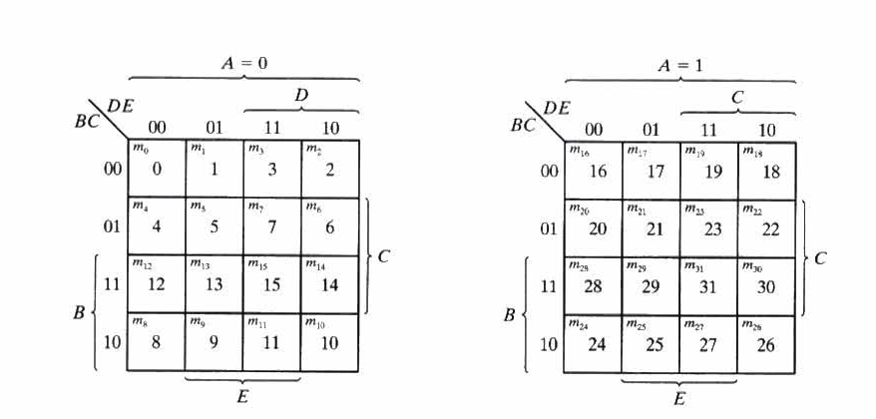
5-Variable K-Map

Slide 16
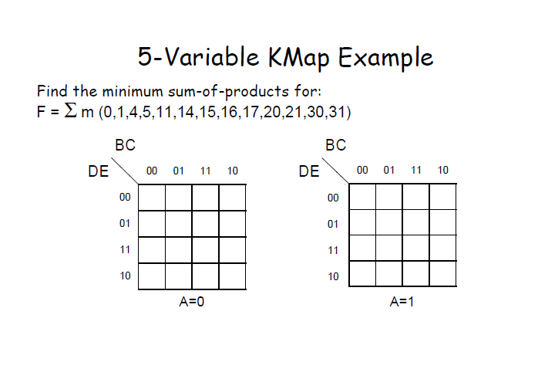

Slide 17
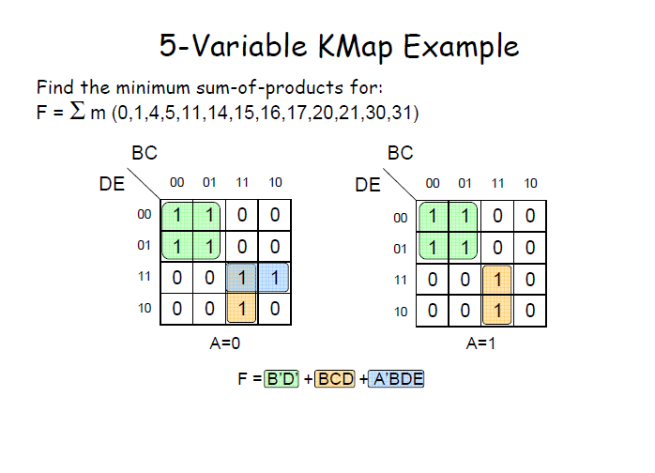

Slide 18
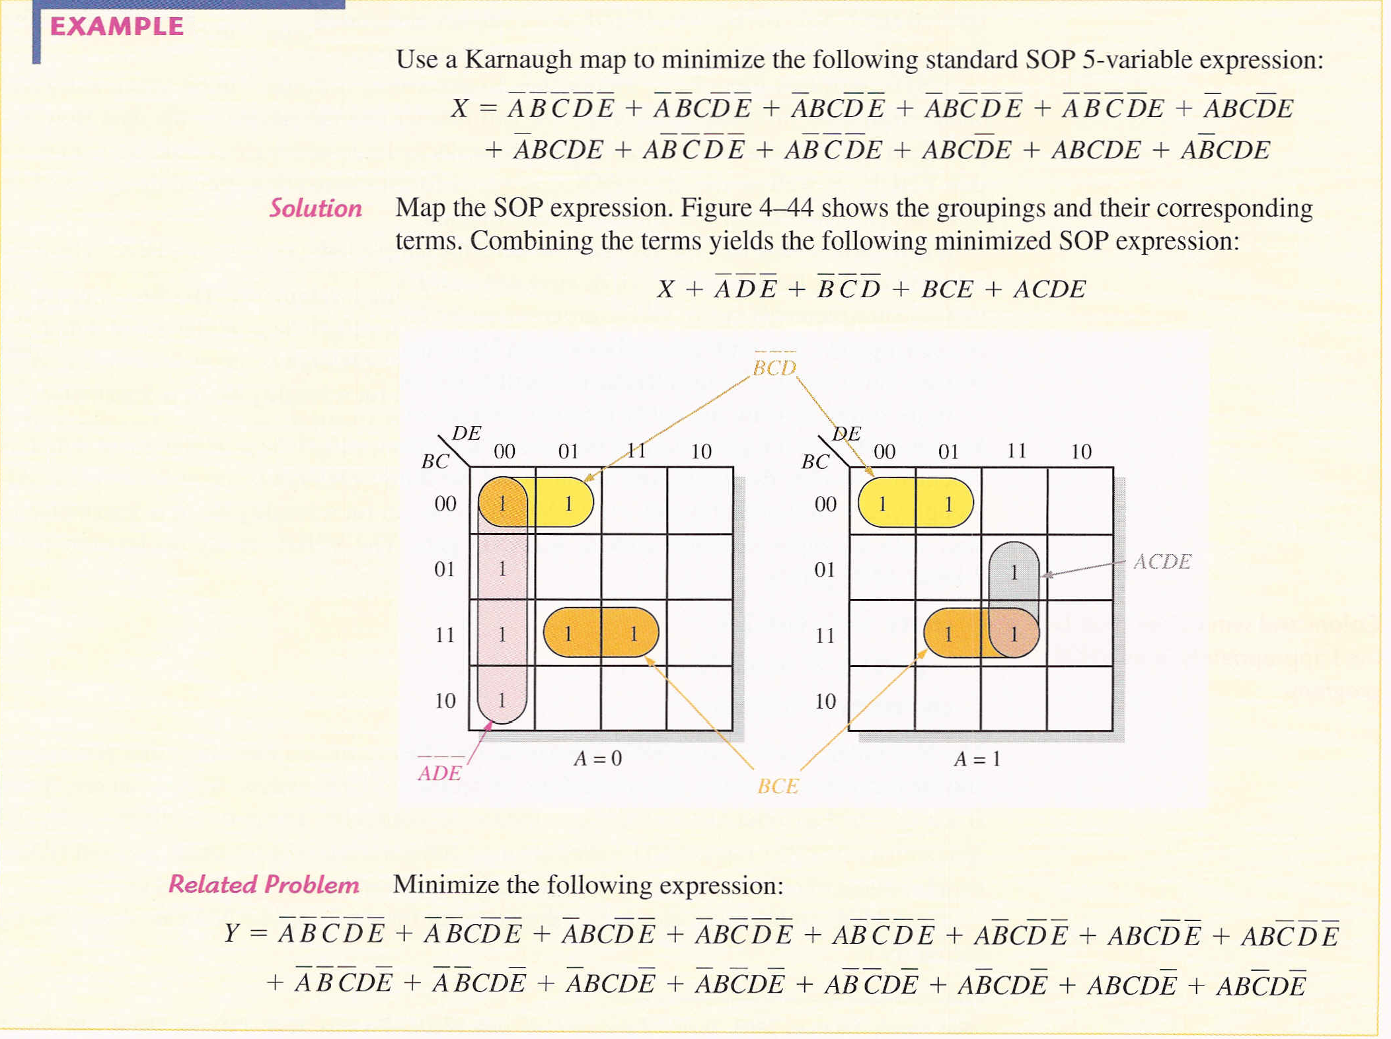

Slide 19
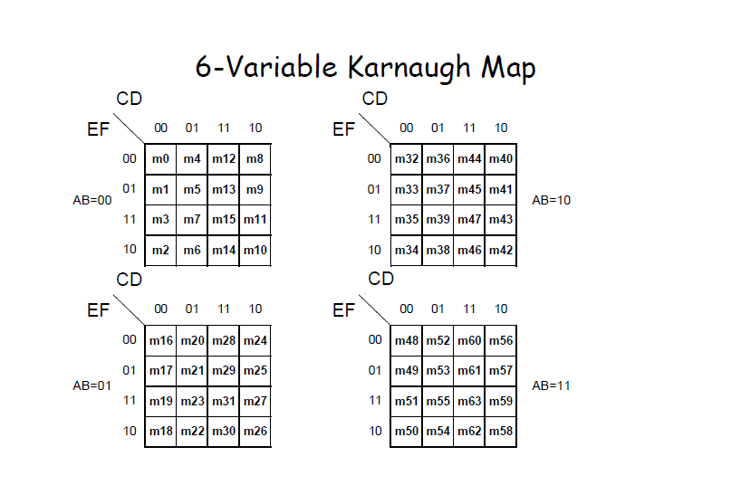

Slide 20
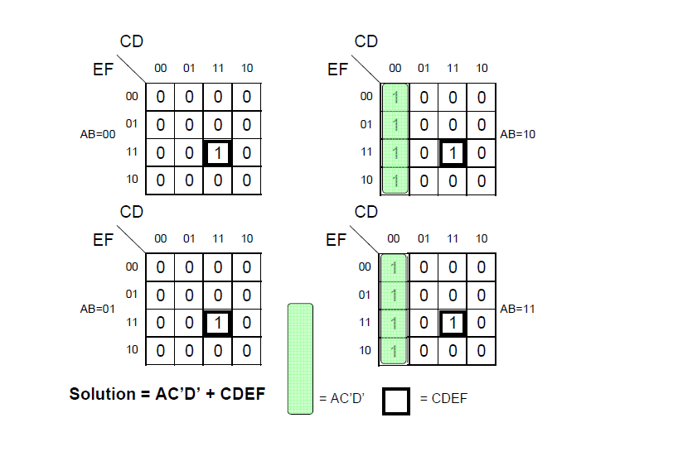
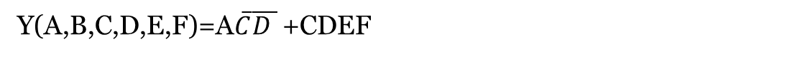

CDEF
A$\overline{C}\overline{D}$
Y(A,B,C,D,E,F)=A$\overline{C}\overline{D }$ +CDEF

