Slide 1
Introduction to Power Quality
Assistant prof. Ammar Issa Ismael

Slide 2
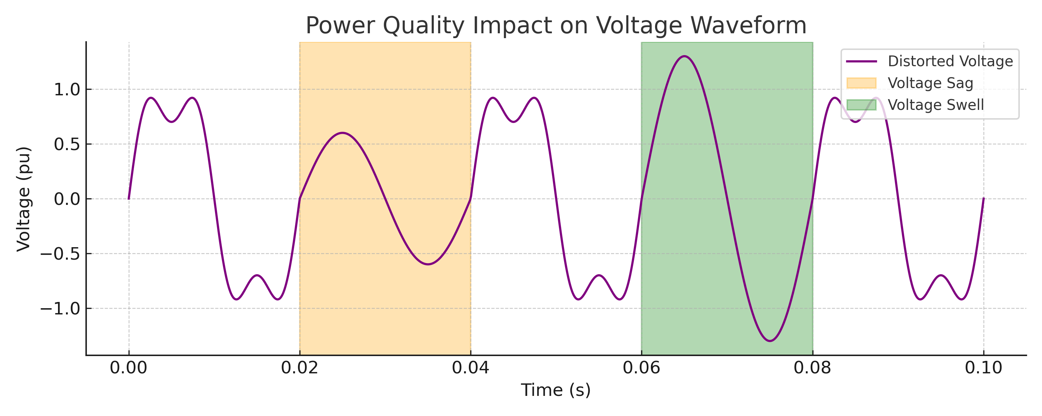
Introduction to Power Quality
Diagram: Power quality impact on waveform
What is power quality?
  Why it matters
  Common causes
Power quality refers to maintaining a stable voltage, current, and frequency in the power system. Poor power quality can damage equipment, reduce efficiency, and cause unexpected shutdowns. Voltage disturbances like sags and swells are caused by switching, faults, or lightning.

Slide 3
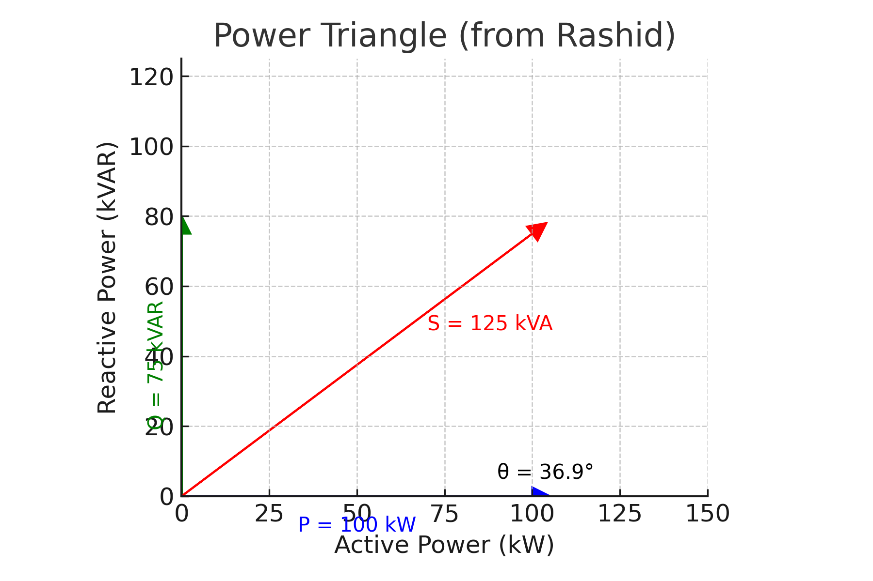
What is Power Factor?
Power Triangle from Rashid's Book
Definition: PF = P / S
  Impact of poor PF
  Mathematical relation
Power factor is a measure of how effectively electrical power is converted into useful work output. It is the cosine of the phase angle between voltage and current. Low power factor causes increased losses and penalties from utilities.

Slide 4
Reactive Power in the System
Difference between real and reactive power
  Inductive and capacitive loads
  Power triangle
Real vs Reactive Power Illustration
Real power (P) performs useful work, while reactive power (Q) supports voltage levels. Inductive loads (motors) consume Q, while capacitors supply Q. Managing reactive power is essential for voltage stability and efficient system operation.

Slide 5
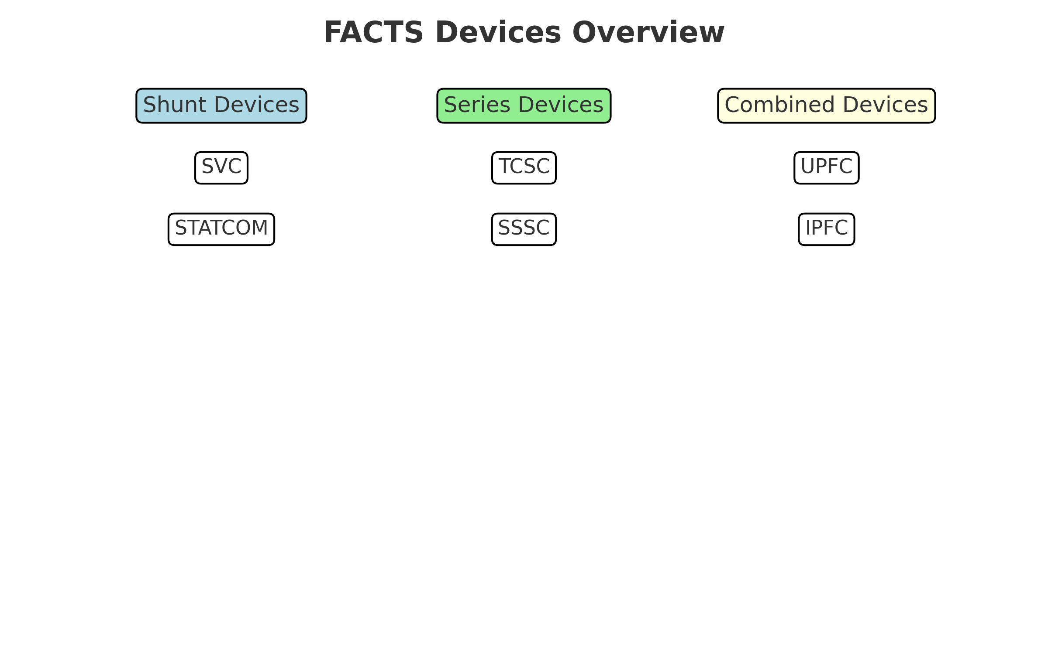
Flexible AC Transmission System (FACTS)
Improves control and power transfer
  FACTS types
  Role of SVC
FACTS devices enhance transmission capability and dynamic stability using power electronics. They can be series, shunt, or a combination. SVC is a shunt-type device used for voltage regulation by managing reactive power.

Slide 6
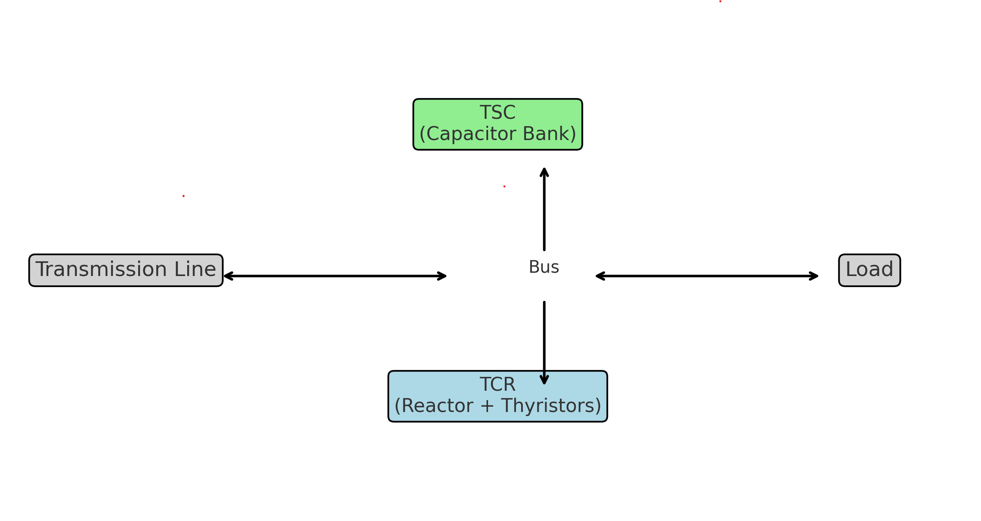
Static VAR Compensator (SVC)
Block Diagram: SVC with TCR & TSC
Definition and function
  Where used
  How it responds
SVC controls voltage by absorbing or injecting reactive power. It is widely used in substations and industries to prevent voltage sags and swells. It reacts dynamically to system voltage changes in real time.

Slide 7
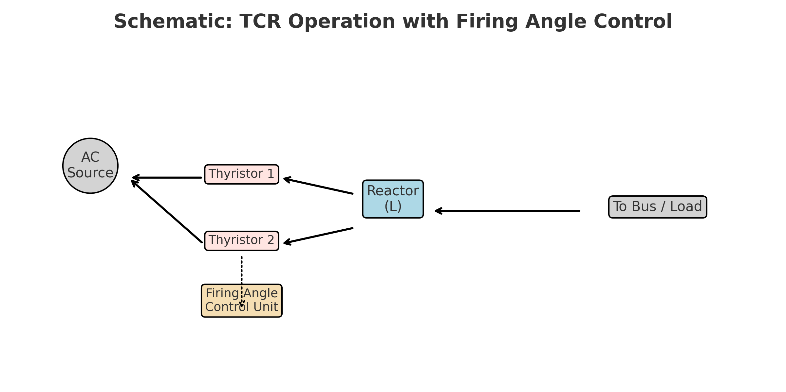
SVC Configuration: TCR and TSC
Schematic: TCR operation with firing angle control
TCR = controlled reactor
  TSC = switched capacitor
  Combined operation
TCR provides variable inductive compensation using thyristors and reactors. TSC offers step-wise capacitive compensation by switching capacitors in and out. Together they maintain voltage by adjusting reactive power dynamically.

Slide 8
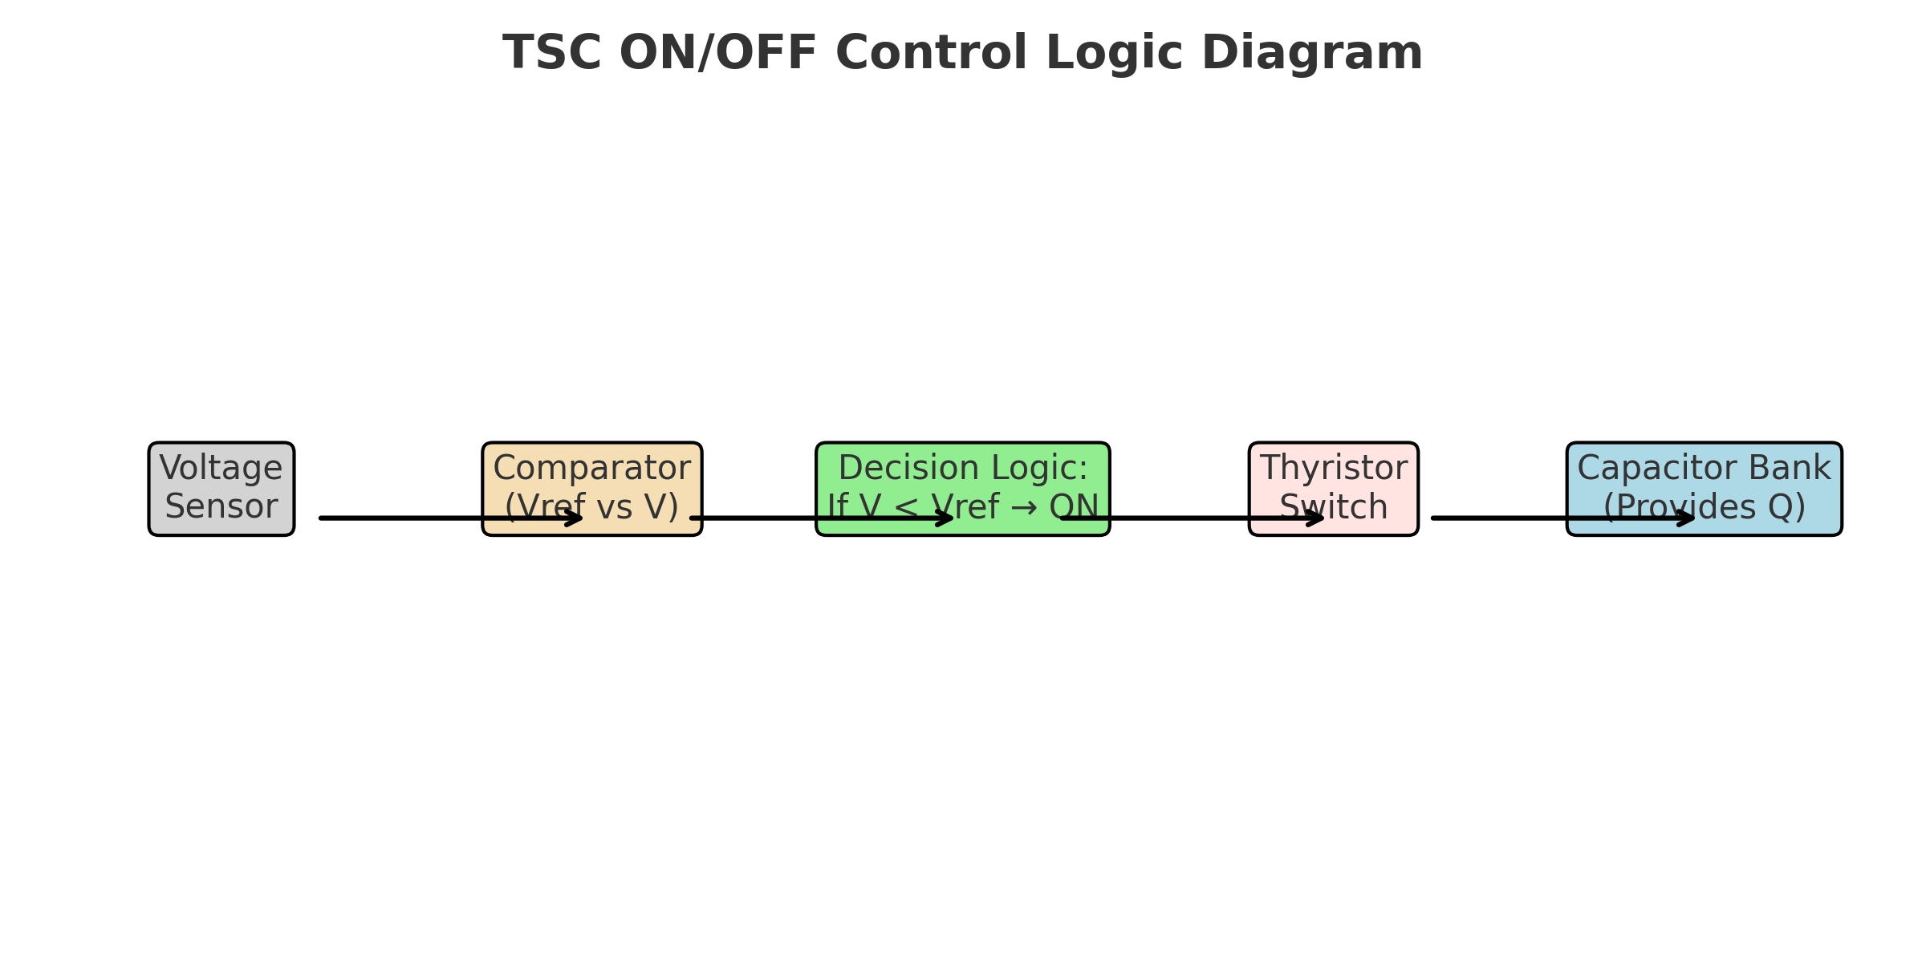
Thyristor Controlled Reactor (TCR)
Diagram: TSC ON/OFF control logic
Absorbs reactive power
  Firing angle control
  Impedance variation
TCR uses thyristors to vary the conduction period in each AC cycle, thus changing the effective reactance. The firing angle (α) determines how much current flows through the reactor and how much reactive power is absorbed.

Slide 9
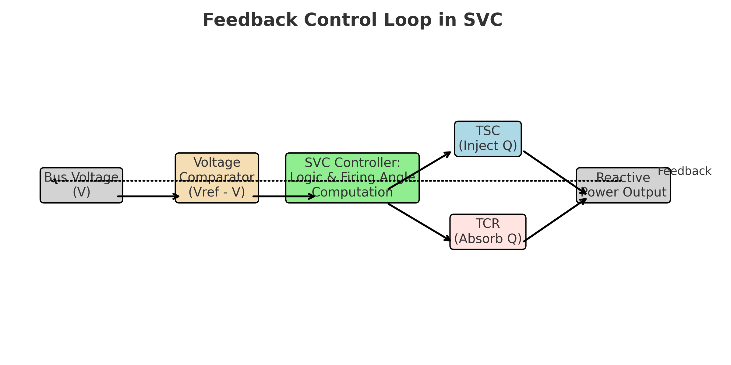
Thyristor Switched Capacitor (TSC)
Feedback Control Loop in SVC
Injects reactive power
  Operates in steps
  No continuous control
TSC switches capacitors ON/OFF using thyristors without phase-angle control. During voltage sag, it injects reactive power to support voltage. It provides fast and step-changed compensation.

Slide 10
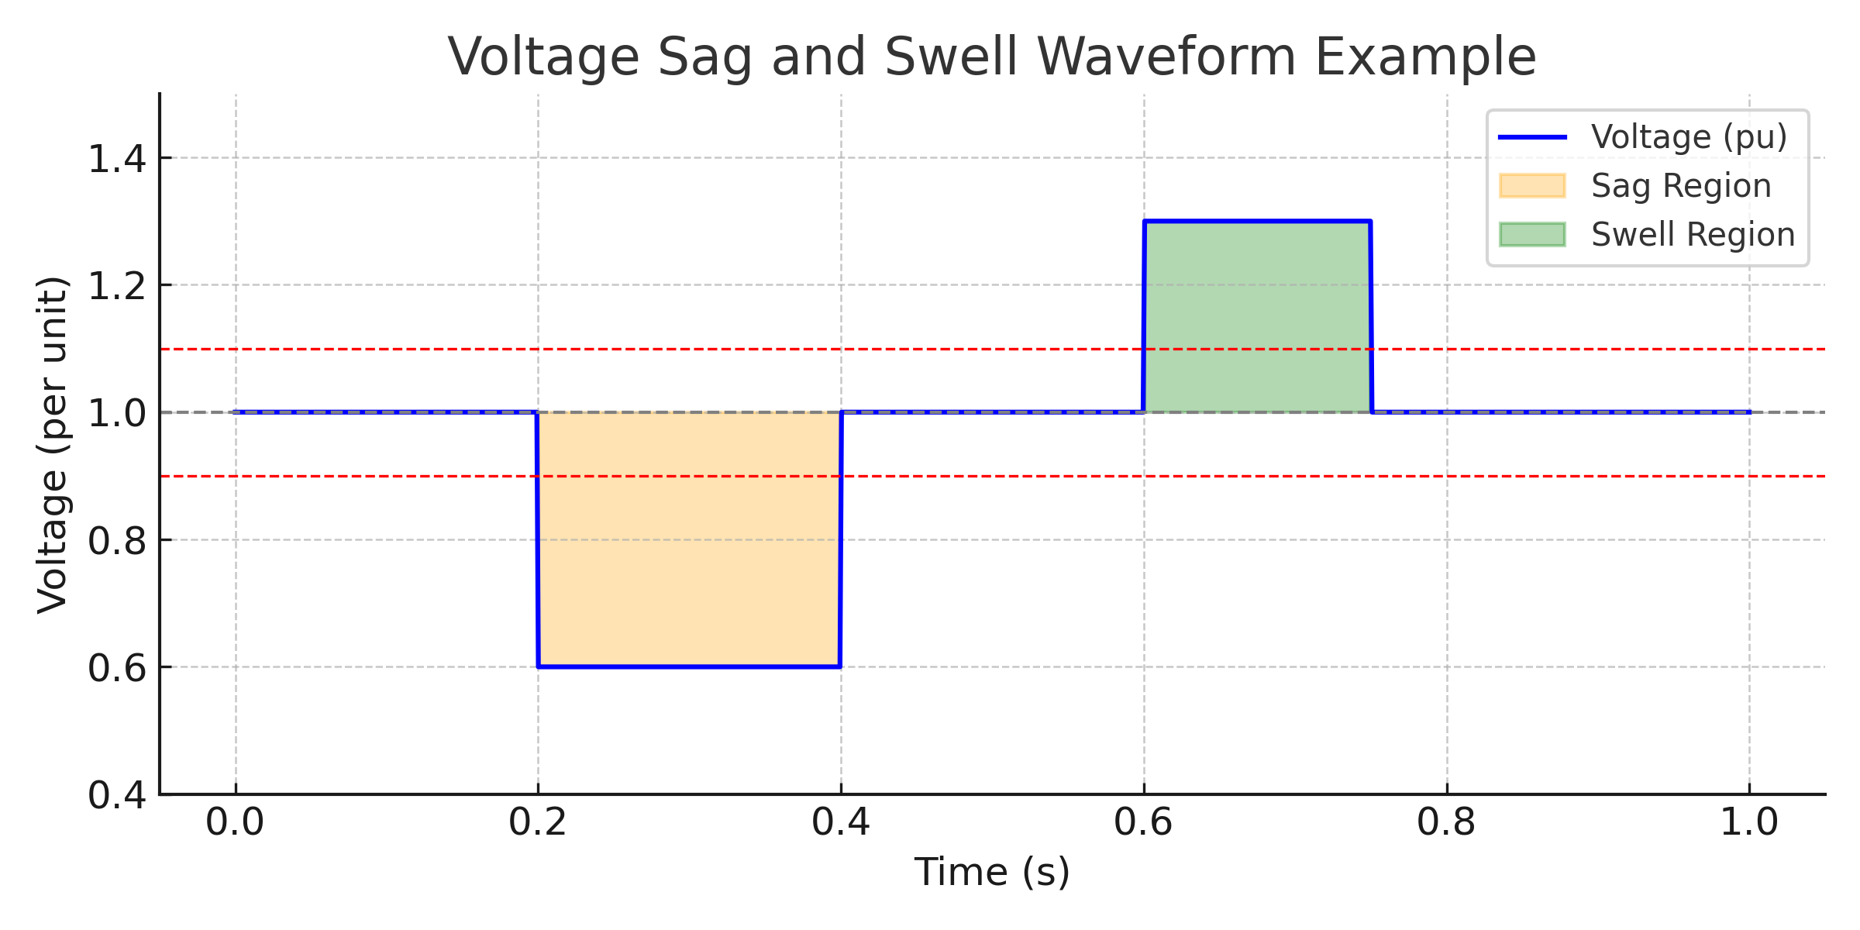
SVC Control Strategy
Voltage sag/swell waveform example
Voltage feedback
  Dynamic response
  Control actions
SVC uses a feedback loop comparing actual voltage to a reference. Based on this, it decides to activate TCR or TSC. The control ensures system voltage stays within acceptable limits during load or fault conditions.

Slide 11
Voltage Sag and Swell
Sag: 0.1–0.9 pu
  Swell: >1.1 pu
  Causes and effects
Voltage sags and swells are temporary deviations from nominal voltage. Sags are caused by faults or large loads starting, while swells may occur due to load shedding. These can damage sensitive equipment if not mitigated.

Slide 12
MATLAB Simulink Model
SVC Model Components
  Power source, load, TCR, and TSC
  Used for performance analysis
A Simulink model replicates real-time behavior of the power system including source, load, and SVC. It helps visualize voltage changes and validate control strategies under sag/swell conditions.

Slide 13
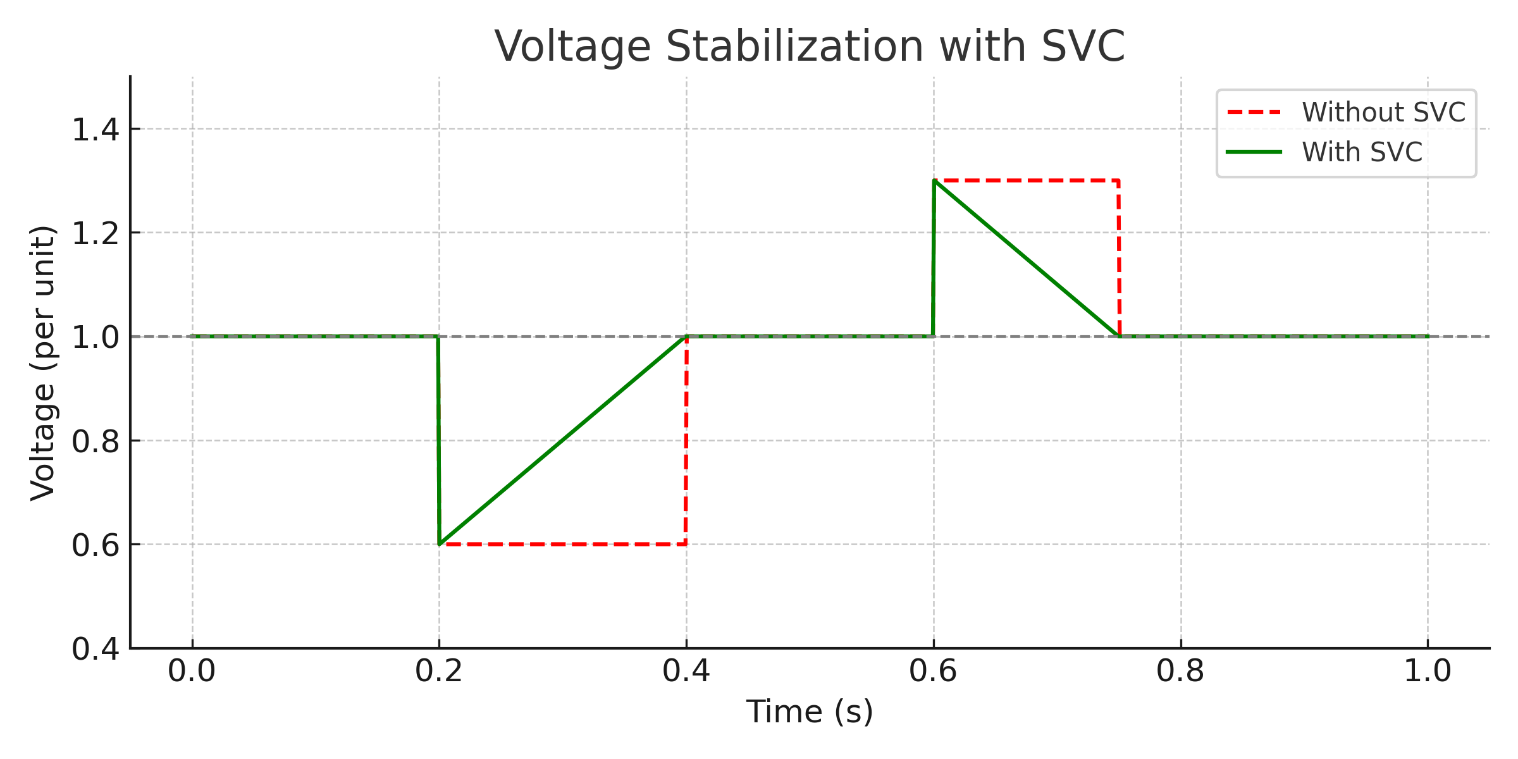
Waveforms Without SVC
Waveform: Stabilized voltage with SVC
Uncompensated voltage
sag and swell
  Higher Total Harmonic
  Distortion
  Instability observed
Without SVC, voltage sag drops the system voltage below acceptable limits and swells may exceed equipment ratings. This causes loss of equipment lifespan and malfunction. THD increases significantly.

Slide 14
Waveforms With SVC
Stable voltage levels
  Reduced distortion
  Corrective action via TSC and TCR
With SVC active, sag is corrected by TSC switching ON to inject reactive power, and swell is mitigated by TCR absorbing excess reactive power. The result is a more stable voltage and improved power factor.

Slide 15
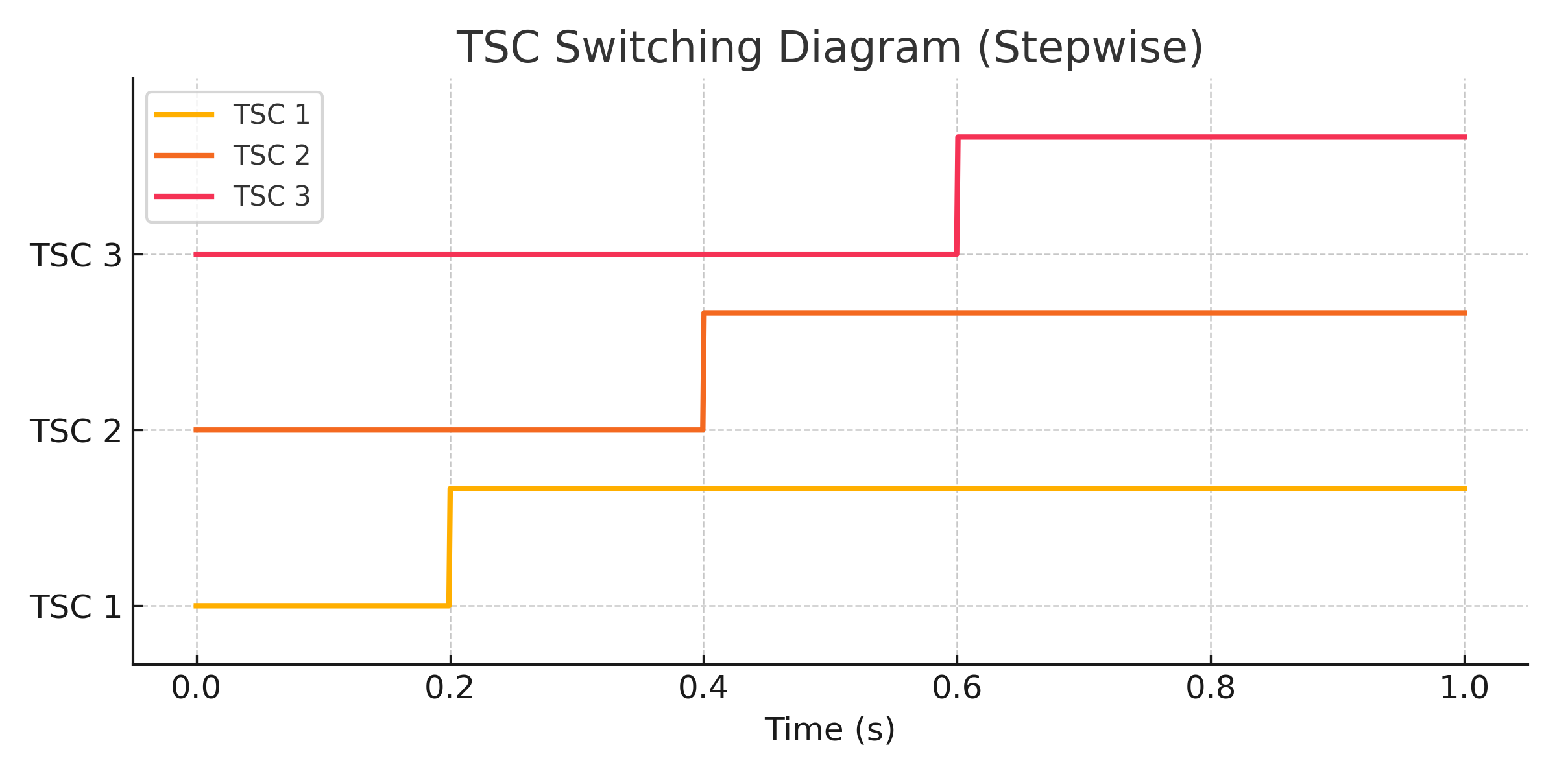
Firing Angle Impact on TCR
TSC switching diagram (stepwise)
Controls amount of reactive
power absorbed
  α = 90° → No conduction
  α < 90° → Increased
  conduction
Reactive current depends on firing angle α:
I(α) = (Vm / XL) * [1 - (2α/π) - (sin(2α)/π)]
This equation shows that by adjusting α, we can control how much inductive power is absorbed.

Slide 16
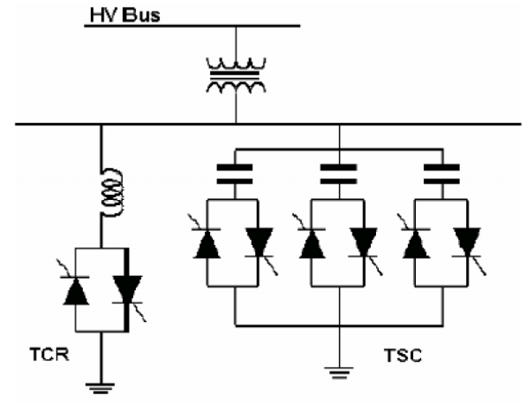
Example: Power Factor Correction
Transmission System with SVC connection
Given: 10 kW load at 0.7
lagging PF
  Target PF: 0.95
  Find required capacitor size
S = 10 / 0.7 = 14.29 kVA
Q_initial = √(S² - P²) ≈ 10.2 kVAR
Q_required = 10 * (tan cos⁻¹(0.7) - tan cos⁻¹(0.95)) ≈ 6.56 kVAR
Capacitor of 6.56 kVAR needed to correct PF to 0.95.

Slide 17
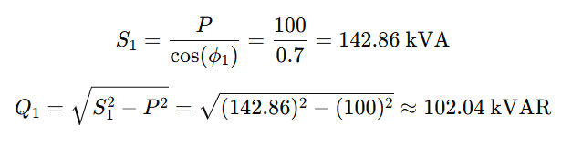
Example: Power Factor Improvement with SVC
Power Factor Improvement Example: Before and After Adding SVC
🧮 Given:
A 3-phase load consumes:
  Active Power P=100 kW
  Operating at power factor cos⁡(ϕ1)=0.7 lagging
  Line Voltage: V=400 V (rms)
  Frequency: f=50 Hz
We aim to improve the power factor to cos⁡(ϕ2)=0.95 using an SVC
Step 1: Before SVC — Calculate Reactive Power

Slide 18
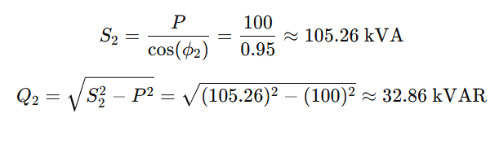

Example: Power Factor Improvement with SVC
🔺 Step 2: After SVC — Target Power Factor (0.95)
⚖️ Step 3: Reactive Power Compensation Required
So, the SVC must supply 69.18 kVAR of leading reactive power to improve the power factor from 0.7 to 0.95.
📦 Capacitor Bank Sizing (TSC):
For a three-phase system

Slide 19
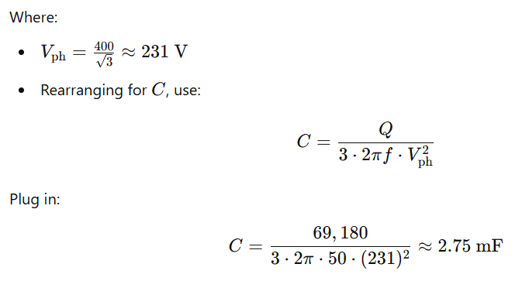
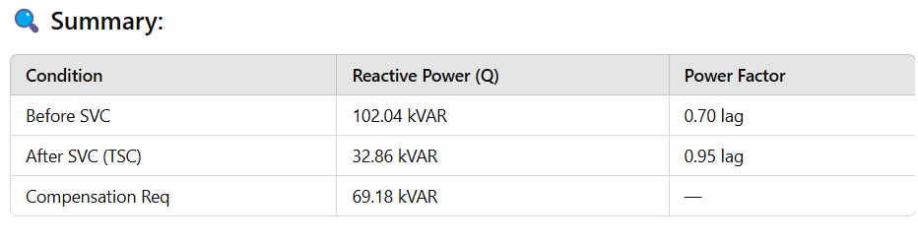
Example: Power Factor Improvement with SVC

Slide 20
Applications of SVC
Used in transmission and distribution
  Industrial loads like motors
  Renewables like wind/solar
SVC ensures voltage quality in high-power applications, supports integration of renewables, and improves the power factor of inductive industrial loads.

Slide 21
Limitations and Considerations
Thyristor switching causes harmonics
  High capital cost
  Requires advanced control systems
Although effective, SVC introduces harmonics due to thyristor switching and requires proper filtering. Economic feasibility must be evaluated for small-scale use cases.

Slide 22
Conclusion
SVC = TCR + TSC
  Improves PF and voltage stability
  Essential for modern grids
Static VAR Compensators offer dynamic voltage control and reactive power management. Their modular design and quick response make them ideal for grid support.

