Slide 1

Power Electronics in Industrial Applications: DC Motors & Transportation
by Asst. Prof. Ammar Issa

Slide 2
DC Motor Drives: Overview
Multipurpose Control
Market Growth
DC motors are widely used for variable speed control in industrial applications. Power electronics enable precise control of DC motor voltage and current, allowing for optimized performance across different operational needs. Common applications include conveyor belts, pumps, fans, machine tools, and robotics.
The global DC motor market is projected to reach $24.89 billion by 2029, reflecting the increasing demand for efficient and reliable motor control solutions in various industries. Power electronics play a crucial role in driving this growth by enhancing the capabilities and performance of DC motor systems.

Slide 3
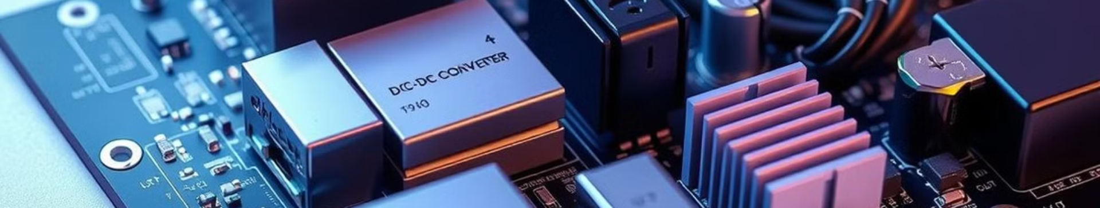
Power Electronic Components in DC Motor Drives
1
Rectifiers
2
DC-DC Converters
3
Inverters
Convert AC to DC power for the motor. Diode rectifiers (uncontrolled) and thyristor rectifiers (controlled) are commonly used to supply DC power from AC sources.
Regulate DC voltage to control motor speed. Buck converters (step-down), boost converters (step-up), and buck-boost converters (step-up/down) provide exact voltage regulation for optimal motor performance.
For AC motor control emulating DC motor characteristics. Create variable frequency AC supply for AC motors simulating DC behavior, allowing for advanced control strategies.

Slide 4

DC Motor Drive Applications: Examples
Conveyor Belts
Pumps
Robotics
Exact speed control for material handling is critical in food processing plants and distribution centers, ensuring smooth and efficient operation.
Variable flow control for energy efficiency in water treatment facilities and chemical plants reduces energy consumption and lowers operational costs.
Accurate positioning and speed control for robotic arms in automotive assembly lines and electronics manufacturing increases production efficiency and precision.
Machine Tools
Variable speed spindles for machining operations in CNC milling machines and lathes enhance machining exactness and material processing capabilities.

Slide 5
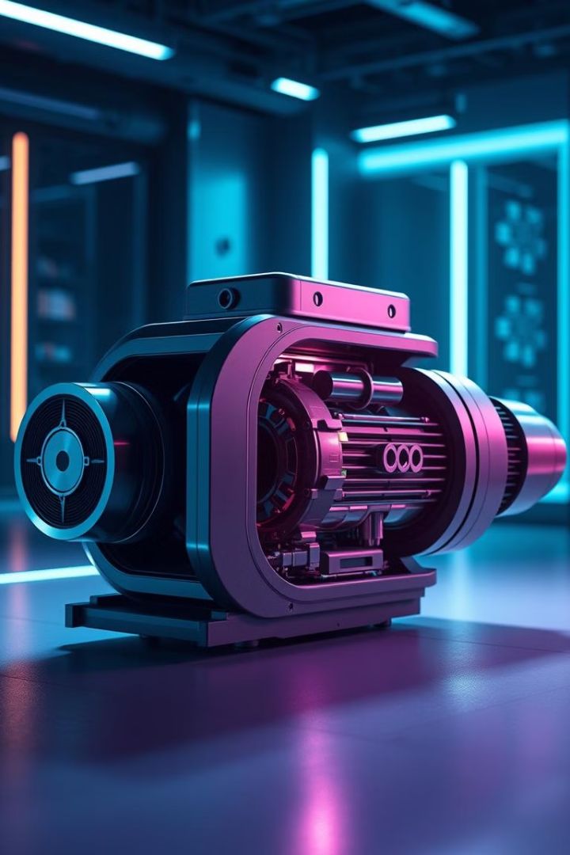
Benefits of Power Electronics in DC Motor Drives
1
Improved Efficiency
Reduced energy consumption and operating costs due to efficiency gains of 10-30% compared to traditional control methods.
2
Exact Speed Control
Enhanced process control and product quality, achieving speed regulation within +/- 1%.
3
Reduced Maintenance
Lower stress on mechanical components extends motor lifespan by 20-50%, reducing downtime and maintenance costs.
4
Compact Size
Smaller and lighter systems with footprint reduction of up to 50% compared to traditional systems, allowing for more flexible installation options.

Slide 6
Transportation: Electric Vehicle (EV) Drives
Essential Technology
Power electronics are essential for electric vehicle propulsion, enabling efficient and reliable operation of EV drivetrains.
Power Conversion
Inverters convert DC battery power to AC for the traction motor, providing the necessary power for vehicle movement.
Voltage Regulation
DC-DC converters regulate voltage for auxiliary systems such as lighting and HVAC, ensuring optimal performance of these components.
Market Growth
The global EV market is projected to reach $823.75 billion by 2030, driven by advancements in power electronics and battery technology.

Slide 7




Key Power Electronic Components in EV Drives
Traction Inverters
High-power inverters drive the electric motor, utilizing Silicon Carbide (SiC) and Gallium Nitride (GaN) devices to improve efficiency, achieving > 95% efficiency with advanced designs.
DC-DC Converters
Regulate voltage for various vehicle systems, with bi-directional converters enabling regenerative braking to recover energy during deceleration.
Onboard Chargers
Convert AC grid power to DC for battery charging, incorporating Power Factor Correction (PFC) circuits to improve grid stability and charging efficiency.

Slide 8
Future Trends in Power Electronics for Industrial Applications
WBG Semiconductors (carbide or gallium nitride)
1
SiC and GaN devices offer higher efficiency, higher switching frequencies, and improved thermal performance; SiC MOSFETs can reduce inverter losses by up to 50%.
Advanced Control
2
AI-powered control algorithm real-time ms for optimal performance adapt to changing conditions and optimize energy usage in.
Digitalization & IoT
3
Remote monitoring, predictive maintenance, and smart grid integration enhance system reliability and efficiency, optimizing performance and reducing downtime.

